Slide 1
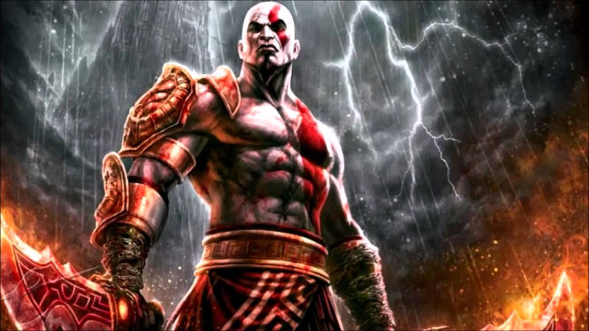
Wars and Conflict

Slide 2
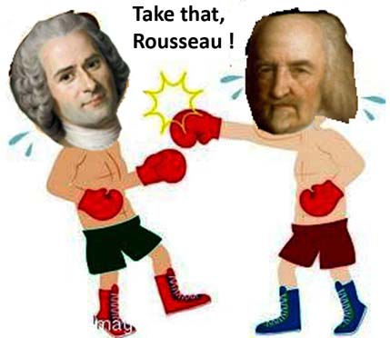
War and Human Nature
Why do people fight?
Is War Natural?
https://www.youtube.com/watch?v=MF_4EWSuzQY

Slide 3
Historiography and Culture
Middle/High School history courses organized by wars.
United States=Militaristic Society
Movies
Video Games
TV Shows

Slide 4
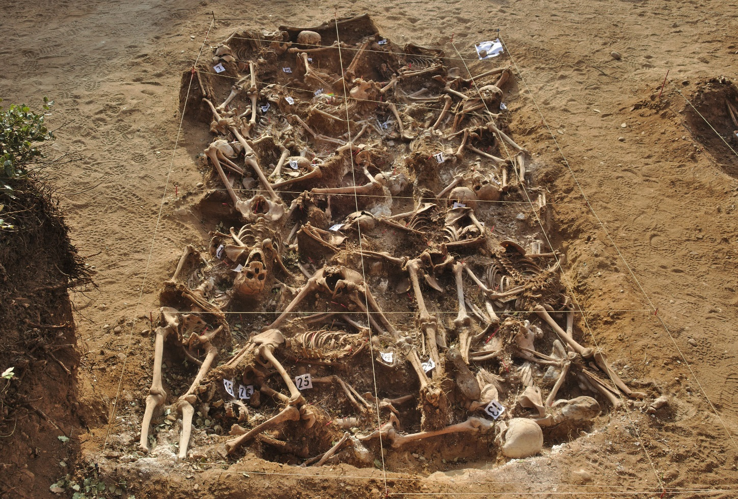
War vs. Conflict
War is often defined as a conflict with at least 1000 deaths in one year.
Criticisms?
A prolonged state of open and armed conflict between two or more organized parties.
Mass grave from the Spanish Civil War. 26 people massacred by the Fascist government.

Slide 5
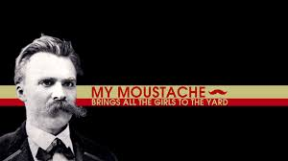
Influential Thinkers
Frederick Nietzche
Believed violence was an innate human desire.
“I am, by nature, warlike. To attack is among my instincts.”

Slide 6
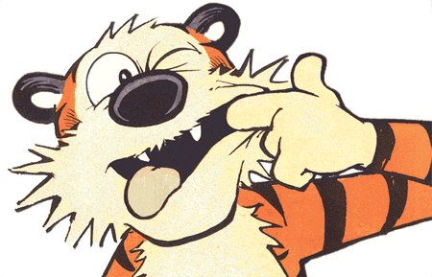
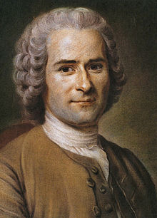
Enlightenment Thinkers
Thomas Hobbes (Visual Approximation)
Jean Jacques Rousseau

Slide 7
Believed that humans are naturally violent due to competition.
Three root causes of all conflict
Gain
Diffidence
Glory
Conflict can only be averted by entering into social contract or by absolute religious devotion.

Slide 8
Evolutionary Biology
Aggression could be a favorable trait when it comes to passing on genes
I kill you and take your stuff.
Therefore I get to pass on my genes.
You feed the worms.
Early humans may have wiped out Neanderthals.
Jane Goodall
Lived with Chimpanzees and observed behavior.
Gombe War: 4 year conflict between two groups of chimpanzees
https://www.youtube.com/watch?v=a7XuXi3mqYM
“For several years I struggled to come to terms with this new knowledge. Often when I woke in the night, horrific pictures sprang unbidden to my mind—Satan [one of the apes], cupping his hand below Sniff's chin to drink the blood that welled from a great wound on his face; old Rodolf, usually so benign, standing upright to hurl a four-pound rock at Godi's prostrate body; Jomeo tearing a strip of skin from Dé's thigh; Figan, charging and hitting, again and again, the stricken, quivering body of Goliath, one of his childhood heroes.”
-Jane Goodall

Slide 9
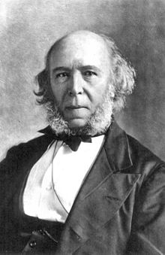
Social Darwinism
Herbert Spencer
Early sociologist
Opposed any sort of social reform
Coined the term “Survival of the fittest.”
Athenian Philosophy
“The strong do what they will and the weak suffer what they must.”
“Might is Right”

Slide 10
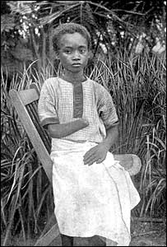
Limitations
Social Darwinism was used to justify…
Eugenics
Slave Trade
Colonialism
Genocide
Jim Crowe
“The White Man’s Burden”
Rudyard Kipling
Congolese child mutilated by King Leopold’s army.

Slide 11
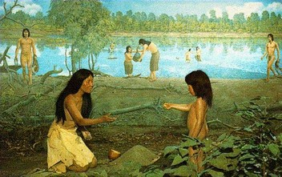
Jean Jacques Rousseau
Humans are naturally peaceful and cooperative but we have been corrupted by society.
Modern needs and wants create destructive behavior.
Too late to return to state of nature but we need to try to emulate it.
Best government=one that provides freedom to citizens.

Slide 12
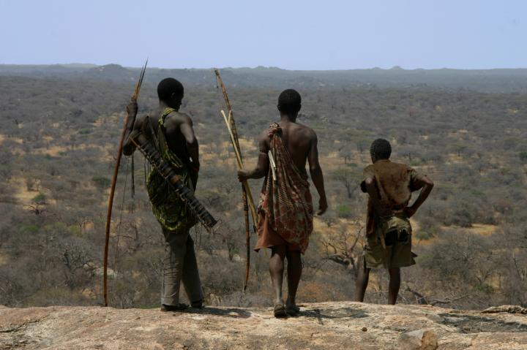
Some support for Rousseau?
Anthropologists Douglas Fry and Patrick Soderberg studied 21 hunter gatherer tribes that exist today.
Found little evidence or large scale conflicts.
Majority of violent deaths were homicides driven by personal or family reasons.

Slide 13
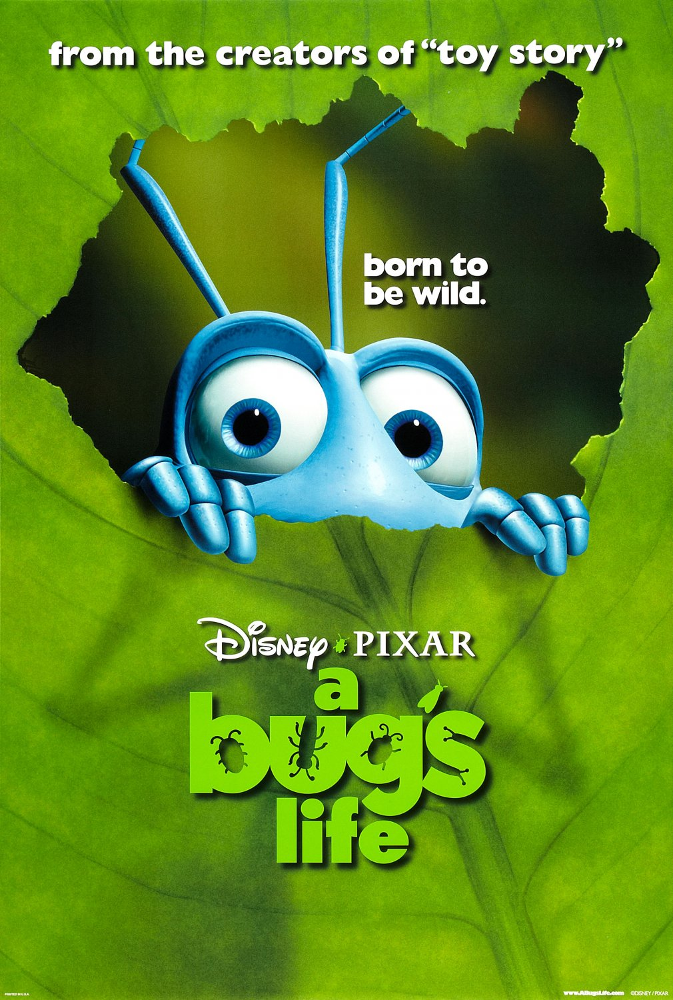
Conflict Theory
Sociological Perspective
Emphasizes conflict, competition, change, and constraint in society
Sees society as a number of groups with competing interests
Social institutions are structured to maintain inequality and conflict among groups of people
Karl Marx
All of history is class conflict between “haves” and “have-nots”
Didn’t necessarily believe that humans were naturally violent, but that any social system that created and perpetuated inequality would inevitably lead to violence.

