Slide 1
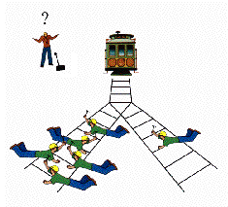
Scenario 1
You are driving a trolley car at 60 mph and you notice five workers on the track ahead of you. The breaks go out. You can steer onto another track where there is only one worker. Should you kill the one to save the five? What’s the right thing to do?

Slide 2
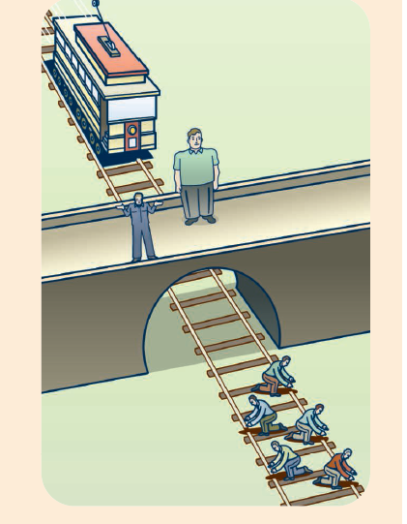
Scenario 2
Imagine that instead of driving the car you are on a ledge watching this unfold. Next to you is a very fat man. Do you push him off the ledge to stop the cart and save the five workers?

Slide 3
Scenario 3
What if the fat man was standing on a trap door and all you had to do was push a button?

Slide 4
Scenario 4
Imagine you are a doctor at an ER. Six patients come in (they’ve been in a terrible trolley car wreck). Five are moderately injured and one is severely injured. You could spend your day caring for the one and in that time the other five would die. Or you could spend your day caring for the five and one would die. How many would save the five?

Slide 5
Scenario 5
Imagine you are a transplant surgeon. There are five dying patients in need of an organ transplant. They all need different organs. In another room there is perfectly healthy guy who came in for a check up. He’s napping. Do you kill him and use his organs to save the other five? What’s the right thing to do?

Slide 6
What did all these topics have in common?

Slide 7
Here’s a Riddle for you…

Slide 8
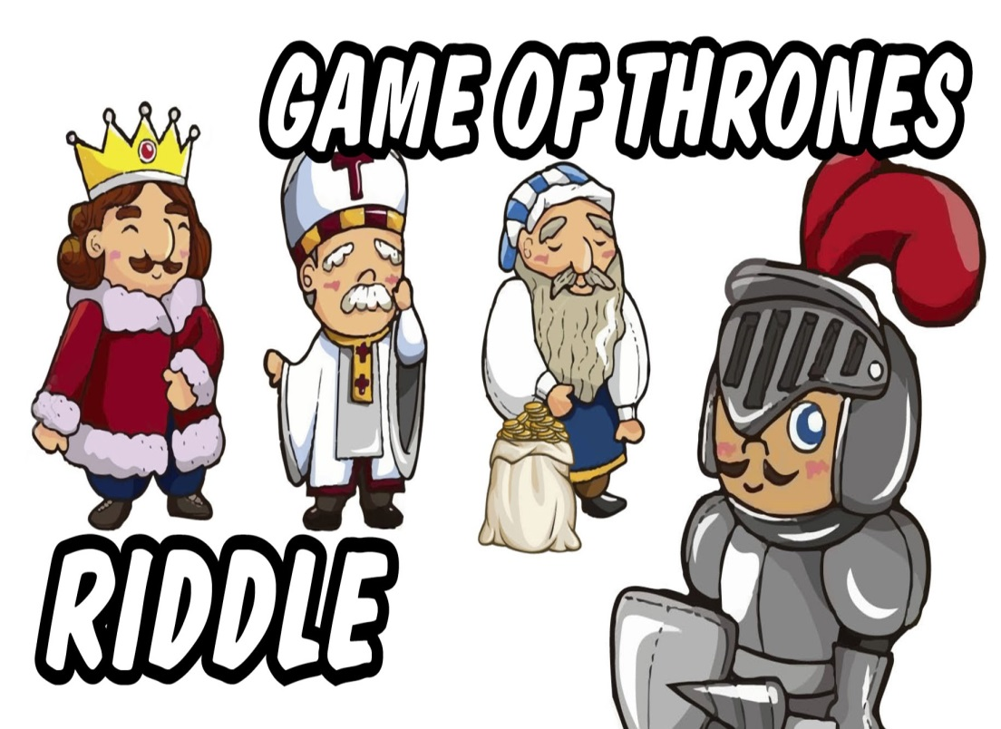
In a room sit three great men, a king, a priest, and a rich man with his gold. Between them stands a soldier, a little man of common birth. Each of the great ones bids him slay the other two.
“Do it,” says the king, “for I am your lawful ruler.”
“Do it,” says the priest, “for I command you in the names of the gods.”
“Do it,” says the rich man, “and all this gold shall be yours.”
Who lives and who dies?

Slide 9
Unit 1
Foundations of American Government

Slide 10
What is Government?
The institution through which the state maintains social order, provides publics services, and enforces decisions that are binding to all people living within the state.

Slide 11
Wait…State?
State: A political community that occupies a definite territory and has an organized government with the power to make and enforce laws.
Population: People
Territory: Land
Sovereignty: Independence and authority
Government
Nation: Any sizeable group of people who are united by common bonds of race, language, custom, tradition, or religion
For the most part, people use the words nation, state, and country interchangeably.

Slide 12
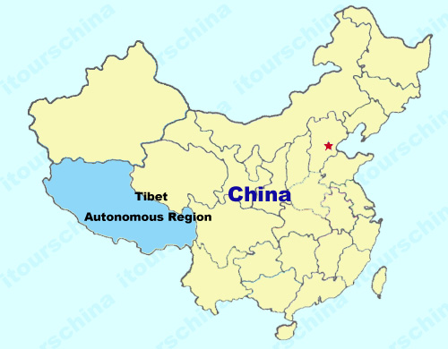
Some Exceptions?

Slide 13
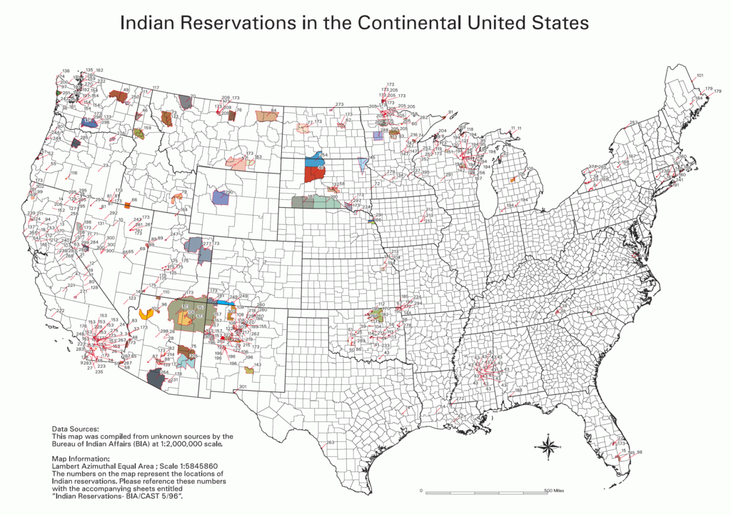

Slide 14
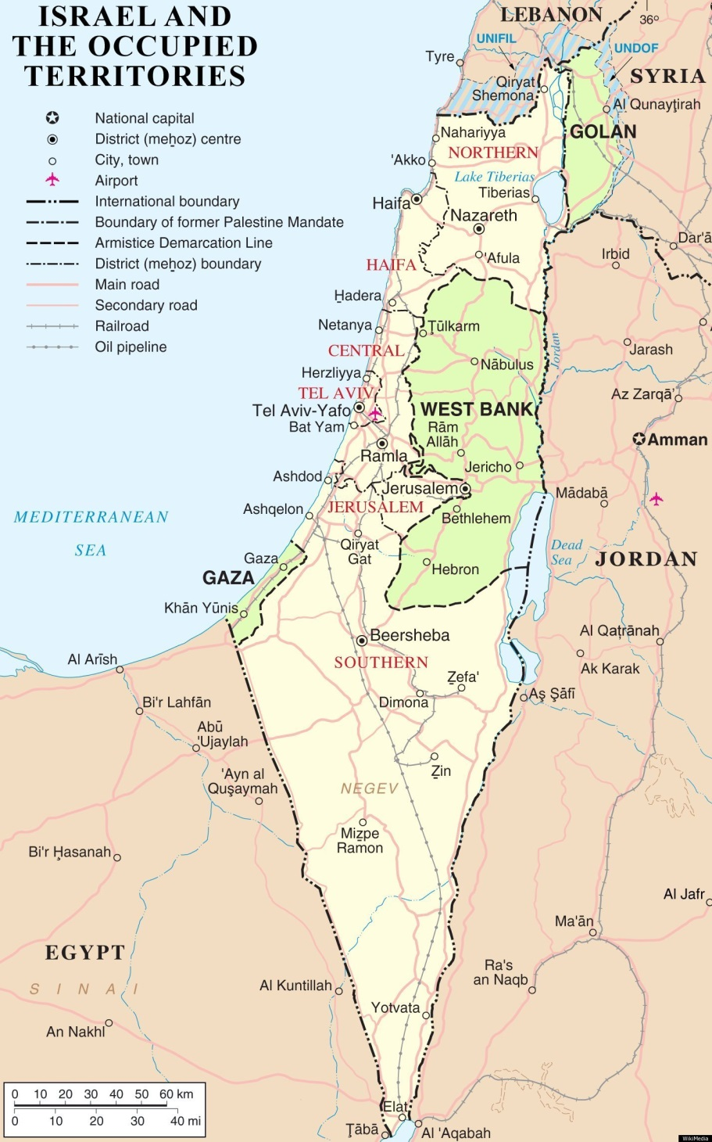

Slide 15
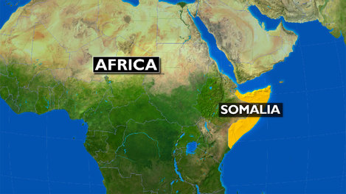

Slide 16
The Purposes of Government
Maintaining Social Oder
Providing Public Services
Providing National Security
Making Economic Decisions

Slide 17
Government Systems
Unitary System
Federal System
Gives all key powers to the national or central government.
Examples: Great Britain, Italy, France
Divides power between national and state governments.
Examples: United States, India, South Africa, Canada
Idea evolved from Confederacy: a loose union of independent states.

Slide 18
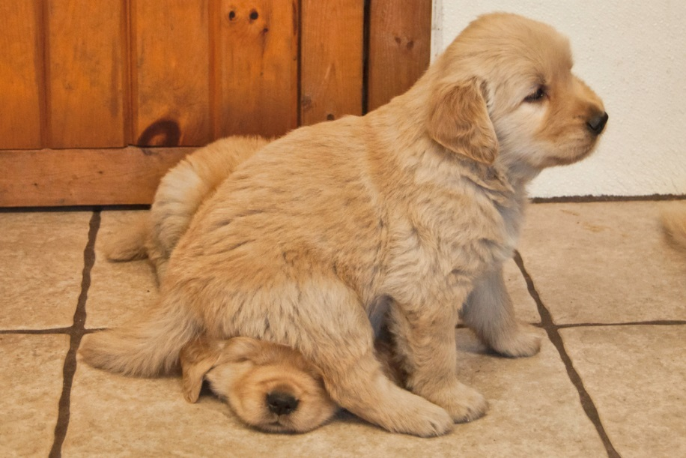
Constitutions!
…yeah you have to take one of those tests again.
But look at this funny picture!
----------------------------------------------------------------------------→
A Constitution is a plan that provides the rules for government.
Sets out ideals that the people bound by the constitution believe in and share
Establishes basic structure of government and defines the government’s powers and duties
Provides the supreme law for the country

Slide 19
Major Types of Government
Autocracy
Oligarchy
Democracy

Slide 20
Who has the power?
Autocracy
Oligarchy
Authority is in the hands of a single person.
Ruler comes to power through inheritance or use of military force
Totalitarian Dictatorship: Ideas of a single leader are glorified. Government seeks to control all aspects of social and economic life.
Examples?
A small group holds power
Group gets its power from wealth, military power, or social position.
Examples?

Slide 21
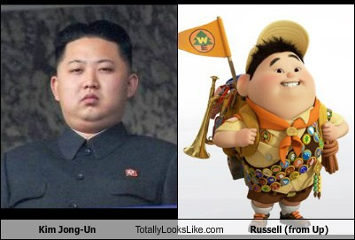
Some crazy facts about North Korea…
Every five years they hold an “election” with only one name on the ballot.
All men living in North Korea must have the same hair cut as Kim Jong Un.
According the North Korean government Kim Jong Un does not ever need to go to the bathroom.

Slide 22
Characteristics of Democracy
Individual Liberty
Freedom to believe and act as you see fit without hurting others.
Majority Rule with Minority Rights
People can vote to make decisions but the rights of individuals are protected and cannot be taken away.
Free Elections

Slide 23
Ideas behind American Government
Thomas Hobbes
Social Contract Theory: People give the government the power to maintain order. In return the government protects its citizens.

Slide 24
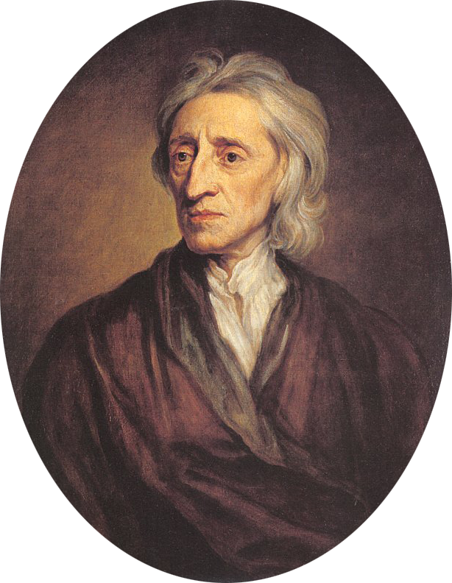
Ideas behind American Government
John Locke
“Father of Classical Liberalism”
All people are equal and independent in their natural state
Right to “Life, liberty, and property”
Wrote Two Treatises of Government explaining social contract theory.
If the government fails to meet its end of the contract the people have the right to overthrow that government

Slide 25
Two Treatises
“Men being, as has been said, by Nature, all free, equal and independent, no one can be put out of this Estate, and subjected to the Political Power of another, without his own Consent. The only way whereby any divests himself of his Natural Liberty, and puts on the bonds of Civil Society is by agreeing with other Men to join and unite into a Community. . . .”
—John Locke, 1690

Slide 26
Enlightenment Era
Both Hobbes and Locke were enlightenment thinkers.
Enlightenment thinkers favored reason and individualism over superstition and tradition
Closely tied to the scientific revolution because it changed the way people thought about the world around them

Slide 27
Enlightening Strikes!
Hmmmm….
Maybe I can learn more about the world through observation….
Maybe governments get their power from the people…
Maybe the king says he was chosen by God just so he can live in a nice castle…
Maybe if we stop putting dead people in the well where we get our drinking water we won’t get sick anymore…

Slide 28
Enlightenment Ideas about Government
Democracy
Any system of government ruled by the people
Direct Democracy: Citizens vote directly to make decisions.
Representative Democracy: People elect representatives and give them the responsibility and power to make laws. Also known as a republic.

Slide 29
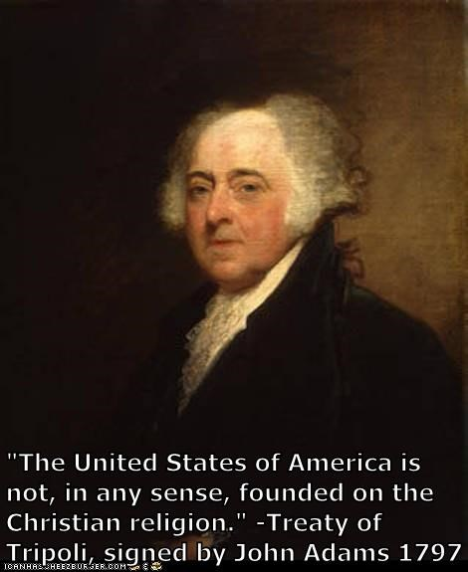
Enlightenment and Religion
Secularism
Separation of church and state
The government cannot stop you from worshipping as you please and it cannot force you to follow a certain religion

Slide 30
Enlightenment and Religion
Deism
Belief that there is one god that created the world based on laws of reason. Does not intervene with laws.
Up to each individual to try to learn these laws.
The Jefferson Bible
Removed all miracles from the bible and wrote out a moral code

Slide 31
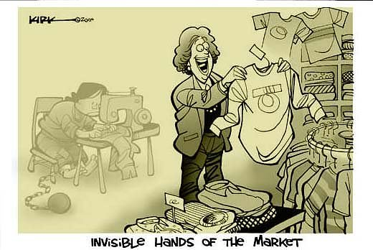
Capitalism
Adam Smith
Scottish philosopher and enlightenment thinker
Suggested a free market system in which government plays no role in making economic decisions
Also known as Laissez-faire, meaning “to let alone”

Slide 32
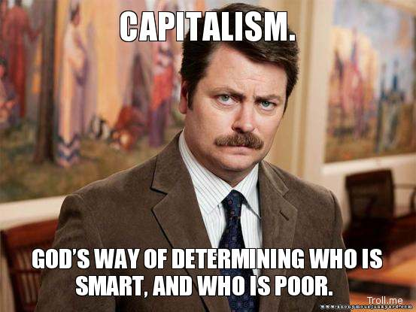
Just remember…
Capitalism= free market = free enterprise = laissez faire

Slide 33
Marxism
Karl Marx: German sociologist who studied capitalism.
Believed that human history could be best understood as class conflict between the “haves” and the “have nots”
Examples?
Studied the French Revolution where the working class overthrew the ruling class.
Capitalists, also known as bourgeoisie, control the means of production
Workers, also known as the proletariat, provide goods and services.

Slide 34
Haves=Capitalists=Bourgeoisie
Have Nots=Workers=Proletariat

Slide 35
Socialism
Socialists believe that economic inequality can be eliminated democratically
Authoritarian Socialism: Ruling party controls all aspects of economy. Citizens are subjects to the state.
Examples?
Democratic Socialism: Citizens have basic rights and free elections.

Slide 36
The Articles of Confederation
Pages 48-52

Slide 37
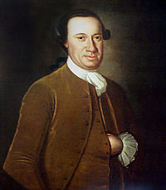
Anybody know who this dude is?

Slide 38
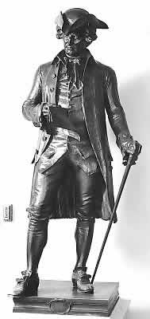
It’s John Hanson, the first president of the United States! (under the Articles of Confederation)
SAY WHAAAT?!

Slide 39
The Articles of Confederation
After gaining their independence from Britain the states to create a confederation, or a “league of friendship.”
All 13 states ratified, or approved, the Articles of Confederation
Central government was made of a unicameral, or single chamber, congress.
Each state has one vote.

Slide 40
The Articles of Confederation
1781-1789
Before the constitution
Established a league of independent states, rather than a nation
Emphasis on states’ rights
Weak central government
Why would they create this?

Slide 41
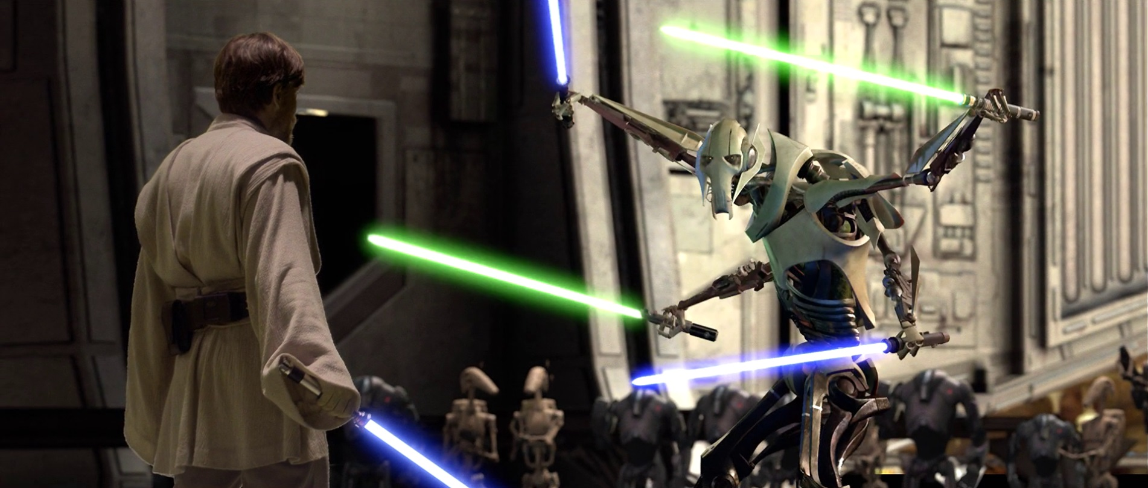
Why is confederacy a bad idea?
Besides the fact that it led to the creation of one of the dumbest Star Wars characters ever…

Slide 42
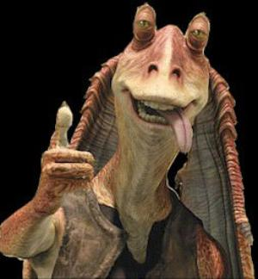

Slide 43
Weaknesses of the Articles of Confederation
No executive to enforce acts of congress
No national court system
Amendments only with consent of all states
9/13 majority to pass laws
Congress powerless to regulate foreign and interstate commerce

Slide 44
Weaknesses of the Articles of Confederation
No Taxes/Money
No army or navy
High Debts
Worthless Money
Led farmers to use barter instead of currency
Could not pay off their debts or taxes
Shays’ Rebellion
Farmers rebelled as a result of losing their property and facing jail time

Slide 45
The Constitutional Convention
Pages 53-58
The Virginia Plan
Drafted by James Madison, “The Father of the Constitution”
Strong National Legislature
Bicameral : two chambers
Lower house elected by the people, upper house elected by the lower house
Strong National Executive
Elected by the legislature
National Judiciary (Court)
Appointed by the legislature

Slide 46
The New Jersey Plan
Unicameral legislature
Executive of more than one person appointed by congress
National judiciary appointed by executive

Slide 47
The Connecticut Compromise
Should the states be represented by population?
Or should the states be represented equally, regardless of population?

Slide 48
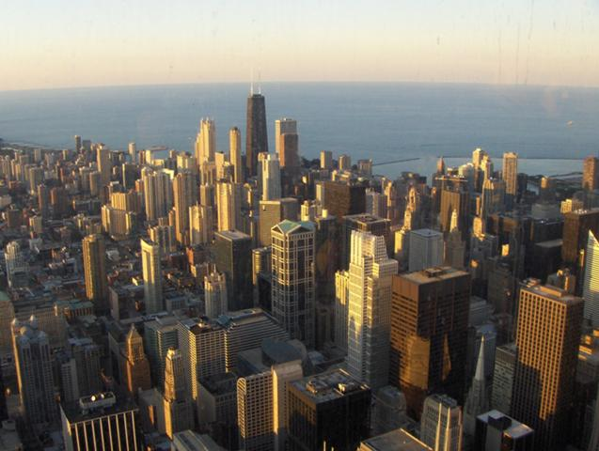
Example?
Illinois has a population of 12.88 million people
North Dakota only has about 700 thousand people.
Do you think these states should have equal power when it comes to making decisions?

Slide 49
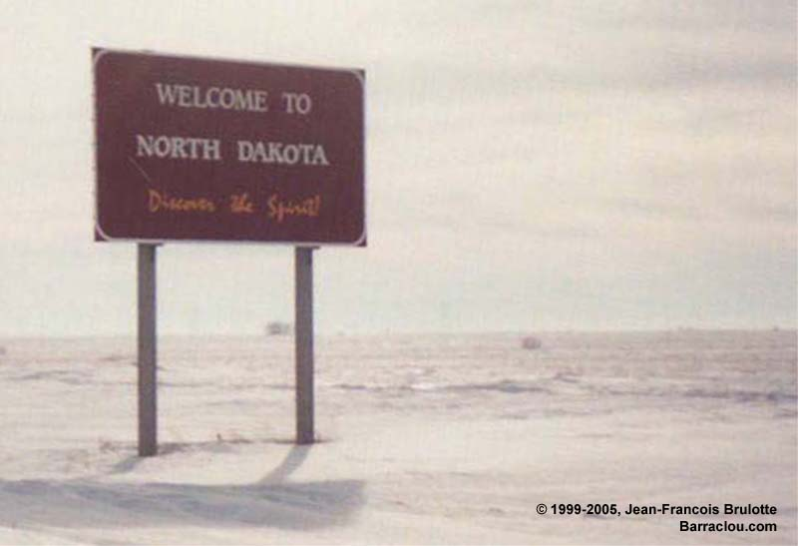
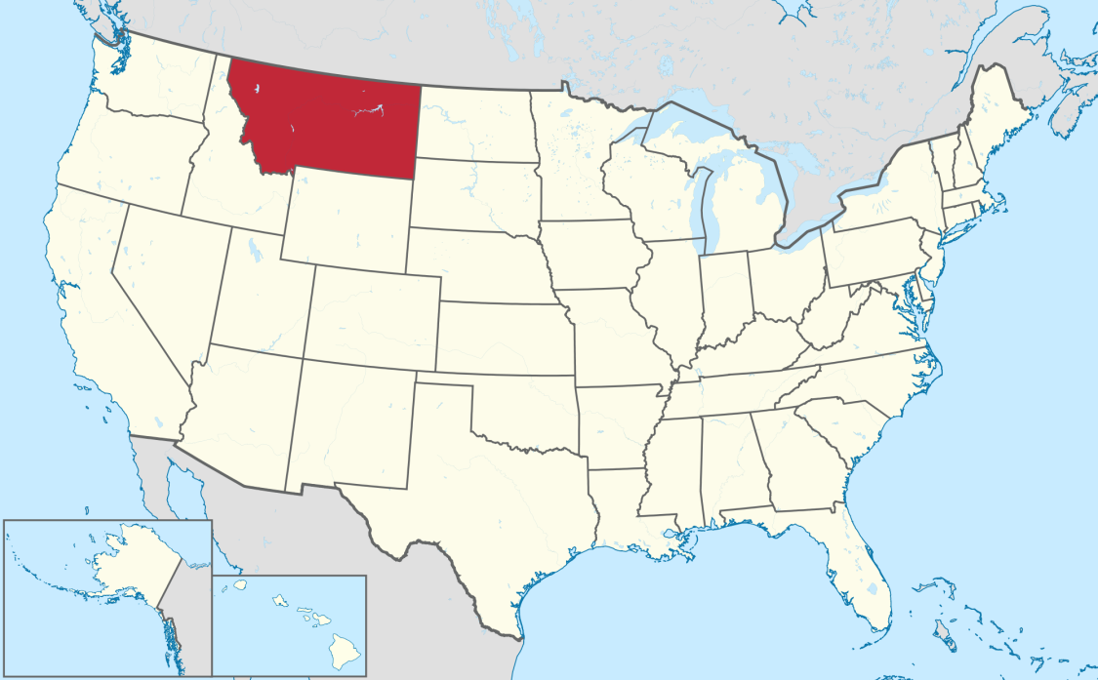
How small is North Dakota?

Slide 50
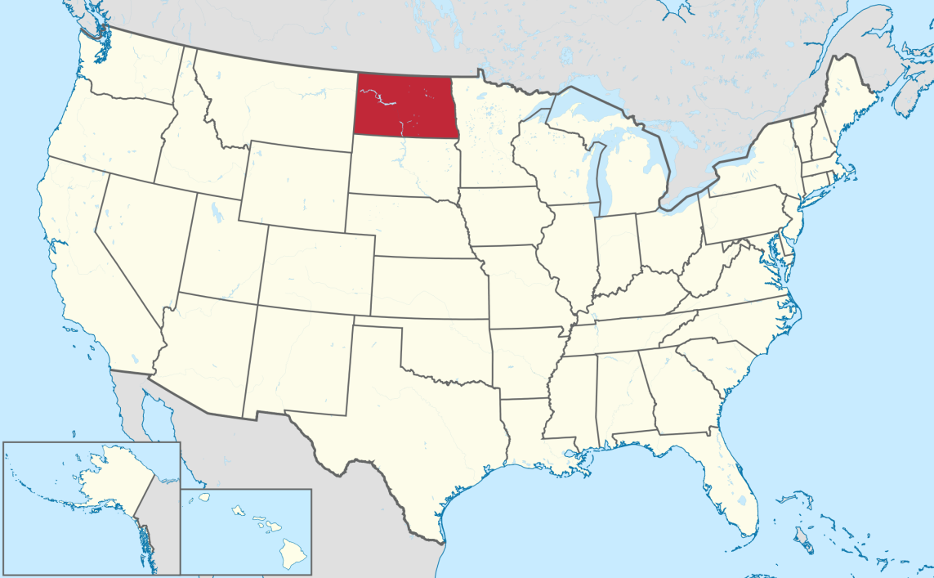
North Dakota

Slide 51
The Connecticut Compromise
Bicameral Legislature
House of Representatives
Based on population
Senate
Two members per state
Illinois has 18 representatives
North Dakota has 1
Both states have two senators

Slide 52
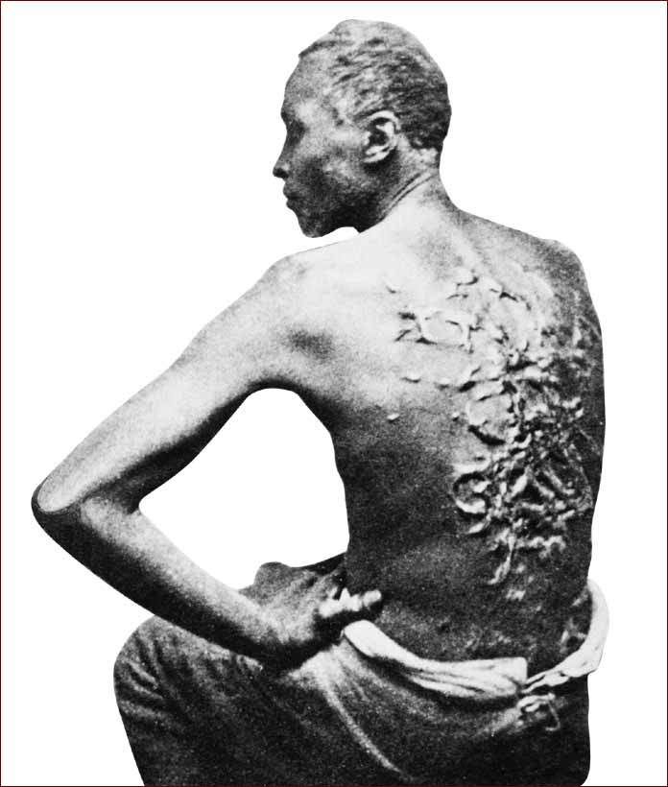
Slavery
About 1/3 of the South’s population were slaves.
Southern States wanted slaves to be counted as free people…
Why?
Northern states opposed this
Led to the Three-Fifths Compromise

Slide 53
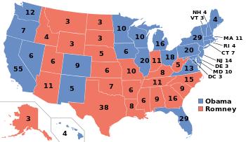
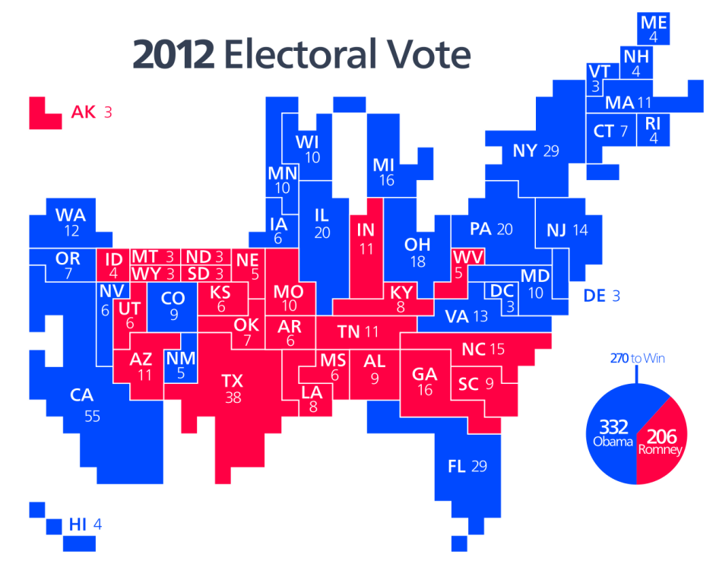
More Compromises
Congress given power to regulate interstate and foreign commerce.
Forbidden to impose export taxes.
Creation of the electoral college.
Four year term for President

Slide 54
Ratification
Supporters of the new Constitution were known as Federalists
Mostly social elite. Wealthy businessmen, merchants, politicians ect.
Critics of the new Constitution were known as Anti-Federalists
Led by Patrick Henry
Mostly farmers and workers
Claimed that too much power was given to the Federal government
Demanded a Bill of Rights

Slide 55
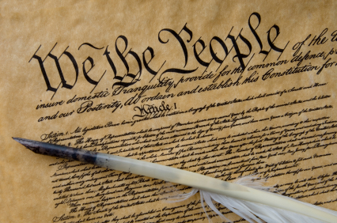
The Constitution
Pages 63-90

Slide 56
Structure of the Constitution
The Preamble
The introduction
Purpose of government
Establish justice, insure domestic tranquility, provide common defense, promote general welfare, and secure liberty.
Seven Articles
Outlines structure of government
Amendments
Any changes made to the Constitution

Slide 57
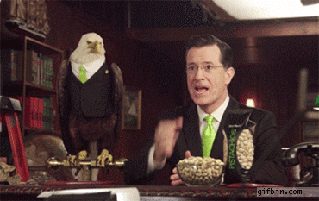
Major Principles of the Constitution
Popular Sovereignty
Federalism
Separation of Powers
Checks and Balances
Judicial Review
Limited Government

Slide 58
Your Assignment
Each group must create and present a poster on one of the principles of the Constitution.
You poster must include
A summary of the principle in your own words
Any new vocabulary words along with their definitions
At least one picture
A real world example of how this principle is applied to government today
Information can be found on pages 65-70

Slide 59
Seven Articles of the Constitution

Slide 60
Article I
Legislative Branch
Makes Laws
Bicameral
Senate (100 members) and House of Representatives (435)
Expressed Powers: Directly stated in the Constitution
Enumerated Powers: Numbered 1-18
Economic Legislation: Levy taxes, borrow money, regulate commerce, coin money, punish counterfeiting.
Defense: Punish piracies, declare war, provide armed forces, call forth and organize militia
Naturalizing citizens, establishing post offices, securing patents and copyrights, establishing courts, and governing D.C.

Slide 61
Article I
Elastic Clause: Gives Congress power to make all laws “necessary and proper” to carry out powers expressed in other clauses.
Allows Congress to stretch powers to meet situations the Founders couldn’t anticipate.
Regulating Commerce?

Slide 62
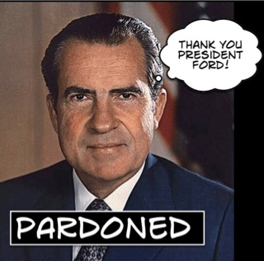
Article II
Executive Branch
Commander in Chief of the armed forces and national guard
Appoints (with Senate’s consent) heads of executive departments (labor, agriculture, ect.)
May pardon convicted criminals or reduce sentence

Slide 63
Article II
Makes treaties with advice of senate
Appoints ambassadors, federal court judges, and other top officials
Delivers annual State of the Union
Calls congress into special session when necessary
Meets with foreign officials
Commissions all military officers
Ensures that laws and the Constitution are “faithfully executed”

Slide 64
Article III
Judicial Branch
Two Court Systems
Federal
State
Federal Courts try cases involving…
U.S. laws
Treaties with other nations
Maritime law
Bankruptcy

Slide 65
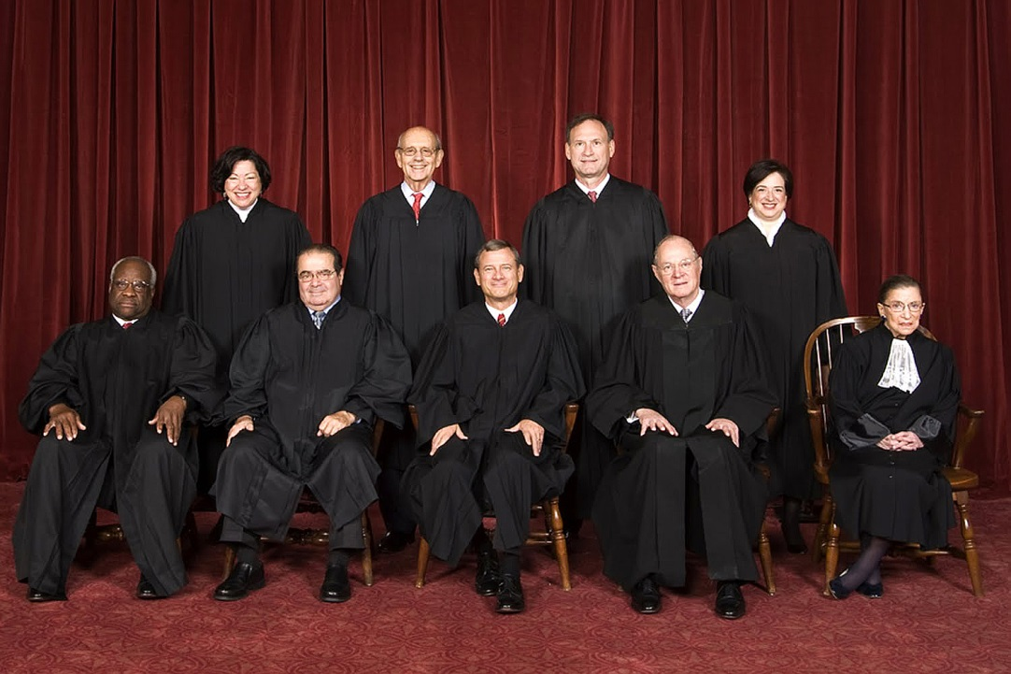
Article III
Judicial Review
Power to declare laws unconstitutional
Established in Marbury v. Madison

Slide 66
Article IV
Relationship between the states and national government
Each state gives citizens of other states the same rights as its own citizens
Article IV, Section I: “Full faith and credit shall be given in each state to the public Acts, Records, and judicial Proceedings of every other state”
Marriage, divorce, driver’s licenses
Extradition: Person convicted of a crime must be returned to the state where the crime was committed.

Slide 67
Article V
How to amend the Constitution
Proposing Amendments
2/3 vote of both houses of congress
Constitutional convention called by congress on petition of 2/3 of the 50 states
Ratification
¾ vote of the 50 state legislatures
¾ vote of constitutional conventions called by all states (only done once)

Slide 68
Article VI
Supremacy Clause: Laws and treaties at the national level are supreme, or more powerful, than the state level
Oaths of Office: No religious test shall be required as a qualification for holding public office.

Slide 69
Article VII
Ratification: Constitution takes effect after ratified by nine states.

