Slide 1
The Schlieffen Plan and The Western Front of The Great War
By:Leonardo Garcia,David Bauer and Richard Saenz

Slide 2
The Schlieffen Plan
The Schlieffen Plan was created by General Count Alfred von Schlieffen in December 1905. The Schlieffen Plan was the operational plan for a designated attack on France instead of Russia, in response to international tension, had started to mobilize its forces near the German border. The execution of the Schlieffen Plan led to Britain declaring war on Germany on August 4th, 1914.
Schlieffen believed that the most decisive area for any war in europe would be in the western sector
Schlieffen concluded that a massive and successful surprise attack against France would be enough to put off Britain becoming involved in a continental war. Giving Germany enough time to move their military to the russian border to take on the russians after the french have been dealt with

Slide 3
Why did the Schlieffen plan fail
The Schlieffen plan failed at the first battle of the Marne
It failed because of poor communication between frontline commanders and army headquarters
Also the germans did not have enough soldiers on the line because they had to send some to the eastern front because russia and its forces were overwhelming them
The plan originally needed those soldiers they sent to russia and when they didn't have them the plan failed

Slide 4
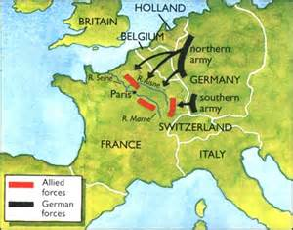
Why did Germany use this plan
It was a great strategy to use
The germans knew they needed to take out france and this plan seemed like the the most effective way to do that

Slide 5
How did the Schlieffen Plan impact the war?
The Schlieffen Plan ultimately sowed the seeds of their own destruction in the war.
Turned by its inability to anticipate was currently going on in the rival nations.
Miscalculations of the belgian resistance
The speed in which russian forces were able to push into east prussian territory
As well as britain immediate entry into land war.
So in the end, Germany's Schlieffen Plan didn't help them achieve victory but instead gave the triple entente forces an open window of opportunity to close in and destroy the German forces.

Slide 6
Creation of the Western Front
The dominion forces of the british empire,portugal and the united states made a stand against the imperial german armies advance on belgium in august 4th 1914 and France on august 6th 1914.
This battle front was known to the Germans as “die westfront”, as Imperial Germany's “western front” for those Imperial German Armies engaged in hostilities against France.

Slide 7
Major battles on The Western Front
Battle of Verdun-
Battle of the Marne-
Battle of Passchendaele-
Battle of Somme-

Slide 8
Battle of the Marne
This battle started on september 5th of 1914 and lasted until september 12th
The germans had pushed through Belgium and into northeastern france only 30 miles outside of paris
The British, french, and Belgian forces had been retreating continuously for 10-12 days before the battle under repeated german attack
They then reached the south of the river Marne, and on september 6th 150,000 french soldiers were sent to attack the german right flank
They started breaking the lines and on september 9th the germans started to retreat with the british and french in pursuit
They were slow on the advance
The official battle ended on the tenth of september but there were a few more skirmishes when it all stopped on the 12th
The French lost a total of 250,000 troops, while the germans suffered around the same because there is no official recording, while the british only lost 12,733 soldiers

Slide 9
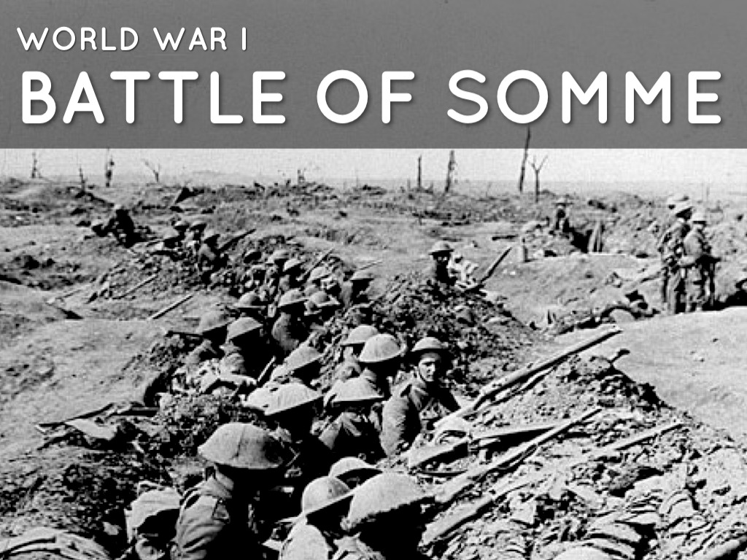
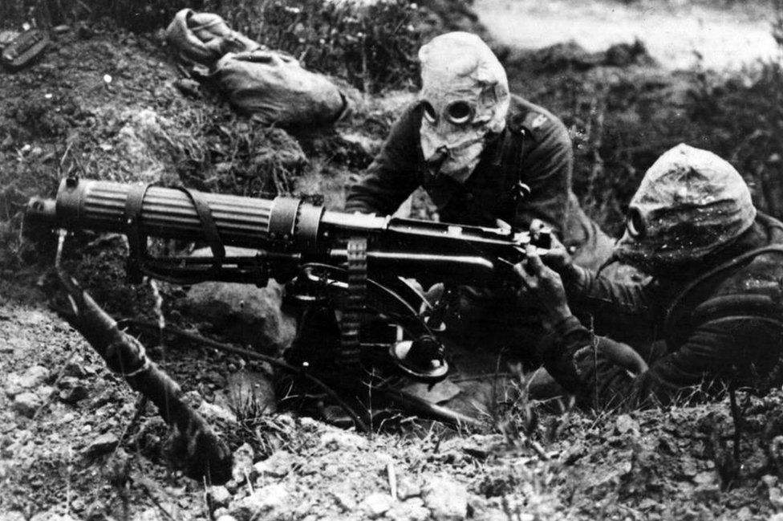
The Battle of the Somme
The battle of Somme was the one of the bloodiest battles in Britain's history with 400,000 British soldier casualties
Sir Douglas Haig was the commander and responsible for most of the front
The battle lasted 141 days with 1.3 million casualties on all sides
The battle front stretched 15-miles in northern france
Anne Frank’s father Otto, and Hitler participated in the battle
The British were planning to attack with artillery bombardment but, the germans dug so deep that they were hard to find and also hard to hit
The purpose was to relieve pressure on the french at verdun

Slide 10
The Battle of Passchendaele
Also known as the 3rd battle of Ypres was a major campaign fought on the western front
It was fought from July 31st to November 6th of 1917
At 3:50am on July 31st allied forces began advancing and the battle had begun
The heads of command were Field Marshal Douglas Haig, General Hubert Gough, and General Sir Herbert Plumer
Haigs men were penetrating the german defenses but were bombarded by bombs and heavy rain making the terrain to muddy so the allies stopped their advance
They were unable to press forward until august 16, when the advance started up again
In the end the british suffered 310,000 casualties, while the germans suffered 260,000 casualties
https://www.youtube.com/watch?v=zJZttzblHFQ

Slide 11
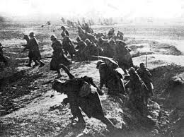
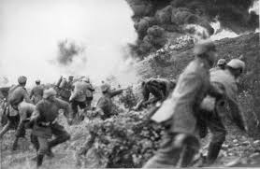
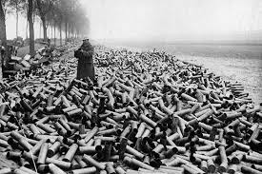
Battle of Verdun
This World War I siege stemmed from German General Erich von Falkenhayn edict to elicit major bloodshed against the French armies defense of the fortress complex located near Verdun.
The German forces quickly advance after capturing forts Douaumont and Vaux after brutal melees
Even after the German forces advanced as far to be within two miles of verdun cathedral they called off their offensive in mid-july and Falkenhayn was relieved from his position.
The French took back their forts as well as pushed back the line and forcing the Germans out. By the time their forces ground to a halt in December, both sides were left with more than 600,000 casualties.
https://www.youtube.com/watch?v=EdihcCMAuE8

Slide 12
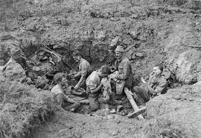
Life as a Soldier on The Western Front
For many, life consisted of struggling to keep those at the front supplied. But the frontline troops as well were also made to ensure that the time spent facing the enemy was balanced by periods of rest and, occasionally, home-leave.
Even when soldiers were “at rest” they would end up finding themselves in exhausting work. There was always a shortage of labour at the front so the fighting men had to send working parties to even out the lack. Officers were exempt from the manual labor but were subject to what it seemed like never-ending paperwork
However, Time out of the line provided an opportunity to get clean and their clothing steamed cleaned which boosted morale even if it was minimal
Tobacco was also central to the lives of most European soldiers. Pipes or cigarettes offered a pleasure that could be enjoyed in almost any circumstance.

Slide 13
Citations
http://www.bl.uk/world-war-one/articles/the-daily-life-of-soldiers
Passchendaele. Dir. Paul Gross. 2008. DVD.
http://www.history.com/topics/world-war-i/battle-of-verdun
http://www.bbc.co.uk/timelines/ztngxsg
http://www.bbc.co.uk/history/worldwars/wwone/battle_passchendaele.shtml
http://www.history.com/topics/world-war-i/first-battle-of-marne
http://www.historylearningsite.co.uk/world-war-one/causes-of-world-war-one/the-schlieffen-plan/

