Slide 1
The Role of Government

Slide 2
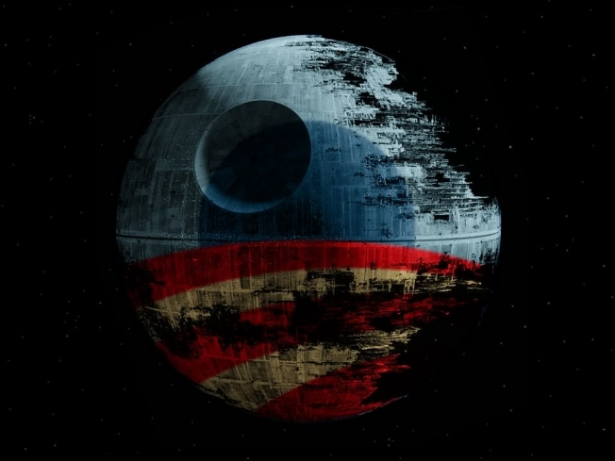
White House declines to build a Death Star
“We the People” website lets anyone propose an idea to the White House—which is obliged to respond to suggestions that get 25,000 signatures within 30 days
The Whitehouse gave the following reasons for not building the death star
The construction of the Death Star has been estimated to cost more than $850,000,000,000,000,000. We're working hard to reduce the deficit, not expand it.
The Administration does not support blowing up planets.
Why would we spend countless taxpayer dollars on a Death Star with a fundamental flaw that can be exploited by a one-man starship?

Slide 3
The Role of Government
There is no such thing as a purely capitalist economy
Government is involved in the economy at local, state, and federal levels.
Can you think of examples?

Slide 4
What are some ways the government involves itself in the economy?
Government employs over 22 million civilian workers.
Largest government expenditures are in military and social security
Public-works projects: Publicly used facilities build by governments with public money

Slide 5
Examples of Government Involvement
Write down an example for each
Transportation
Education
Regulation
Product Safety
Worker Safety
Taxation
Public Safety
Why does the government involve itself in these areas instead of just leaving it to private businesses?

Slide 6
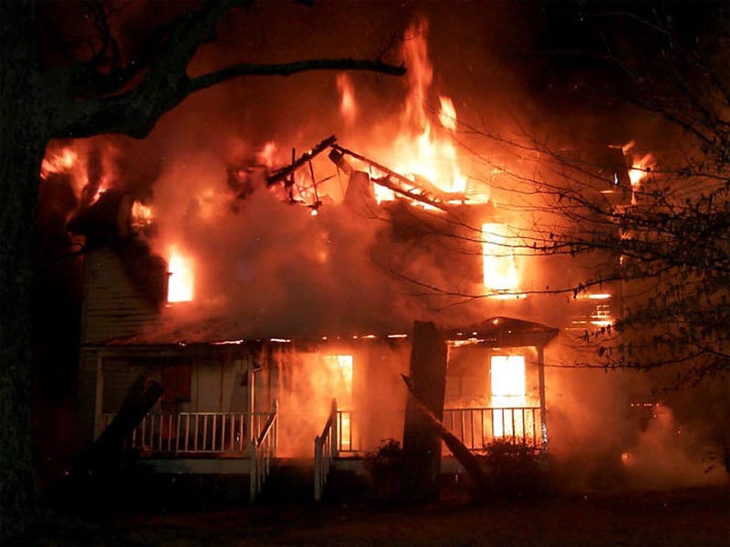
Privatized Fire Departments?
Justin and Kasia Purcell's home went up in flames on the night of Aug. 12. The Purcells, who were staying with relatives because they were preparing for the birth of a child, were not home at the time of the fire. A neighbor notified them of the blaze, and they made the 45-minute drive to their home in Surprise, a city in Maricopa County. They arrived just in time to see firefighters extinguish flames from what was left of their house. The home was a total loss, and the cause of the blaze is undetermined. The couple received a bill from Rural Metro Fire Department for $19,825. The bill included charges of $1,500 per fire truck and $150 dollars per hour for firefighters.
There have been other instances in which private fire stations have let peoples’ homes burn down because they could not afford to pay the fee.

Slide 7
Functions of Government
Providing Public Goods
Goods or services that can be used by many individuals at the same time without reducing the benefit each person receives.
Examples?
Street lights
Legal system
Fire departments
School system
Roads

Slide 8
Types of Public Goods
Merit Good: Deemed socially desirable by government.
Examples
Public Pools
Museums
Zoos
Recreational Center
Government may fund or subsidize these goods
Subsidy: a sum of money granted by the government or a public body to assist an industry or business
Demerit Good: Goods which are deemed as socially undesirable by government
Tobacco
Alcohol
Prostitution
Gambling
Drugs
These goods can be outlawed, regulated, or taxed to prevent consumers from using them.

Slide 9
Promoting General Welfare
Many Americans do not have sufficient income for a tolerable level of living.
Government programs may provide support to certain groups such as the elderly, disabled, and poor.
Income Redistribution: Government activity that takes income from some people through taxation and uses it to help citizens in need.

Slide 10
Social Insurance Programs
Government programs that pay benefits to retired or disabled workers, their families, and the unemployed
Social Security: Federal program that provides monthly payments to people who are retired or unable to work
Medicare: Federal Program that provides low-cost health care for the elderly
Workers’ Compensation: Program that extents payment for medical care to workers injured on the job

Slide 11
Public-Assistance Programs
Welfare: Government program that makes payments to citizens based on need.
Example: Single mother worker multiple jobs to support family
Supplemental Security Income: Federal programs that include food stamps and payments to the disable and aged.
Another example would be “Meals on Wheels”

Slide 12
Who are “the poor?”
United States
Roughly 50 million Americans live in poverty (16%)
Census Bureau found that roughly 25% of Americans would live in poverty if not for social security and welfare programs.
Majority of American poor are children under the age of 18, elderly, single-parent households, military veterans.
The World
Over 80 countries have lower incomes than a decade ago
Over 1.2 billion people live on less than $1/day
Global unemployment over 1 billion people

Slide 13
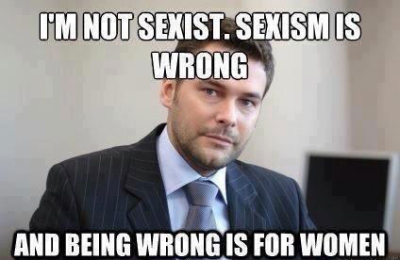
Inequality and Gender
In the U.S.
On average women paid 23% less than men
“Glass ceiling” certain point where women are unable to move up in companies.
Stereotypes and double standards
Ex. Woman is too weak she is “dainty,” if she is too strong she’s a “nag” or “feminazi”

Slide 14
Types of Welfare
Social Welfare
$59 billion spent per year
Corporate Welfare
Financial aid provided by the government to corporations or other businesses
Examples: Subsidies, tax breaks, bailouts
$272 billion spent per year ($92 billion on subsidies, 180 billion on tax breaks)
$12.2 TRILLION on bailouts

Slide 15
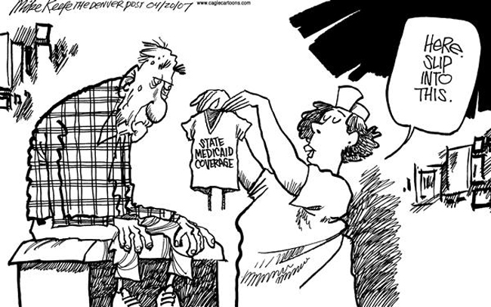
Public-Assistance Programs
Temporary Assistance for Needy Families: State-run program that provides assistance and work opportunities to needy families
Medicaid: State and federal public-assistance program that helps pay health care costs for low-income and disabled persons.

Slide 16
The Federal Budget and National Debt
Remember that all economic decisions have opportunity costs!
In order for government programs to be funded we must be willing to give up buying something else.
If you want your local government to build a public pool, you need to be willing to pay higher taxes and forego spending your money on something else

Slide 17
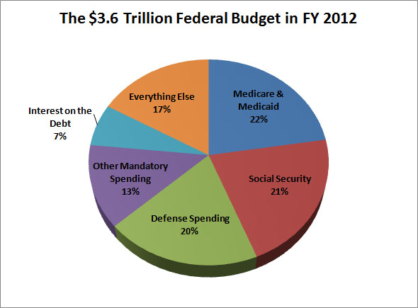
All Governments have Budgets
Budget: Income and expenditures for a set period of time.
In the U.S. congress creates the budget and the president approves it.
Fiscal Year: Year by which accounts are kept; for the federal government, October 1st to September 30th of the next year.

Slide 18
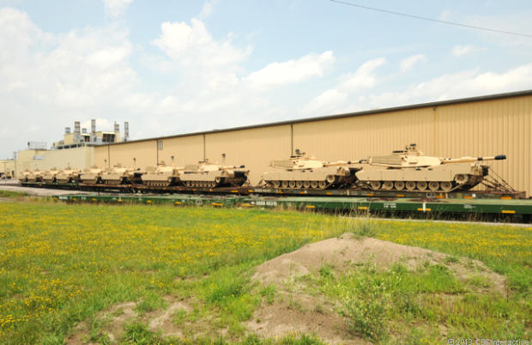
Tanks, but no tanks…
Every year congress spends $3 billion dollars building and maintaining tanks we don’t need!
The military has asked congress to stop wasting the money but they have been ignored…

Slide 19
The National Debt
Budget Deficit: The amount of money government spends more than it collects during the fiscal year.
Budget Surplus: The amount of money the government collects is greater than it spends during the fiscal year.
National Debt: Total amount of outstanding debt for the federal government
Austerity: Policy of reducing deficits through cuts in government services or tax increases.

Slide 20
Taxation
The government receives money by taxing individuals, businesses, and corporations.
How do we decide who to tax?
What’s the most “fair?”

Slide 21
Principles of Taxation
Benefits-received principle: System of taxation in which those who use a particular government service support it with taxes in proportion to the benefit they receive. Those who don’t use the service don’t pay for it.
Example: Using a tax on gasoline to pay for roads. The more you drive and use the roads, the more you pay
Excise Tax: Paid on manufacture, use, and consumption of certain goods.

Slide 22
Principles of Taxation
Ability-to-pay Principle: Those with higher incomes pay more taxes than those with lower incomes.
Example: Paying for public schools with property taxes. Property taxes are calculated as a percentage of value of a person’s home. So the wealthier people pay higher taxes.

Slide 23
Forms of Taxation
Proportional Tax: Tax that takes the same percentage of all incomes
Progressive Tax: Tax that takes a larger percentage of higher incomes than of lower incomes
Regressive Tax: Tax that takes a larger percentage of lower incomes than higher incomes.

Slide 24
Promoting Economic Growth
Keynesian Economics
Supply-Side Economics

