Slide 1
The Lost Generation

Slide 2
The Lost Generation is…
The Lost Generation is a term used to refer to a collective group of artists and writers who settled in Europe in the wake of the First World War
The generation reaching maturity during and after World War I. Disillusioned by the large number of deaths in the War and Rejected many of the previous generation’s ideas of appropriate behavior, morality, and gender roles. The values that its members were being taught didn’t fit the reality of life after the brutal and horrifying World War I.
Two “Lost Generation” presidents were Harry S. Truman and Dwight D. Eisenhower.

Slide 3
https://www.youtube.com/watch?v=nj5ClZAQwHs

Slide 4
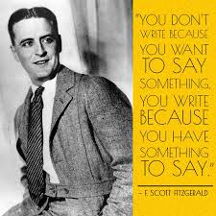
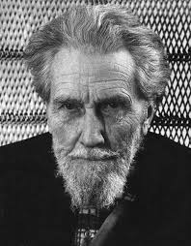
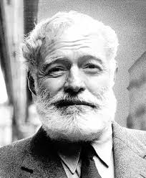
Some well-known members of the group include Gertrude Stein, Ernest Hemingway, Ezra Pound, and F. Scott Fitzgerald. The Lost Generation included the modernist movement in art and writing, along with the Surrealist movement. Many members of this generation were deeply political, often holding radical political views that led to their marginalization in mainstream society.

Slide 5
Modernist Movement
Philosophical movement that, along with cultural trends and changes, arose from wide-scale and far-reaching transformations in Western society in the late 19th and early 20th centuries.
At its basis, the rejection of European culture for having become too corrupt, complacent and lethargic, ailing because it was bound by the artificialities of a society that was too preoccupied with image and too scared of change.

Slide 6
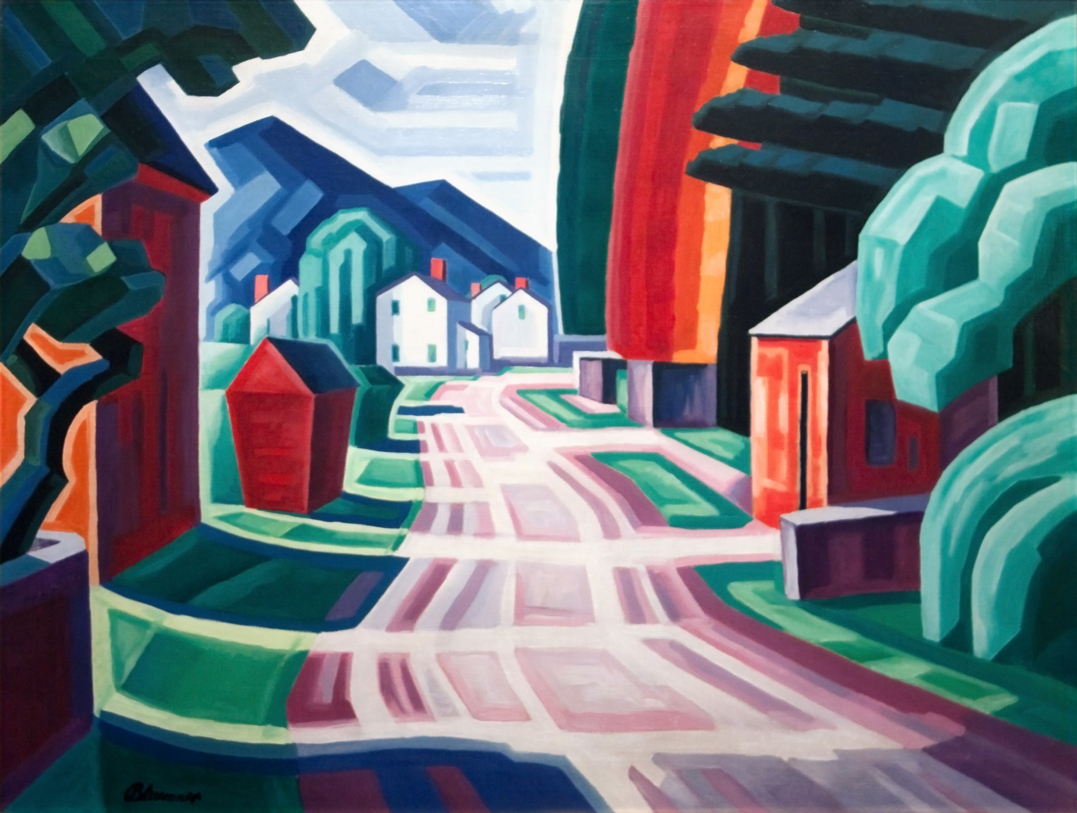
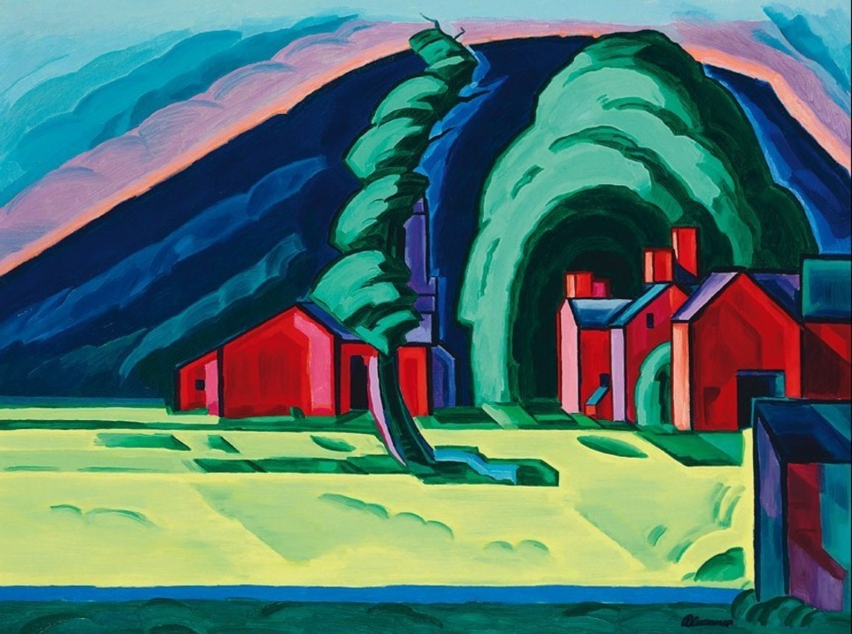
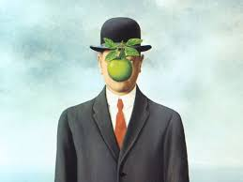
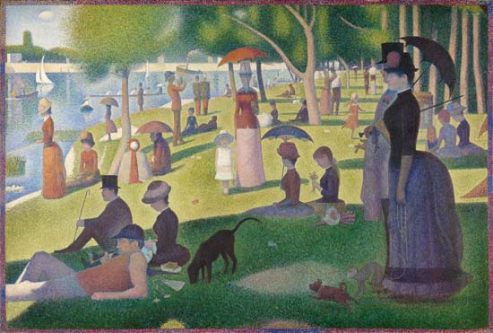
Examples of modernist art

Slide 7
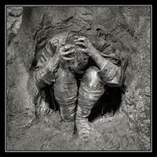
Shell Shock & PTSD
Shell shock was a condition commonly found in retuning infantry soldiers. At first doctors thought it was from being exposed to repeated bombardment when in the trenches. But really it was from the horrors the soldiers were exposed to. British soldiers that had bayoneted their enemies in the face had later had nervous tics in the face muscles. Soldiers that had stabbed men in the stomach had repeated aches and pains in the belly area. By the end of the war there were over 80,000 shell shock victims in Britain alone.

Slide 8
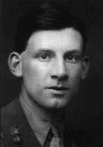
Siegfried-Sassoon
Sassoon was maybe the most innocent of the war poets. Being an innocent, Sassoon's reaction to the realities of the war were all the more bitter and violent.
after the death of fellow officer David Thomas and his brother Hamo at Gallipoli, Sassoon earned the nickname "Mad Jack" for his near-suicidal exploits against the German lines.
His friend and fellow poet Robert Graves convinced the review board that Sassoon was suffering from shell-shock and he was sent to the military hospital at Craiglockhart where he met and influenced Wilfred Owen.

Slide 9
Poetry by; Wilfred Owen
Anthem of the Doomed
https://youtu.be/nMlDPsRwZE4
What passing-bells for these who die as cattle?
Only the monstrous anger of the guns.
Only the stuttering rifles' rapid rattle
Can patter out their hasty orisons.
No mockeries for them from prayers or bells,
Nor any voice of mourning save the choirs,—
The shrill, demented choirs of wailing shells;
And bugles calling for them from sad shires.
What candles may be held to speed them all?
Not in the hands of boys, but in their eyes
Shall shine the holy glimmers of good-byes.
The pallor of girls' brows shall be their pall;
Their flowers the tenderness of silent maids,
And each slow dusk a drawing-down of blinds.

Slide 10
The parable of the old man
So Abram rose, and clave the wood, and went, And took the fire with him, and a knife. And as they sojourned both of them together, Isaac the first-born spake and said, My Father, Behold the preparations, fire and iron, But where the lamb for this burnt-offering? Then Abram bound the youth with belts and straps, and builded parapets and trenches there, And stretchèd forth the knife to slay his son. When lo! an angel called him out of heaven, Saying, Lay not thy hand upon the lad, Neither do anything to him. Behold, A ram, caught in a thicket by its horns; Offer the Ram of Pride instead of him. But the old man would not so, but slew his son, And half the seed of Europe, one by one.

Slide 11
Bent double, like old beggars under sacks, Knock-kneed, coughing like hags, we cursed through sludge, Till on the haunting flares we turned our backs And towards our distant rest began to trudge. Men marched asleep. Many had lost their boots But limped on, blood-shod. All went lame; all blind; Drunk with fatigue; deaf even to the hoots Of tired, outstripped Five-Nines that dropped behind. Gas! GAS! Quick, boys! -- An ecstasy of fumbling, Fitting the clumsy helmets just in time; But someone still was yelling out and stumbling And flound'ring like a man in fire or lime . . . Dim, through the misty panes and thick green light, As under I green sea, I saw him drowning.
In all my dreams, before my helpless sight,
He plunges at me, guttering, choking, drowning.
If in some smothering dreams you too could pace
Behind the wagon that we flung him in,
And watch the white eyes writhing in his face,
His hanging face, like a devil's sick of sin;
If you could hear, at every jolt, the blood
Come gargling from the froth-corrupted lungs,
Obscene as cancer, bitter as the cud
Of vile, incurable sores on innocent tongues, --
My friend, you would not tell with such high zest
To children ardent for some desperate glory,
The old lie: Dulce et decorum est
Pro patria mori.

Slide 12
WORKS CITED “books”
All quiet on the Western Front - Erich Maria Remarque
No man’s land. Writings from a world at war - Pete Ayrton
“some returned reduced by injury, others were never reconciled to the horrors they witnessed and how the war made them unfit for the return to civilian life” (Ayrton).
“By noon I am groping on the the outer limits of reason. Hunger devours ne, I could almost weep for something to eat, I cannot struggle against it. Again and again I fetch water for the dying man and drink some myself” (Remarque 221).

Slide 13
WORKS CITED
https://www.britannica.com/topic/Lost-Generation
http://www.bbc.co.uk/history/worldwars/wwone/shellshock_01.shtml
http://www.hrc.utexas.edu/educator/modules/teachingthetwenties/theme_viewer.php?theme=big&section=war&subsect=3
http://www.irishtimes.com/culture/books/young-fit-and-doomed-the-lost-generation-of-the-first-world-war-1.1777719
http://1920sgirls.tripod.com/lostgeneration.html
http://www.wisegeek.org/what-is-the-lost-generation.htm

Slide 14
WORKS CITED
https://books.google.com/books?id=lBhaBAAAQBAJ&printsec=frontcover&dq=No+man%E2%80%99s+land.+Writings+from+a+world+at+war+Pete+Ayrton&hl=en&sa=X&ved=0ahUKEwir2YSkpefOAhVHlh4KHYirB0AQ6AEIHDAA#v=onepage&q=No%20man%E2%80%99s%20land.%20Writings%20from%20a%20world%20at%20war%20Pete%20Ayrton&f=false
https://www.mdc.edu/wolfson/Academic/ArtsLetters/art_philosophy/Humanities/history_of_modernism.htm
http://www.poemhunter.com/siegfried-sassoon/biography/
Remarque, Erich Maria, and A. W. Wheen. "9." All Quiet on the Western Front. N.p.: n.p., n.d. 221. Print.

