Slide 1
The Fall of the Ottoman Empire
By Hanna Milas, Keriann Baron and Jissel Irizarry

Slide 2
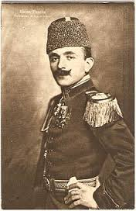
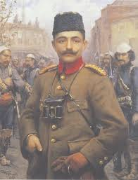
Important people leading-during ww1
Enver Pasha (1881-1922)
Ottoman minister of war/commander-in-chief
Trained in germany which lead to him improving the efficiency of Ottoman armed forces
One of 3 leaders in the ‘Young Turk’ movement
Enver lead the coup d'etat bringing full power to the Young Turks. With the success of this movement Enver remained an influential member of the Ottoman government until 1918

Slide 3
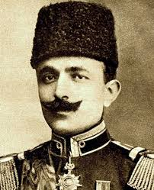
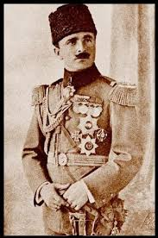
Enver Pasha (1881-1922)
Mobilized the ottoman army in response to Russia
Signed a secret treaty with the german ambassador on August 2nd
Was utterly defeated at the Battle of Sarikamish in Dec. 1914–Jan. 1915.
This was the single worst Ottoman defeat of World War I.
Russia's withdrawal from the war, and the February Revolution of 1917, presented Enver with the opportunity to lead the Ottoman forces

Slide 4
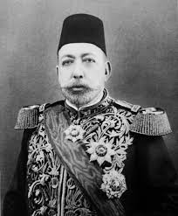
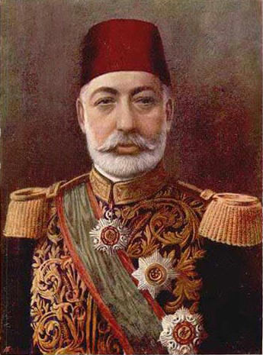
Mehmed V (1909-1918)
35th and the next to last Ottoman Sultan
Was little more than a puppet Sultan whose actions were directed by leaders of the Committee of Union and Progress.
Under his rule, Over the course of the next two years however the Ottoman Empire lost virtually all of its European territory
Somewhat against his will, Turkey entered the First World War. Once in however he, as former ruler of the ottomans, called upon all Muslims to rally to the Ottoman cause on 14 November 1914.
Hs reign had sadly officiated over the effective dismemberment of the Ottoman Empire.
Was succeeded by his brother Mehmed VI.

Slide 5
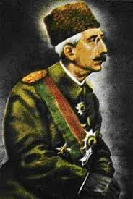
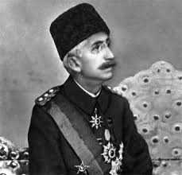
Mehmed VI: (1918-1922)
served as the last Sultan of the Ottoman Empire from 1918 until his overthrow in 1922.
Presided over the terminal decline of the Ottoman Empire.
Parliament was dissolved on 21 December with Mehmed publicly affirming his determination to suppress nationalist ideologies of all colours.
The nationalists nevertheless remained active in Anatolia. After prolonged negotiations they secured Mehmed’s agreement to hold elections late in 1919.

Slide 6
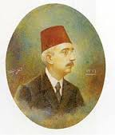
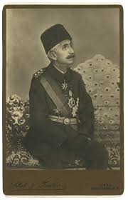
Mehmed VI: (1918-1922)
Mehmed dissolved the Parliament
It was Mehmed's signing of the Treaty of Sevres on August 10th 1920 that sparked the anger of the nationalists under the leadership of Kemal Pasha.
Under the terms of the treaty the Ottoman Empire was reduced to little more than Turkey itself.
the Sultanate was formally abolished by the Grand National Assembly.
His later attempts to re-establish himself as caliph in the Hejaz proved a failure.

Slide 7
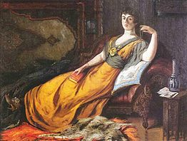
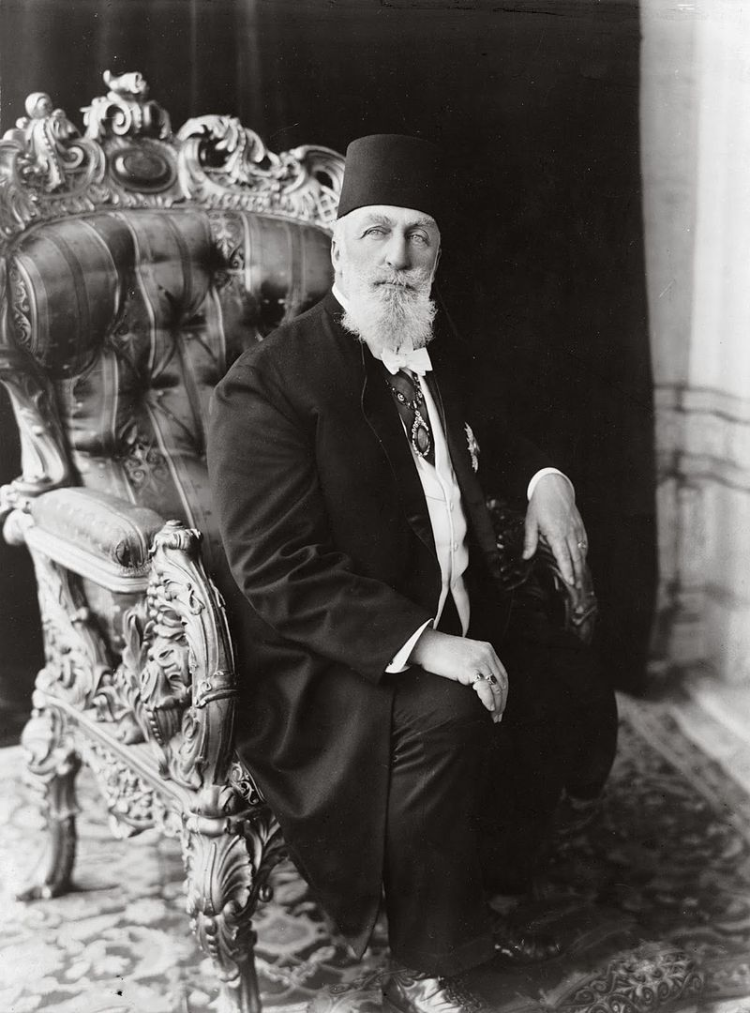
Abdülmecid II: (1922-1924)
the last caliph and crown prince of the Ottoman dynasty of Turkey.
Abdülmecid was confined to the palace until he was 40
father, Abdülaziz, and three of his cousins reigned. When his fourth cousin took the throne as Mehmed VI in 1918, Abdülmecid became crown prince.
He was elected caliph by the Grand National Assembly on November 18, 1922, after the sultanate was abolished
he lost his title of crown prince after Mehmed left Constantinople on the assumption of power.
Abdülmecid, a gentle and scholarly man, was the living symbol of Turkey’s link to the Islamic-Ottoman past.
Mustafa Kemal, determined to break with the Islamic past, first proclaimed the Turkish Republic and on March 3, 1924, the Grand National Assembly abolished the caliphate. The next day Abdülmecid was exiled.

Slide 8
Vid
https://www.youtube.com/watch?v=J1HORlg5wMY
1:20

Slide 9
What lead to the Ottoman Empire entering the world war
Ottoman Empire had one of the largest imperial powers, which meant that the extension of a nation's authority by territorial acquisition or by the establishment of economic and political dominance over other nations was required.
The Ottoman Empire joined the Central Powers to form the Triple Alliance with the signing of the August 1914 Turco-German Alliance.
Turkey formally entered World War I on October 28, 1914, with the bombing of Russian Black Sea ports. The Triple Entente, or Allied Powers, declared war on the Ottoman Empire on November 4.
Two major factors led to Ottoman involvement on the side of the Central Powers, German pressure was one. Other motives for joining the Central Powers were the German victories early in the War and Turkey's friction.
To keep Turkey from joining the enemy (and by gaining Ottoman support, encourage Romania and Bulgaria to enter the Alliance). The German military mission of 1913 was to organize the Turkish army and navy under German leadership and brought forth the Turco-German Alliance. The secret treaty (only five people in Turkey were aware of it, one being Enver Pasha) was signed 2 August 1914.

Slide 10
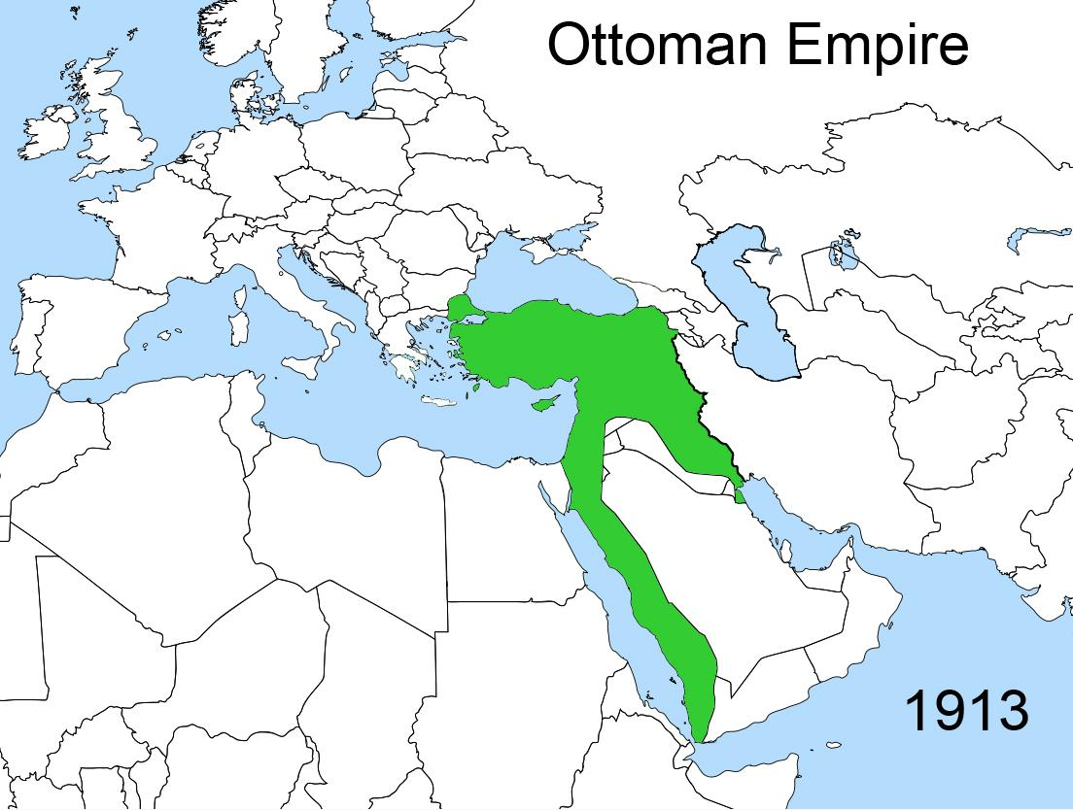
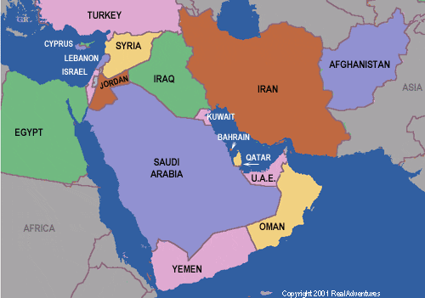
The Ottoman Empire before and after WWI

Slide 11
The Balkan Wars/World War I
the Ottoman Empire sides with the Central Powers for their greatest enemy was Russia, who was aligned with the Allied Powers
the goal of joining WW1 was to take back the European lands that the Ottoman Empire lost in the Balkan wars
The defeat in the First Balkan War had been particularly costly for the Ottoman Army, which suffered 250,000 casualties and lost large amounts of weapons and equipment.
On 31 July 1914, Tsar Nicholas II ordered full mobilisation of Russian Army in response to Germany’s preparations for war in the east. Enver Pasha, the Ottoman Minister for War, reacted by ordering the full mobilisation of the Ottoman Army.
On 2 August he signed a secret treaty with the German Ambassador. Although this was essentially a defensive military alliance, calling on each party to come to the other’s aid against an attack by Russia, it revealed Enver Pasha’s view as to who was the Ottoman Empire’s most important friend – and who was its most bitter enemy.

Slide 12
WW1
Enver Pasha was opposed by the Prime Minister, Sait Halim, who was convinced that the empire’s best option was to remain neutral.
Enver gained the crucial support of Cemal Pasha, the Minister of Marine (responsible for the Ottoman Navy), and Talât Pasha, the Minister of the Interior (responsible for the paramilitary Jandarma – a 40,000-strong force modelled on the French gendarmerie).
Ottoman officers admired the German Army’s professionalism and traditions, and, like many foreign observers at the time, were convinced that it was the best in the world.
the Royal Navy was clearly the world’s pre-eminent naval power, and a British military mission was helping modernise and develop the Ottoman Navy.
the British government decided to requisition two Ottoman battleships nearing completion in British shipyards for wartime service with the Royal Navy. The decision aroused anger across the Ottoman Empire, as the ships had already been paid for by public subscription.
the German battlecruiser SMS Goeben and the light cruiser SMS Breslau appeared off the Dardanelles, after evading the French and British fleets in a daring dash through the Mediterranean. They requested passage through the straits to Constantinople. After delicate negotiations – and over Sait’s objections – they were allowed to proceed. A week later the two warships – complete with their German crews – were officially ‘transferred’ to the Ottoman Navy and renamed the Yavuz Sultan Selim and Midilli.

Slide 13
WW1 continued...
This rapid escalation in tension quickly led to the withdrawal of the British mission to the Ottoman Navy.
General Liman von Sanders, head of the German military mission to the Ottoman Empire, was appointed commander of the Ottoman First Army (whose remit included the Gallipoli Peninsula). Rear-Admiral Wilhelm Souchon, the German naval commander of the Goeben and Breslau, was appointed by Cemal Pasha to command the Ottoman Navy. Although the Ottoman Empire was still ostensibly neutral at this point, Cemal then appointed German Vice-Admiral Guido von Usedom as ‘Inspector-General of Coastal Defences and Mines’. Von Usedom’s job was to help the Ottoman Army strengthen the coastal defences along both the Bosphorus and the Dardanelles.
On 25 October 1914, without consulting any of his ministerial colleagues, he ordered Admiral Souchon to take the Ottoman fleet, including the German-crewed ships, into the Black Sea to attack the Russians. The fleet carried out surprise raids on Theodosia, Novorossisk, Odessa and Sevastopol, sinking a Russian minelayer, a gunboat and 14 civilian ships.

Slide 14
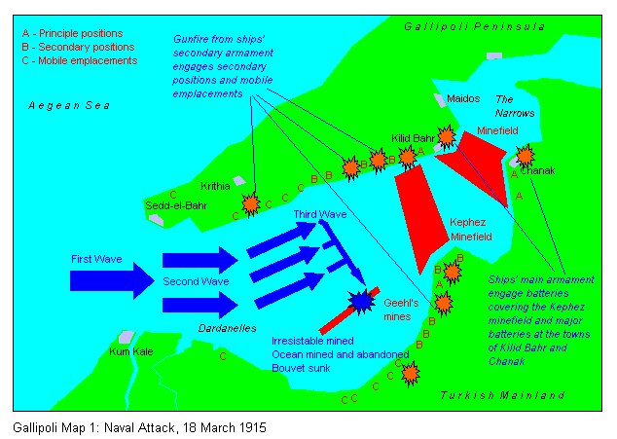
Ww1
2 November, Russia declared war on the Ottoman Empire. France and the British Empire, Russia’s wartime allies, followed suit on the 5th. Enver Pasha had succeeded in bringing the Ottoman Empire into the First World War on the side of the Central Powers, Germany and Austria-Hungary.
The disruption caused by the Balkan Wars and a primitive railway network meant that the Ottoman Empire was the slowest of all the great powers to mobilise in 1914. It took three months for the army to complete mobilisation and gather in the last of its one million reservists. This delay was an important factor in the Turkish decision not did to enter the war immediately – the army simply wasn’t ready. And even when it reached full strength in manpower terms, it still lacked key weapons and equipment – especially modern artillery.

Slide 15
Video
Beginning to 2:45 and 9:20 to end
https://m.youtube.com/watch?feature=youtu.be&v=8ImrCaFJVQg

Slide 16
In WW1
Initially the Ottoman war effort focused on fighting the Russians in the Caucasus and protecting its remaining European territory and the coast of western Anatolia from Allied attack.
Within days of the declarations of war British forces had landed in the Shatt al Arab waterway at the head of the Persian Gulf. They destroyed the Turkish coastal fort guarding the area, opening the way to Basra. This and other early successes encouraged the British to mount a full-scale invasion of Mesopotamia with a force of mostly Indian troops. Opposing them was the under-strength Ottoman Sixth Army, which would spend the next four years fighting to hold on to the region.
Palestine region the equally under-strength Ottoman Fourth Army was given permission to attack the Suez Canal. Defeated in this attempt in early 1915, it then restricted itself to defending the Sinai Peninsula. In 1916 the British went on the offensive, driving the Turks out of the Sinai by year’s end. With Palestine now threatened, reinforcements were rushed to the new front line around Gaza and two new field armies, the Seventh and Eighth, were later formed to defend it. These armies fought the British for control of Palestine and the Trans-Jordan until September 1918, when both were destroyed in the Battle of Megiddo.

Slide 17
WW1
The Allied invasion of the Gallipoli Peninsula in 1915 saw the Ottoman Army stretched to breaking point to contain the invading British, French and Anzac forces. The best remaining units of the Ottoman Army – those kept back to guard against any threat from the Balkans – were all committed to the desperate battles that raged across the peninsula from April to September. When these units were exhausted, Ottoman troops were taken from other battlefronts, even the Caucasus, where the Ottoman Third Army was engaged in a gargantuan struggle against the Russians.
Turks enjoyed some victories, massive Russian offensives in mid-1916 cost the Turks 100,000 casualties and drove them out of a large part of eastern Anatolia. Luckily for the Turks, the outbreak of the Russian Revolution the following year led their enemy to abandon these gains.

Slide 18
In WW1
Russia’s withdrawal from the war in late 1917 encouraged the Ottoman leadership to revive their pan-Turkic ambitions, and in February 1918 much of the Ottoman Army’s remaining strength was squandered on an invasion of the Caucasus and northern Persia. The initial aim was to crush attempts by the Georgians, Armenians and Azerbaijanis to establish their own independent states out of the ashes of the Russian Empire. After largely succeeding in this aim, the Ottoman troops were ordered by Enver Pasha in July to drive on to the Caspian Sea and beyond.
But as 1918 drew to a close the British expeditionary forces in Mesopotamia and Palestine made decisive breakthroughs, destroying the Ottoman armies on both fronts. The British now threatened to invade eastern and central Anatolia and the Ottoman forces in the Caucasus were too far away to stop them. Bulgaria’s capitulation in late September also meant that the Allied armies on the Salonika Front were poised to overrun all of European Turkey and capture Constantinople. Acknowledging the hopelessness of this situation, the Ottoman leadership agreed to an armistice with the Allies, which took effect on 30 October 1918.

Slide 19
Video
https://youtu.be/WcVHuR9DOv4

Slide 20
The end of the war and an empire
The loss of the war and the peace treaties cause the empire to end
The Republic of Turkey is established in 1923
Ottoman Empire will best be remembered for its glory years of strong leadership and cultural influences that affected the lands they conquered.
Battles were fought in territory of the modern states of Egypt, Yemen, Saudi Arabia, Jordan, Israel, and Palestinian Territories, Syria, Lebanon, Iraq, Turkey, and Iran. The majority of these countries emerged into statehood as a direct consequence as the Fall of the Ottoman Empire following the end of the First World War.

Slide 21
The end of the war and an empire continued…...
- There was petroleum. The British had tightened their grip on the Persian Gulf in the early years of the new century, as the Royal Navy contemplated shifting away from coal.
-Territorially, the ending of the Ottoman empire created the present Middle East.
-League of Nations and ruled under fictions of conditional sovereignty that they called mandates. With the exception of the as yet non-existent Israel, the map of the region that emerged in the 1920s looks much as it does today.
-it has survived its traditional enemies, the Russian and Habsburg Empires, and its disastrous ally, the German Empire.
- Most ambitious and dangerous enemy is the british empire.
-Territorially, the ending of the Ottoman empire created the present Middle East. The new republic of Turkey eventually won independence for itself and many of the other territories became independent, giving rise to the new nations and mandates.

Slide 22
Fall of the ottoman empire video
https://www.youtube.com/watch?v=m4UXwXhn9ME (3:20-5:17)

Slide 23
Links
http://www.softschools.com/timelines/ottoman_empire_timeline/159/
http://www.nzhistory.net.nz/war/ottoman-empire/enters-the-war
http://www.theottomans.org/english/family/index.asp
http://www.historyguy.com/fall_of_the_ottoman_empire.htm#.V8SFDU3JDIU
http://www.nzhistory.net.nz/war/ottoman-empire/enters-the-war
https://en.wikipedia.org/wiki/List_of_sultans_of_the_Ottoman_Empire
http://www.jewishvirtuallibrary.org/jsource/History/ottoww1.html
http://www.firstworldwar.com/bio/enver.htm
BOOK SOURCES
The Ottoman empire, 1300-1650 The Structure of Power by Colin Imber
The Fall of the Ottomans: The Great War in the Middle East by Eugene Rogan

