Slide 1
The EASTERN FRONT
By: Sheldon Mckittrick, Jake Trevino, Cooper Gross
Period 8
20th Century Wars

Slide 2
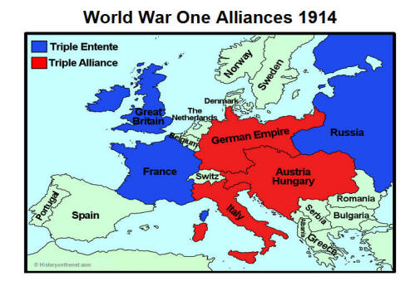
GEOGRAPHY

Slide 3
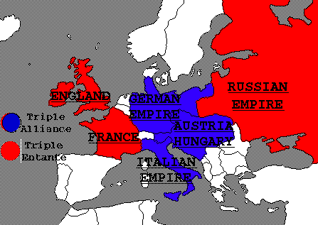
GEOGRAPHY II
THE EASTERN FRONT CONTAINED THE COUNTRIES RUSSIA, GERMANY, AUSTRIA-HUNGARY, the OTTOMAN EMPIRE, AND SERBIA.
GERMANY, RUSSIA, AND AUSTRIA-HUNGARY WERE ALL MAJOR POWERS IN THE WAR.

Slide 4
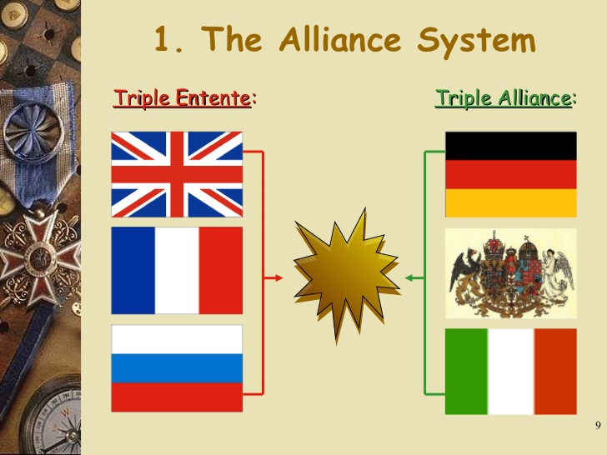
GEOGRAPHY III
ALONG THE EASTERN FRONT RUSSIA AND SERBIA WERE WITH THE TRIPLE ENTENTE.
THE TRIPLE ALLIANCE ALONG THE EASTERN FRONT WERE GERMANY, AUSTRIA-HUNGARY, and the OTTOMAN EMPIRE.

Slide 5
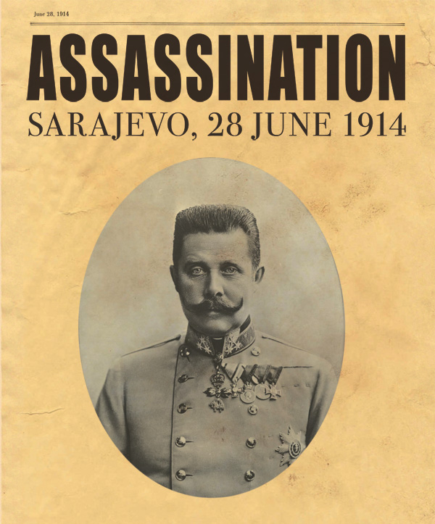
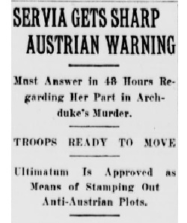
The Situation with Austria-Hungary and Serbia
At six o’clock in the evening on July 23, 1914, nearly one month after the assassination of Austrian Archduke Franz Ferdinand and his wife by a young Serbian nationalist in Sarajevo, Bosnia, Baron Giesl von Gieslingen, ambassador of the Austro-Hungarian Empire to Serbia, delivers an ultimatum to the Serbian foreign ministry.

Slide 6
Russia Mobilizes
July 31, 1914 - Reacting to the Austrian attack on Serbia, Russia begins full mobilization of its troops.
Russia mobilized before Serbia even responded to Austria-Hungary’s Ultimatum, which would allow Austria-Hungary to pursue a hard-line policy towards Serbia. Their plan was to force a military conflict that would end quickly and decisively with a crushing Austrian victory before the rest of Europe had time to react.
Austria-Hungary’s plan was developed in coordination with the German foreign office.

Slide 7
War Begins on the Eastern Front
http://www.history.com/this-day-in-history/archduke-franz-ferdinand-assassinated

Slide 8
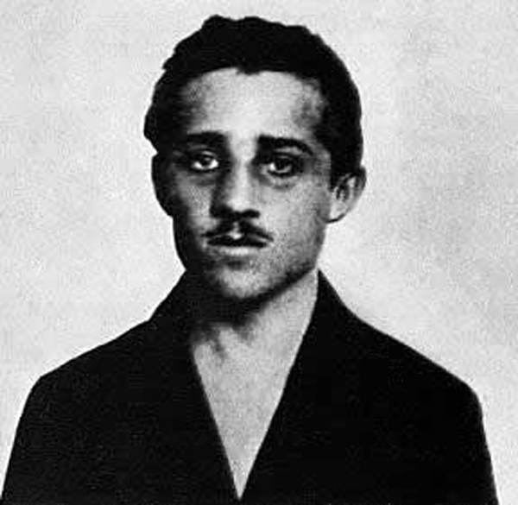
War Begins on the Eastern Front II
The war basically began when Archduke Franz Ferdinand was assassinated on June 28th 1914. He was assassinated by Gavrilo Princip.
Gavrilo Princip was a Serbian nationalist with ties to the secretive military group known as the Black Hand.
This event propelled the major European military powers towards war.

Slide 9
War begins on the Eastern Front III
The first artillery barrage of the war took place in July 1914 when Austro-Hungarian gunners fired into Belgrade, capital of Serbia, at the confluence of the Sava and Danube rivers.
Eastern Europe was then largely divided between the great empires and Austria-Hungary held the north and west river banks, meaning the city was separated from their guns by only a few hundred yards of water.

Slide 10
Key Battles along the Eastern Front
Engagement Date
Battle of Stalluponen Opened 17 August 1914
Battle of Gumbinnen Opened 20 August 1914
Battle of Tannenberg Opened 26 August 1914
First Battle of the Masurian Lakes Opened 9 September 1914
Battle of Bolimov Opened 31 January 1915
Second Battle of the Masurian Lakes Opened 7 February 1915
Battle of Lake Naroch Opened 18 March 1916
Battle of Lutsk Opened 4 June 1916

Slide 11
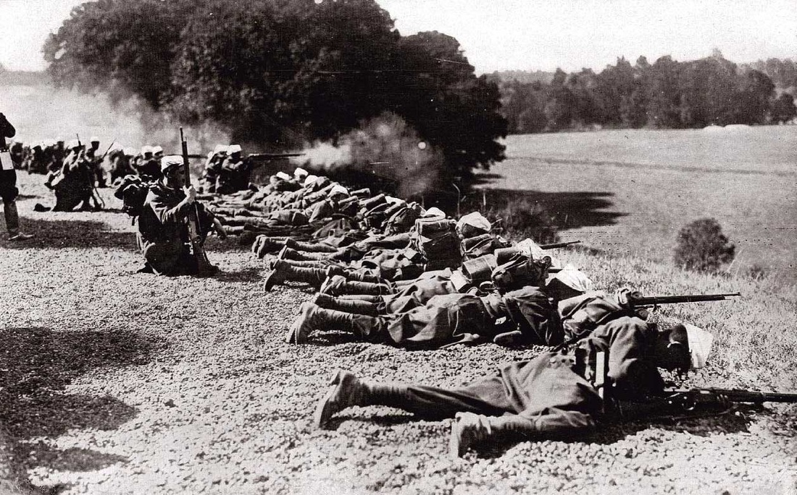
Battle of Stalluponen
The first action on the Eastern Front, the Battle of Stalluponen was fought by a corps of the German Eighth Army against the Russian First Army. Rennenkampf First Army, of 200,000 men, entered East Prussia from the north while General Samsonov's Second Army invaded from the south. The Russian First Army was spread out over too wide a front. It ran into a single German army corp under General Hermann von Francois, and was badly mauled. Rennenkampf temporarily withdrew to the border, having lost 3,000 men.

Slide 12
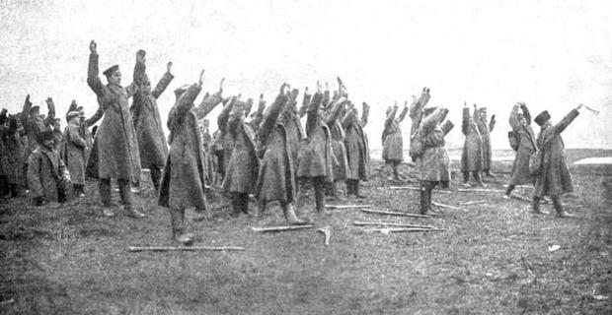
Battle of Gumbinnen
General Francois managed to persuade the German command to launch a counterattack, and his own attack, in the centre of the Russian line, drove the Russians back over five miles, but his success was exceptional. The battle was a draw, but the failure to inflict a defeat on the Russians caused a panic at the German headquarters which resulted in the replacement of General Prittwitz with the team of Hindenburg and Ludendorff.

Slide 13
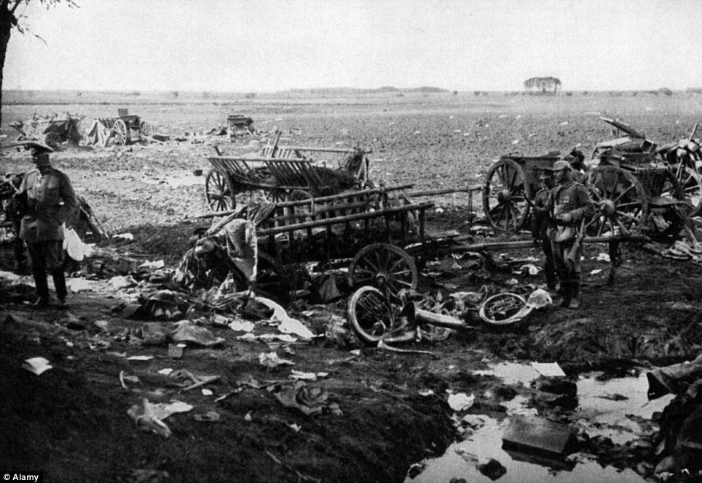
Battle of Tannenburg
On August 26, after intercepting uuencoded wireless messages from both Samsonov and Rennenkampf, the Germans were able to take Samsonov’s army by surprise. After three days of battering by German artillery, Samsonov’s troops began their retreat; more German forces cut off their path and a massive slaughter ensued. In the first hours of August 30, confronting the reality of his army’s collapse, Samsonov went into the forest, away from his staff, and shot himself.
In total over 50,000 Russian soldiers were killed and 92,000 were taken prisoner.

Slide 14
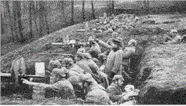
First Battle of the Masurian Lakes
the Germans, despite now outnumbering the Russians, were unable to encircle the Russians in the broken terrain of the Masurian Lake lands, and Rennenkampf was able to extract his army intact, and even launch his own counterattack on 25 September which regained much of the land lost during the battle.

Slide 15
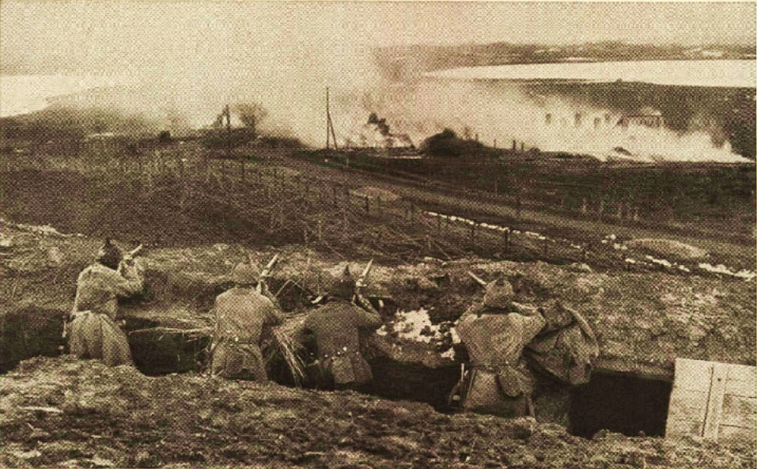
Battle of Bolimov
It was a German attack intended to draw Russian attention towards Warsaw and away from East Prussia.
The attack was launched from the west of Warsaw, against Polish positions at Bolimon, on the Rawka river. This was the area held by the German Ninth Army, under General Hoffman.
The attack at Bolimov did achieve its main objective. Russian attention remained focused around Warsaw, and the attack further north was a total success.

Slide 16
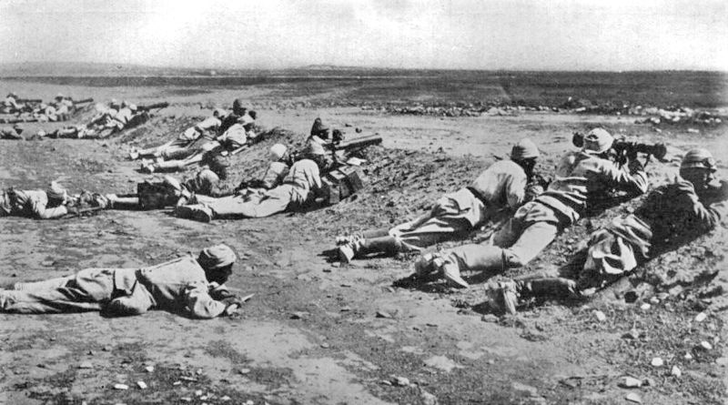
Second Battle of the Masurian Lakes
The second battle of the Masurian Lakes was part of an over-ambitious German and Austrian plan designed to cut off the Russian armies in Poland.
This involved an Austro-Hungarian attack in Galicia, towards Lemberg, and a German attack from East Prussia. It was hoped that the two pincers could meet east of Warsaw.

Slide 17
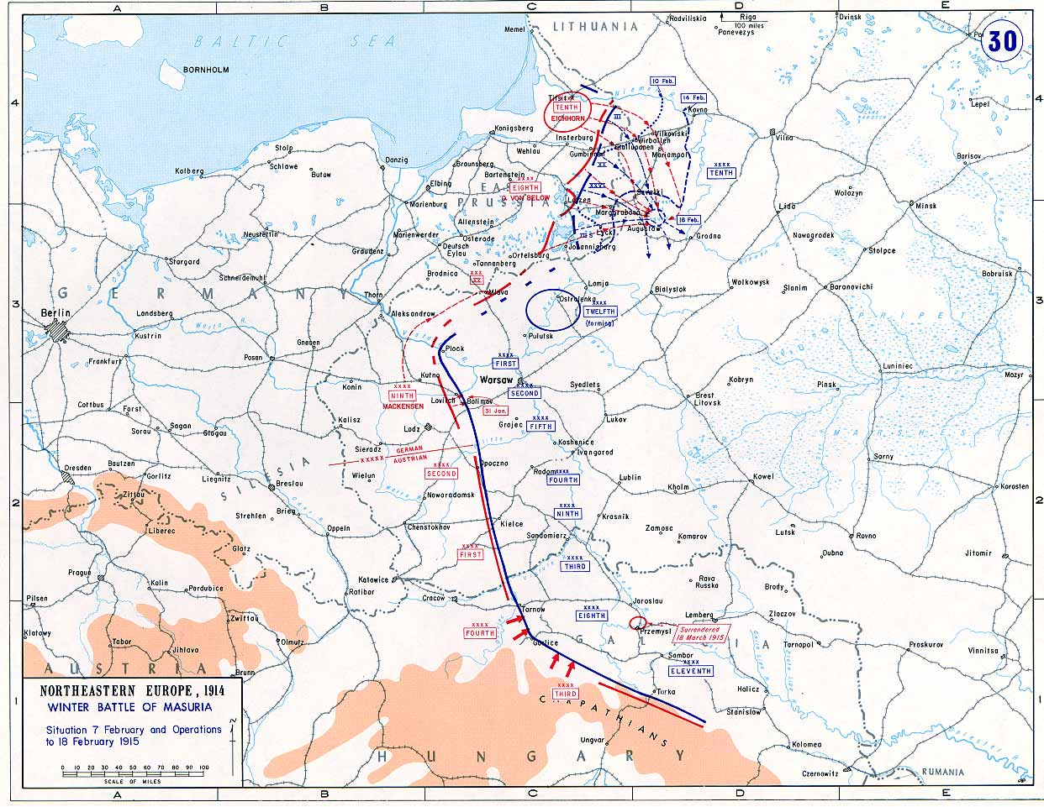
Second Battle of the Masurian Lakes II

Slide 18
Battle of Lake Naroch
The battle was a Russian offensive launched around Lake Naroch in the hope of recapturing Vilna.
The initial attacks made some limited progress, especially along the shore of the lake, but the attacks had been made on very narrow fronts north and south of the lake.
The Russian offensive continued until 26 March. During April local German counterattacks took back most of the lost ground. The Russians suffered 100,000 casualties, and failed to pull any German troops away from the Western Front.

Slide 19
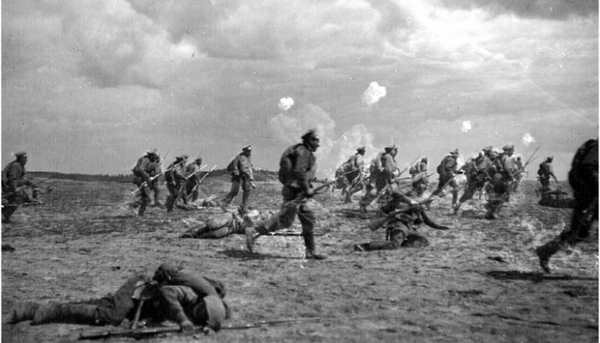
Battle of Lake Naroch II

Slide 20
Battle of Lutsk
Lutsk had subsequently been heavily fortified as a reserve position by the Austro-Hungarians. The little-respected commander of the Austro-Hungarian Fourth Army, Archduke Josef Ferdinand, was consequently complacent in his firm belief in the impregnability of his line's defences.
With the pounding of Russian artillery - creating more than fifty breaches in barbed wire defences - the Lutsk defenders fled in wholesale panic.
The Austro-Hungarians lost a staggering 1.5 million men (including 400,000 taken prisoner) and ceded some 25,000 square kilometres of ground during the overall campaign.

Slide 21
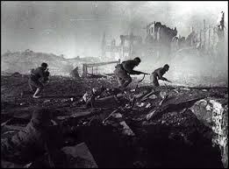
Battle of Lutsk II

Slide 22
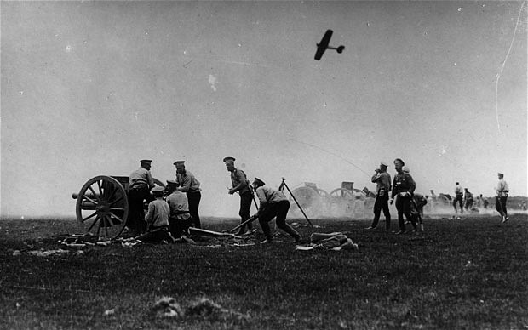
Fighting Style in Eastern Front
Traditional warfare was used on the Eastern Front. Unlike the Western Front battles, which were fought mainly in trenches, Eastern Front battles were fought mainly in big, open areas that required troops to march forward and backwards in great distances. The Eastern Front was longer, with German and Austro-Hungarian forces lined up against Russia and its allies such as Serbia along a front of almost 1,000 miles from the Baltic to the Black Sea.

Slide 23
Fighting style II
Eastern Front saw clashes that were bloody and chaotic, with cavalry officers leading suicidal mounted charges against dug-in machine-guns and modern artillery.
The Eastern Front was the war everyone expected: it featured mass armies making sweeping movements, breakthroughs leading to tremendous advances, and innovation in both tactics and technology.

Slide 24
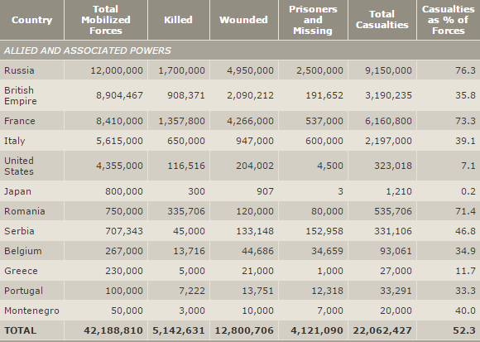
Fighting Style III

Slide 25
Commanders and Leaders
German commanders- Paul von Hindenburg, Erich Ludendorff, Leopold of Bavaria, Max Hoffmann, August von Mackensen,
Austria-Hungary commanders- Conrad von Hotzendorf, Arthur Arz von Straubenburg
Bulgarian commanders- Nikola Zhekov
Russian Empire/Russian Republic commanders- Tsar Nicholas II, Grand Duke Nicholas, Aleksei Brusilov, Aleksei Brusilov, Lavr Kornilov, Nikolay Dukhonin
Romania- Ferdinand I
Russian SFSR- Nikolai Kreylenko

Slide 26
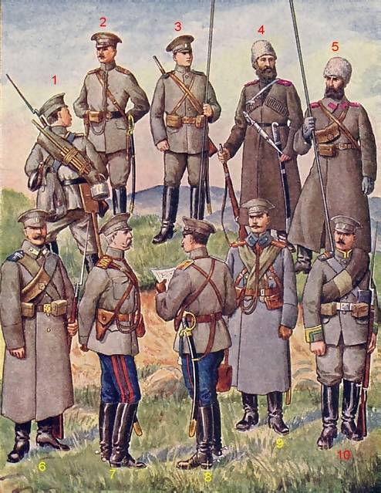
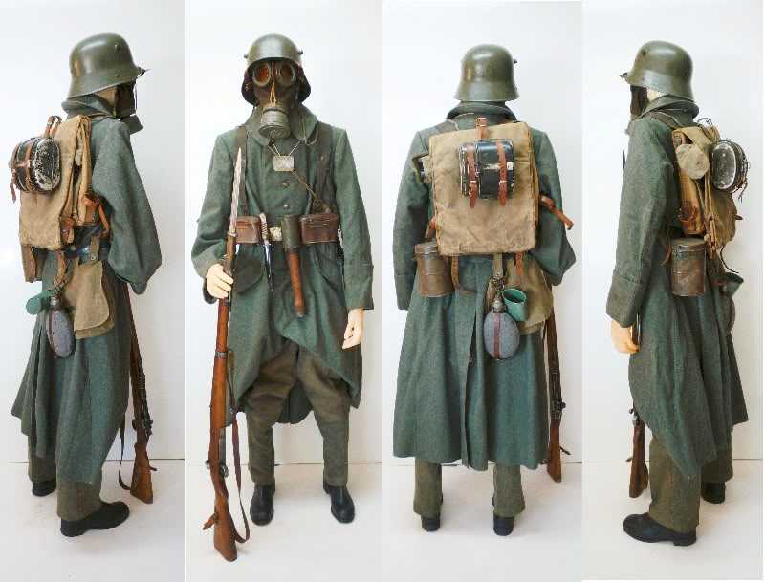
Russian and German Infantry Uniforms

Slide 27
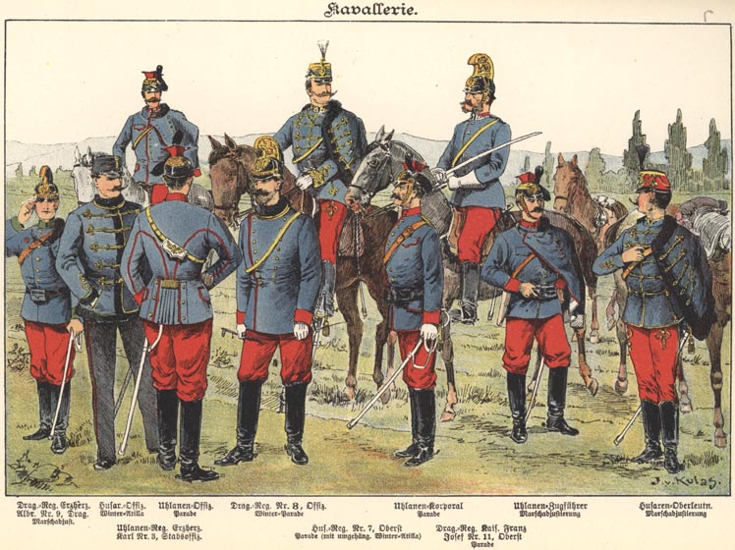
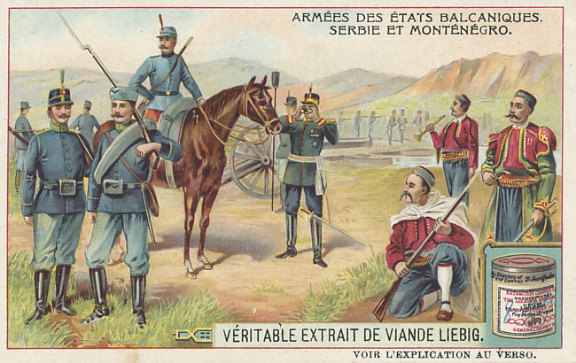
Austria-Hungary Uniforms
Serbian Uniforms

Slide 28
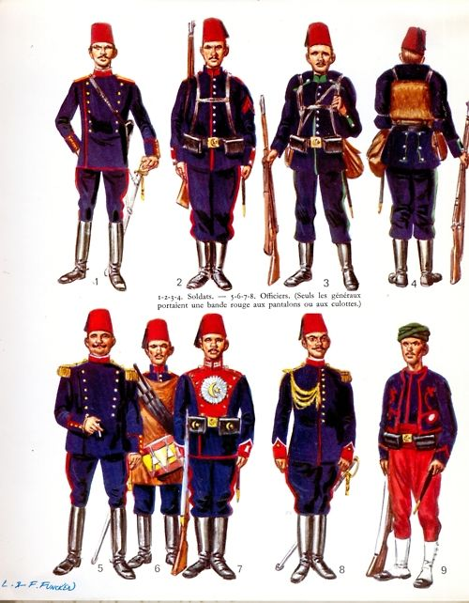
The Ottoman Empire Infantry Uniforms

Slide 29
Russian Military
There were 5,971,000 men in the Russian Army. This was made up of 115 infantry and 38 cavalry divisions.
The Russian Army had 7,100 field guns, 540 field howitzers and 257 heavy guns.
Almost 15 million served in the Russian Army. Casualties totalled an estimated 1.8 million killed, 2.8 million wounded and 2.4 million taken prisoner.

Slide 30
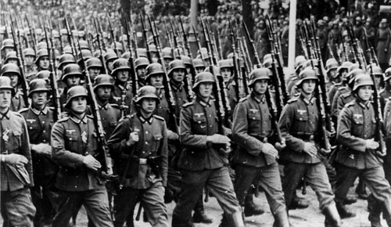
German Military
The German Army placed great emphasis on high quality training and maintaining a large number of experienced senior officers.
By August 1916, about 2.85 soldiers were serving on the Western Front with another 1.7 million on the Eastern Front.
The German Army had suffered an estimated 5 million casualties, including 1.75 dead
After the war the Treaty of Versailles restricted the German Army to 100,000 men.

Slide 31
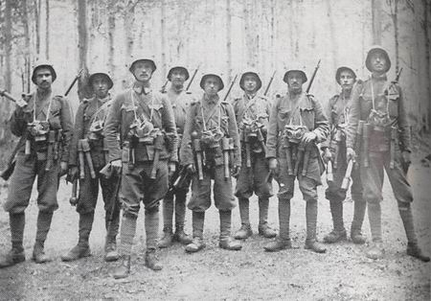
Austria-Hungary Military
The Army was officially under the control of the Commander-in-Chief, Emperor Franz Josef.
At the start of WW1 Austro-Hungary was able to mobilize 2.25 million men.
About 1.54 million men in the Austro-Hungarian army were killed during the war. A further 1.22 million were taken prisoner and about 2 million were wounded during the conflict.

Slide 32
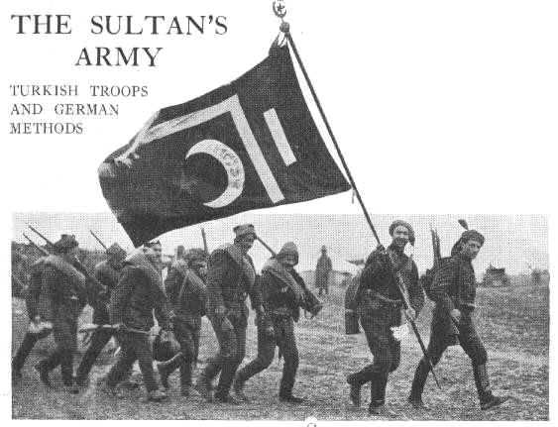
Ottoman Empire Army
36 divisions were organised into three armies. Each division had three battalions, a machine gun detachment and 36 field guns. The full strength was never above 43 divisions.
in July 1914, they signed a defensive alliance with Germany.
The Turkish government did not keep accurate records of its wartime losses so estimates of battle deaths varies from 470,000 to 530,000. Another 770,000 were wounded and another 100,000 probably died from illness.

Slide 33
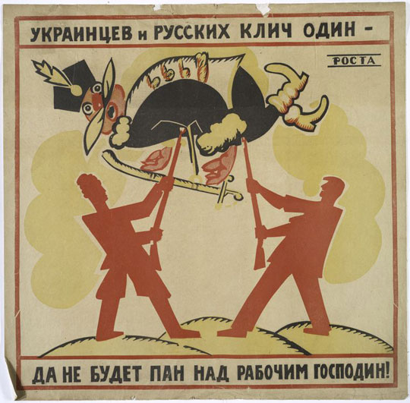
Russian Civil War
By 1917, most Russians had lost faith in the leadership ability of Czar Nicholas II. Government corruption was rampant, and the Russian economy remained backward.the immediate cause of the February Revolution–the first phase of the Russian Revolution of 1917–was Russia’s disastrous involvement in World War I (1914-18). Militarily, imperial Russia was no match for industrialized Germany, and Russian casualties were greater than those sustained by any nation in any previous war.

Slide 34
Russian Civil War II
FEBRUARY REVOLUTION: 1917
The February Revolution (known as such because of Russia’s use of the Julian calendar until February 1918) began on March 8, 1917 (or February 23 on the Julian calendar), when demonstrators clamoring for bread took to the streets in the Russian capital of Petrograd (now called St. Petersburg).the protesters clashed with police but refused to leave the streets. On March 12, the revolution triumphed when regiment after regiment of the Petrograd garrison defected to the cause of the demonstrators. The imperial government was forced to resign, and the Duma formed a provisional government that peacefully vied with the Petrograd Soviet for control of the revolution.

Slide 35
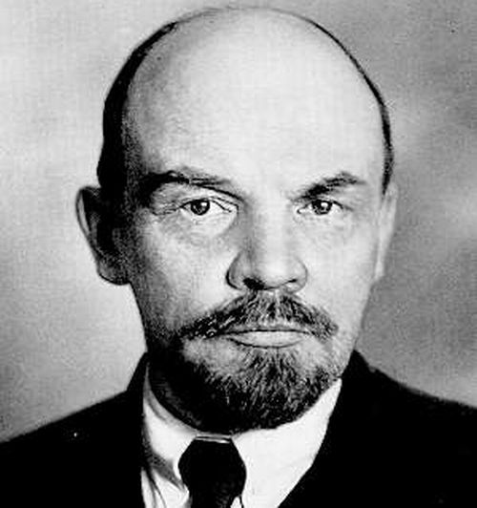
Russian Civil War III
In the aftermath of the February Revolution, power was shared between the weak provisional government and the Petrograd Soviet. Then, on November 6 and 7, 1917. Leftist revolutionaries led by Bolshevik Party leader Vladimir Lenin launched a nearly bloodless coup d’état against the provisional government. The Bolsheviks and their allies occupied government buildings and other strategic locations in Petrograd, and soon formed a new government with Lenin as its head.

Slide 36
Post-Civil War Russia
Lenin became the virtual dictator of the first Marxist state in the world. His government made peace with Germany, nationalized industry and distributed land, but beginning in 1918 had to fight a devastating civil war against anti-Bolshevik White Army forces. In 1920, the anti-Bolsheviks were defeated, and in 1922 the Union of Soviet Socialist Republics (USSR) was established.

Slide 37
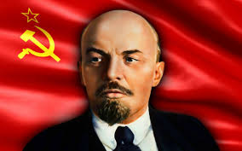
Vladimir Lenin
http://www.biography.com/people/vladimir-lenin-9379007/videos/vladimir-lenin-world-war-i-20879427686

Slide 38
Why is the Eastern front glossed over in history?
Usually when talking about important battles and victories in World War 1 the Western front is typically the first thing that comes to mind. The Eastern front seems to be glossed over because it wasn't involved in the war as long. Russia was the only major power in the Eastern front, and they dropped out of the war because of civil unrest. So the winning countries that remained fighting got to choose which battles were important, and since they were on the western front those battles get all the credit.

Slide 39
Random Facts WW I
rr

Slide 40
Sources
Biography.com
Firstworldwar.com
Greatwar.com
History.com
Historyofwar.org
Richthofen.com
Spartacus-educational.com
World War 1 by Christine Hatt
World War 1 by Frans Coetzee and Marilyn Shevin-Coetzee

