Slide 1
The Role of Government and Health Care
We have already discussed some of the roles of government in the economy such as providing schools, fire departments, police departments, and regulating certain industries. Today we will look at another potential role of government…

Slide 2
Bell-work
Do you think the government should provide everyone with health care? Why or why not?

Slide 3
How does health insurance work?
A premium is the monthly fee that is paid to an insurance company or health plan to provide health coverage, including paying for health-related services such as doctor visits, hospitalizations, and medications.
When someone gets sick their insurance company pays for a portion of their medical bills.
In order for the insurance company to remain profitable they need to take in more in premiums than they spend on health care for their clients.

Slide 4
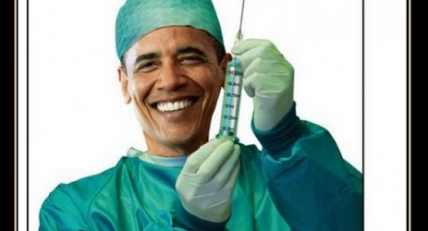
The Affordable Care Act
AKA “Obamacare”

Slide 5
Most people aren’t too informed about this issue…
http://www.youtube.com/watch?v=sx2scvIFGjE

Slide 6
What does the law try to do?
Financially speaking, insurance companies do not have an incentive to provide health care to people who are very sick because there is a higher chance those people could cost the insurance companies more money than they pay with their premiums.
The ACA (Affordable Care Act) tries to provide everyone with health insurance without making the insurance companies lose money.

Slide 7
What are the main aspects of the law?
Young people can stay on their parent’s health insurance until they turn 26.
Insurance companies cannot drop people who are sick.
Insurance companies cannot deny coverage to people with preexisting conditions(people who are already sick)
Companies with more than fifty employees must provide their full time workers with health insurance
Removes “caps”
Example: If someone has cancer and requires long term treatment, insurance companies used to be able to “cap” or limit the amount of money they would pay to treat the person’s disease. Obamacare removes caps as long as patients continue to pay their premiums.

Slide 8
Now if only they could get the website working…

Slide 9
Who do these reforms help/hurt?
Helps
Hurts
Young people can stay on their parent’s health insurance plans
Sick people who want to buy health insurance
Anyone with a long-term health problems
Insurance companies will make less money because they view sick people as a “bad investment” because they cost more money than they pay.
Businesses with over fifty workers may lose money because that have to pay for their employees health insurance.

Slide 10
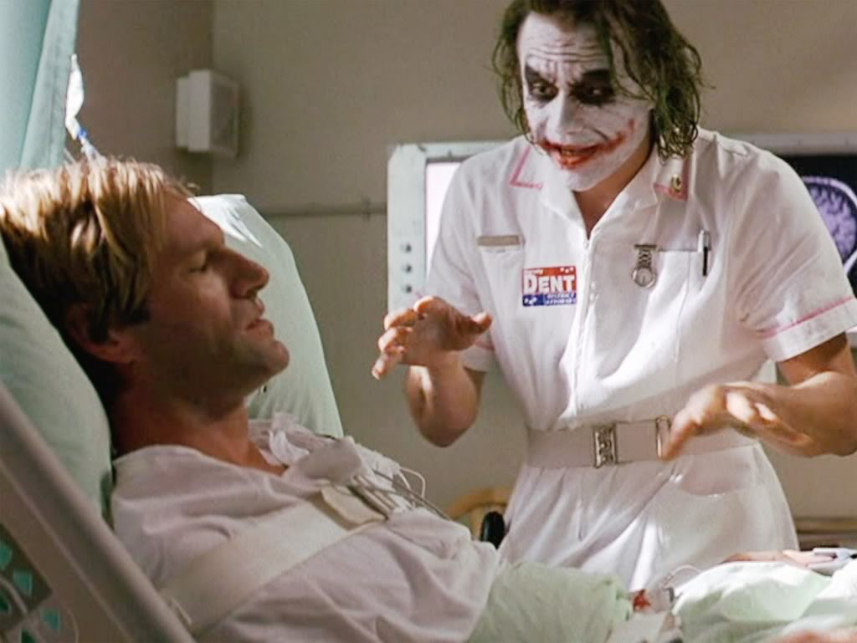
Why so controversial?

Slide 11
Why so controversial?
Because the insurance companies may lose money by having to cover sick people the law also contains a mandate that requires everyone to buy health insurance.
Without the mandate the insurance companies could not remain profitable BUT…
Critics argue that it is not right for the government to force people to buy something

Slide 12
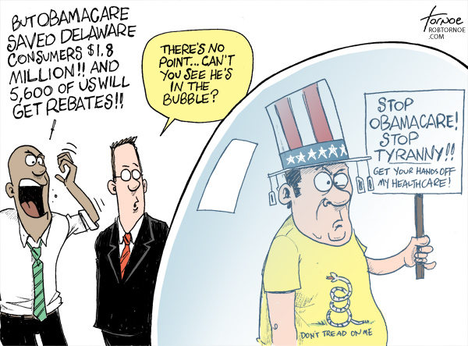
Take a look at the following political cartoon and answer the question.
How does this artist feel about Obamacare? How can you tell?

Slide 13
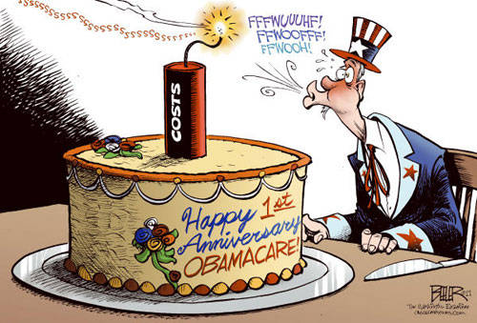
Take a look at the following political cartoon and answer the question
How does this artist feel about Obamacare? How can you tell?

Slide 14
Are there alternatives to the ACA?
Most conservatives favor a free market approach in which the government plays no role whatsoever in health care. Only those who can afford to pay for health insurance should receive health care.
Advocates of free market health care think consumers should be responsible for finding affordable health care for themselves when they need it.
The United States used to use this system before the Affordable Care act was passed.
Many liberals argue for a single-payer health care system in which the government (in place of insurance companies) provides everyone with health care by using tax dollars.
Advocates of single-payer point out that health care is not an “open market” (if you have a heart attack you can’t exactly shop around from hospital to hospital)
This system is used by other countries such as Canada and institutions such as the U.S. military.

Slide 15
Read the following articles…
Free Market
Single-Payer
http://blog.heritage.org/2013/11/12/what-does-a-free-market-in-health-care-look-like-heres-an-example/
http://nhlabornews.com/2013/10/why-we-need-a-single-payer-healthcare-system-over-the-aca/

Slide 16
Which do you think would work best?
Write a paragraph arguing for either the Affordable Care Act, single-payer health care, or free market health care.
Be sure to explain your reasoning.
Give specific examples from the notes and articles you just read to support your opinion.
Identify which principle of taxation is being used for the health care system you support (Benefits-received or ability-to-pay). ←You may need to look back in your notes for this

