Slide 1
Supply & Demand
Unit II

Slide 2
Essential Question: How are prices set ????
Seller ?
Both Buyer and Seller
Buyer?

Slide 3
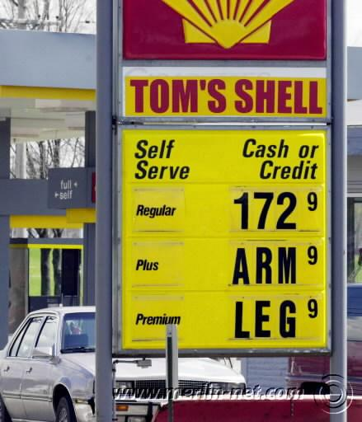

Slide 4
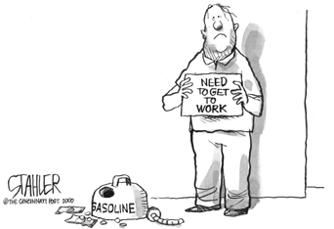

Slide 5
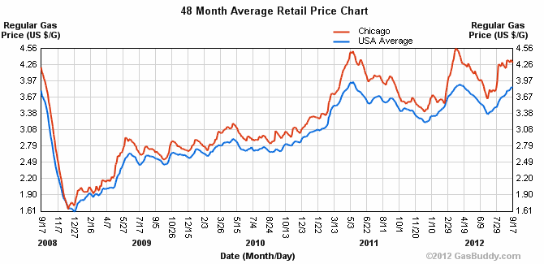

Slide 6
Setting an Economy’s Price System
To understand how a nation’s economy functions it is important to understand the nation’s price system
The forces that determine price are called the forces of supply and demand
The place where these two forces meet is called the marketplace

Slide 7
Marketplace
Marketplace is a mechanism that brings together buyers and sellers of a particular good and service to establish a market or retail price
Stock market sets stock prices
NASDAQ is an “electronic” marketplace
Commodities market sets price of corn, wheat, etc.

Slide 8
Demand
Demand is a schedule which shows the various amounts of a product that consumers are willing and able to buy at each price during a specified time period.
e.g. Swimming suits have a different price and quantity demanded in summer vs. winter

Slide 9
Law of Demand
Law of Demand says that as the price of an item decreases, the quantity demanded will increase; and, as the price of an item increases, the quantity demanded will decrease
The quantity demanded varies inversely with the price

Slide 10
Demand Curve
Demand Curve is a line graph that shows the amount of a product that will be purchased at each price; it shows an inverse relationship and is always downsloping
D
Qd

Slide 11
Remember:
A change along the curve indicates a change in price and a change in quantity demanded
A change of the curve (right or left) indicates an across the board change in demand

Slide 12
Aggregate (Market) Demand
What events would increase or decrease the aggregate or market demand for goods and services “across the board”
At every price range – generic Wal-Mart brand ice cream to Ben and Jerry’s premium brand !

Slide 13
1. Seasonality
More lemonade will be demanded
More bathing suits will be demanded
More sun tan lotion will be demanded

Slide 14
2. Trends
Advertising creates trends
Gap
Everybody in vests!
Everybody in leather
Everybody in stripes
Some advertising can decrease demand
SUV = Terrorism

Slide 15
3. Change in Income
A raise in income will increase demand for superior goods ( Rolex) and decrease demand for inferior goods ( Timex watch)
Conversely, a decrease in income will increase demand for inferior goods ( Timex) and decrease demand for superior goods ( Rolex)

Slide 16
4. Expectations
If the Farmer’s Almanac forecasts a cold winter people may demand more snow tires and rock salt

Slide 17
5. Price of Related Goods
Substitute Goods
A rise in the price of one
(e.g. butter) may increase the demand for the substitute ( margarine)
This is a direct relationship
Complementary Goods
An increase in the price of one good ( e.g cameras) will decrease the demand for the complementary good (film/memory cards).
This is an inverse relationship

Slide 18
6. Demographics
Number and Kinds of Buyers in the Market can change demand
Baby Boomers are getting ready to retires
Increased Demand for:
More housing in Florida and Arizona
Assisted Living Complexes
Walkers
Wheelchairs

Slide 19
Elasticity of Demand
Elasticity of Demand describes the percentage change in quantity demanded that follows a price change

Slide 20
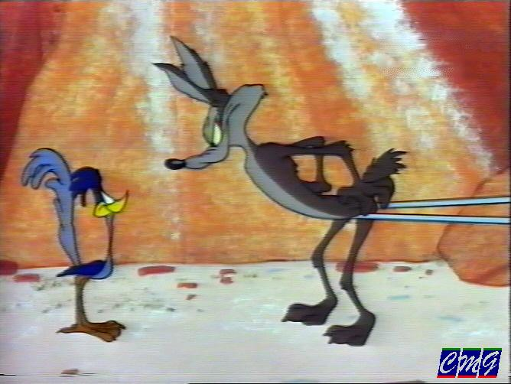
Elasticity of Demand
Demand is elastic if a rise in price results in a large drop in demand and demand is inelastic if a rise in price results in a relatively small or no drop in demand

Slide 21
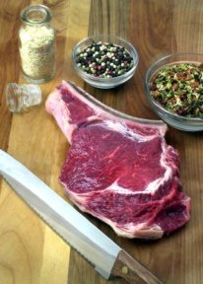
Steak: Elastic or Inelastic ?
Elastic
Why? People as a whole can do without steak and will substitute chicken or other protein for expensive steak

Slide 22
Milk: Elastic or Inelastic ?
Inelastic
Why?
The population as a whole can do without steak….but can not do as easily without milk…especially families with children

Slide 23
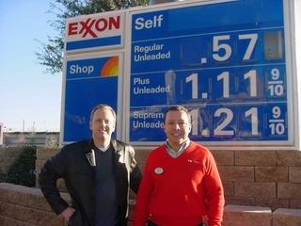
Gasoline: Elastic or Inelastic ?

Slide 24
What Products are Subject to Elastic Demand ?
Luxury Items – Most customers want luxuries and will consider buying them if price drops
If Price Represents a Large Portion of Family Income
e.g. Mortgage Rates drop from 6.5 to 5.5% people will “refinance”
Availability of Substitute Items
e.g. Steak /chicken
Durable Goods
Computers, cars, washers, dryers will be in greater demand if the price drops

Slide 25
Perfectly Elastic Demand Curve
Refers to a situation where a small or very small price reduction causes buyers to increase purchases from 0 to all they can get
E.g. Foreign currency ( FX Market)
Miniscule changes in currency exchange rate would prompt FX brokers to buy (or sell !) large amounts of money
Price
$20
$15
$10
$5
$0
Qd
0
2
4
6
8
10
Quantity Demanded

Slide 26
What Products are Subject to “Inelastic Demand”?
Necessities (milk, gasoline)
Drugs
Legal (heart medicine antibiotics)
Illegal (heroin, cocaine)
Products with no good substitute
insulin, cancer drugs, etc.
salt in Middle Ages (preservative)

Slide 27
Perfectly Inelastic Demand Curve
Price
Refers to a situation where no change takes place in Quantity demanded as a result of a change in price
Examples:
Diabetic – insulin
Addict - heroin
$20
$15
$10
$5
0
Qd
0
2
4
6
8
10
Quantity Demanded of Insulin

Slide 28
Elastic ? Inelastic?
Formula for Elasticity = % of Change in Qd
% of Change in Price
1) 60-48 = 12 = .2 X 100 = 20
60 60
2) $10- $11 = -.1 X100 = 10
$10
3) % Change in Qd 20 = 2
% Change in Price 10
4) 2 > 1 Change is Elastic

Slide 29
Q. Any other Way to Determine Elasticity of Demand ?
A. Total Revenue !
P X Q = TR
Old Price $ 40 X 33,781 = $1,354,840
New Price $ 50 = $ 1,250,000
How many fans showed up?
$1,250,000 / $ 50 = 25,000 fans showed up
Q. Was demand elastic or inelastic ?
Elastic ! If all the fans had showed up, the TR would have been $1,693,550 !
What could determine elasticity for Red Sox ?

Slide 30
Why is Elasticity of Demand Important ?
What happens if a florist increases the price of roses 400 % in October ? Will sales go up or down ?
A. Probably, down
What happens if a florist increases the price of roses on February 14th? Will sales go down or up?
A. Probably up ( OTBE !) Why ? Frantic husbands and boyfriends will pay exorbitant prices for a dozen roses on Valentine’s Day – if they know what’s good for them ! !

Slide 31
Supply
Supply is a schedule which shows the amounts of a good or service a producer is willing and able to make available at each price during a specified time period
Law of Supply states that the quantity of a commodity supplied varies directly with its price: the number of goods and services offered for sale increases as the price increases.

Slide 32
Supply Curve
Supply Curve will always be upsloping.
S

Slide 33
Equilibrium Price
Equilibrium Price (also called the Market price) is the price at which goods and services may actually be bought and sold.
Equilibrium Price is where quantity demanded is equal to the quantity supplied

Slide 34
Equilibrium Price
S
E P
D

Slide 35
Remember………..
A change along the curve indicates a change in price and a change in quantity supplied
A change of the curve (right or left) indicates an across the board change in supply

Slide 36
..and they are called “Determinants of Aggregate Supply”
Just as there are events that can cause demand “across the board” -at every price level to change….there are also events that can cause supply “across the board”- at every price level- to change !

Slide 37
Determinants of Supply
What could cause a huge increase or decrease in supply across the board ( and a change in price is not a factor !)
Resource prices ( raw materials)
Technology (produce more products faster & more efficiently
Taxes
Subsidies ( Gov’t grants)
Related Goods ( e.g corn, wheat)
Expectations
Number of Sellers in the Market

Slide 38
How much coffee can you drink ?
One cup, two, three, four ?
How does Dunkin Donuts get you to buy more coffee after lunch ?

Slide 39
They offer you a deal…buy a large coffee, get a free muffin or donut
Dunkin Donuts knows ALL about the Principle of Diminishing Marginal Utility !!!

Slide 40
Principle of Marginal Utility
Utility is the measure of satisfaction that one gets from the use of a good or service
Marginal Utility is the degree of satisfaction a consumer gets from each additional purchase of a product ( marginal in economics means “additional”)
Principle of Diminishing Marginal Utility explains spending patterns of customers and states that each additional purchase of a product or service by a given customer will be less satisfying than the previous purchase

Slide 41
Elasticity of Supply
Like Demand, Supply is subject to elasticity
If a change in price produces only a small change in supply, it is said to be inelastic
What goods are subject to supply elasticity?
Manufactured goods are more subject to elasticity of supply than goods produced by nature
Skateboard manufacturers can get employees to produce more skateboards, but farmers can’t force cows to produce more milk or trees to grow faster

Slide 42
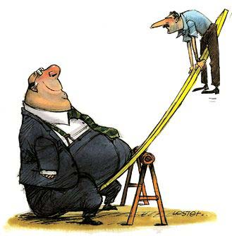
Market Disequilibrium
Price Ceilings and Price Floors cause market disequilibrium because they disrupt the natural dynamics of the marketplace (supply and demand)

Slide 43
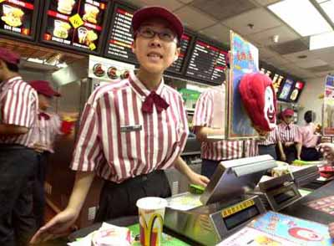
Price Floors:
Price floor are prices below which it is illegal to buy or sell.
Federal Min Wage = $7.25/hr
IL State Min Wage= $8.25/hr
Dilemma: Some argue that minimum wage laws disrupt the equilibrium in the market and actually increase unemployment
Why? left to the forces of supply and demand more workers would be hired at LOWER wages, decreasing unemployment.
McDonald’s Worker and other fast food workers generally earn minimum wage

Slide 44
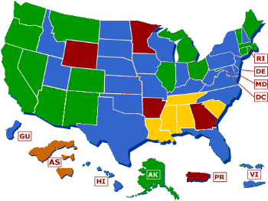
Minimum Wage by U.S. stateMinimum Wage by U.S. state and U.S. territoryMinimum Wage by U.S. state and U.S. territory (American SamoaMinimum Wage by U.S. state and U.S. territory (American Samoa, GuamMinimum Wage by U.S. state and U.S. territory (American Samoa, Guam, Puerto RicoMinimum Wage by U.S. state and U.S. territory (American Samoa, Guam, Puerto Rico, Virgin Islands), as of Jan. 1, 2012.
States with minimum wage rates higher than the Federal rate
States and territories with minimum wage rates the same as the Federal rate
States with no state minimum wage law
States and territories with minimum wage rates lower than the Federal rate
Territory with varied minimum wage rates lower than the Federal rate

Slide 45
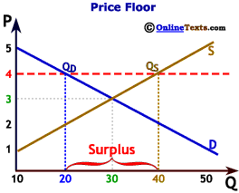

Slide 46
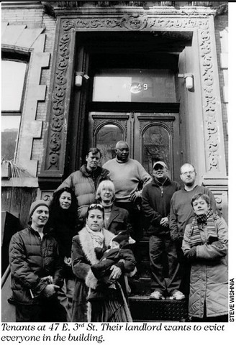
Price Ceilings:
Prices above which it is illegal to buy or sell
Examples:
Rent controlled apartment buildings in cities
Certain goods and services during emergencies.
Dilemma: Since rents are frozen, many landlords cannot keep up with the rising costs of maintenance – which have not been frozen !
They stand in the way of market forces of supply and demand

Slide 47
