Slide 1
Research Methods
The goal of sociological research is to test “common sense” assumptions and replace false ideas with facts and evidence.
Sociologists ask “why” and “how” questions to form hypotheses to arrive at accurate understandings.

Slide 2
Survey Research
Survey: A research method in which people respond to questions
Population: a group of people with certain specified characteristics
Sample: A group of people that represents a larger population
Representative Sample: A sample that accurately reflects the characteristic of the population as a whole

Slide 3
Survey Research
Questionnaire: A written set of questions to be answered by a research participant.
Interview: A survey method in which a trained researcher asks questions and records the answers
Close-ended questions: Questions a person musts answer by choosing from a limited predetermined set of responses
Open-ended questions: questions a person is to answer in his or her own words
Secondary Analysis: Using precollected information for data collection and research purposes.

Slide 4
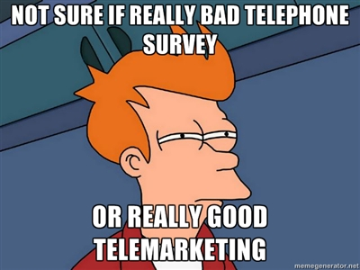
Problems with Surveys
When surveys are voluntary, only people with strong opinions may respond
Example: Voting
Leading questions may skew results
Examples
If you ask your sample, “how tall do you think this building is?” you will get higher responses than if you asked, “how short do you think this building is?”
“Do you think the United States should implement tighter gun-control policies, like those used in Nazi Germany?”

Slide 5
Types Research
Field Research: Research that takes place in a natural setting.
Case Study: Intensive study of a single group, incident, or community.
Participant Observation: A case study where the researcher becomes a member of the group being studied

Slide 6
Causation
Causation: The belief that events occur in predictable ways and that one event leads to another.
Multiple Causation: The belief that an event occurs as a result of several factors working in combination.

Slide 7
Standards for Showing Causation
Correlation: A measure of the relationship between two variables.
CORRELATION DOES NOT NECISSARILY MEAN CAUSATION
If you ate ice cream the night before the test and did poorly, that does not necessarily mean that ice cream caused you to fail

Slide 8
Variables and Correlations
Variable: A characteristic that is subject to change.
Quantitative Variable: A characteristic that can be measured numerically
Qualitative Variable: A characteristic that is defined by its presence or absence in a category (Yes no questions)
Independent Variable: A characteristic that causes something to occur
Dependent Variable: A characteristic that reflects change
Example: If you wanted to see how the amount of time studying affected test scores
Time studying would be the independent variable
Test Scores would be the dependent variable
Intervening Variable: A variable that changes the relationship between an independent and dependent variable

Slide 9
Steps for Doing Research
Identify problem
Review literature
Formulate hypothesis
Develop a research design
Collect data
Analyze data
State findings and conclusions

Slide 10
Let’s look at example
https://www.youtube.com/watch?v=FnT2FcuZaYI

Slide 11
Questions to ponder…
Why did having a partner change the subject’s behavior?
Why did the subject believe that having a partner did NOT influence their behavior?
Why did subjects not conform when given the option to write down their answers?

Slide 12
Conformity
Behavior that matches group expectations
Two types of conformity
Informational: Going along with the group because we believe they are right
Normative: Going along with the group because we are apprehensive that the group will disapprove if we are deviant

Slide 13
Conformity
Coercion: Social interaction in which individuals or groups are forced to give in to the will of other individuals or groups
Groupthink: Self-deceptive thinking that is based on conformity to group beliefs, and created by group pressure to conform.

Slide 14
Ethics
Where do we draw the line when it comes to research?
Is it okay to study a group of people without their consent?
Should you publish the names of the people you are studying?
Remember that people are not lab rats.
Should we ever cause physical or psychological harm when conducting research?
Participant observation research often raises ethical questions. Why do you think this is?

