Slide 1
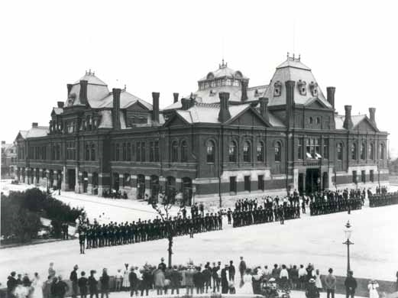
1894 Pullman Strike
Madelyn Smith

Slide 2
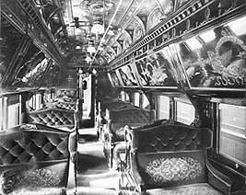
Parties involved
The American Railway Union (ARU)
Industrial union- labor union in which all workers in the same industry participate
465 local unions with 150,000 workers
Eugene Debs
Pullman Company and gov’t
v.
Made and operated railroad cars
Sleeping car
George Pullman
President Grover Cleveland

Slide 3
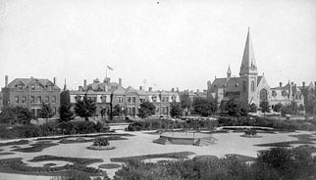
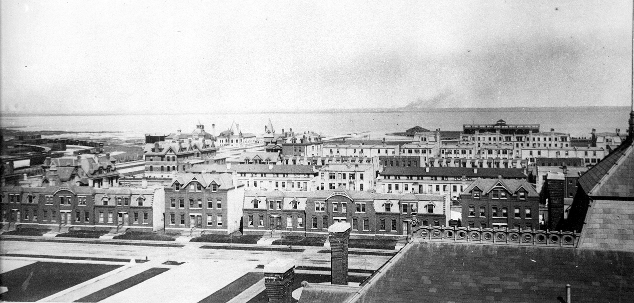
Historical Context- 1894
Company towns- remote areas where stores and housing are owned by one company whose workers are the residents
Southside of Chicago
Model town
Pullman attracted African-Americans and women to work for his company through advertisements

Slide 4
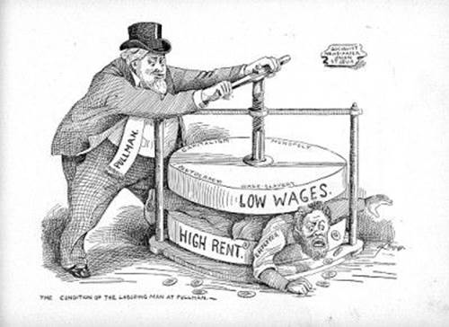
Revenue dropped
Workers united over their frustration with lack of democracy in Pullman:
Workers laid off
Lower wages
Workers could only rent, not buy houses
High water and gas rates
May 7, 1894: Workers formed a committee to ask for lower rent
May 10, 1894: When rejected, they began their strike
May 11, 1894: Pullman plant closed
Political cartoon conveying workers’ frustrations

Slide 5
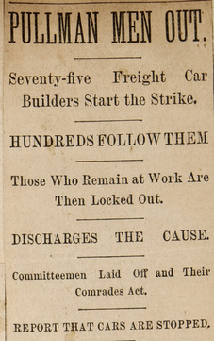
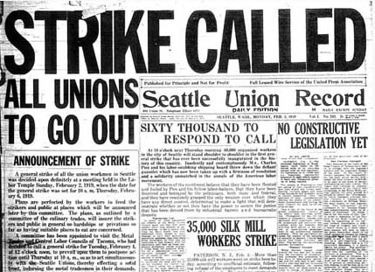
Methods of Resistance
At first, peacefully picket
June 26: After no change, ARU stopped handling Pullman cars
Affected most rails west of Detroit

Slide 6
How Management Tried to Stop Them
Federal injunction: judicial order restraining a person from beginning or continuing an action threatening or invading the legal right of another
issued against ARU leaders from communicating with workers
President Grover sent in federal troops, despite Illinois’ governor’s protests

Slide 7
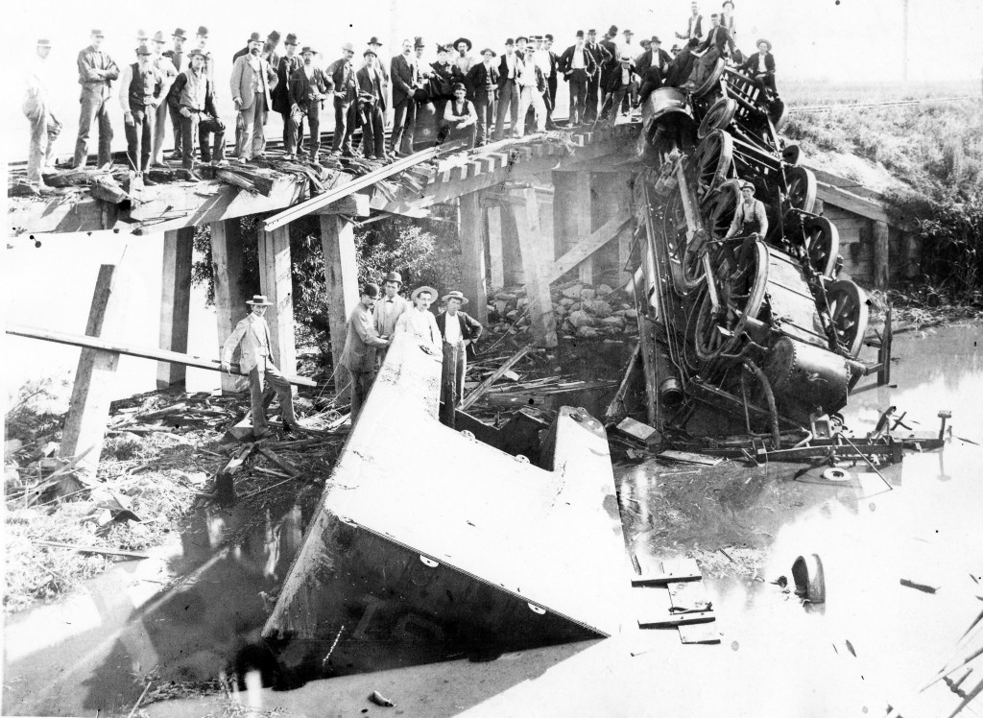
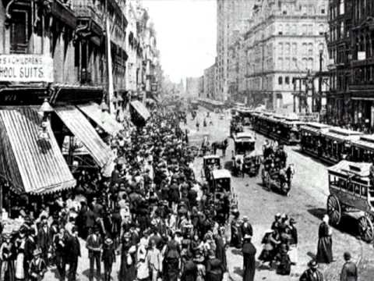
Violent
Federal troops outraged strikers
July 4: fireworks and tipping over rail cars
Built blockades
Riots
7 buildings burned in a fire
30 people killed

Slide 8
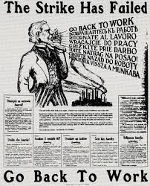
Outcome
Strikes weakened and eventually ended
Violence
American Federation of Labor (AFL) did not support it
Workers did not get rent lowered
Railroads lost $4,600,000 in revenue
Illinois courts ruled company town land to be annexed to city
Debs and three others convicted of violating their indictment

Slide 9
Public and Media Response
Opposition to strike/supported Cleveland, specifically Rep.
Train schedules were interrupted
However, Governor of Illinois (D.) objected to federal intervention
AFL opposed it
Churches denounced boycott
Tea party, rebellion
Media coverage negative:
Mobs, “foreign trash”
Defiance of law
"...surely the facts have not been correctly presented to you in this case, or you would not have taken the step, for it seems to me, unjustifiable. […] Illinois is not only able to take care of itself, but it stands ready to furnish the Federal Government any assistance it may need else where..." (Altgeld pp. 656)
“Wild Demands of Pullman Men”
-Chicago Tribune

Slide 10
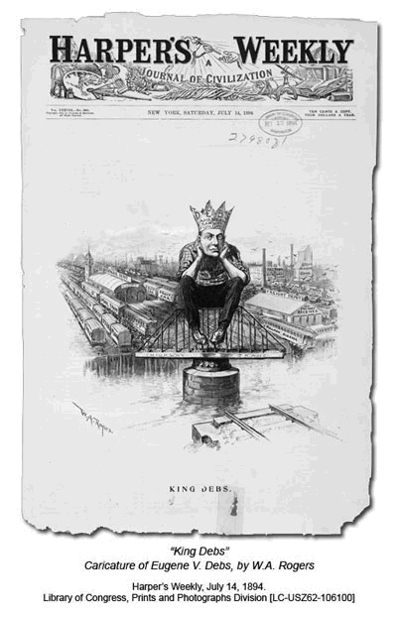
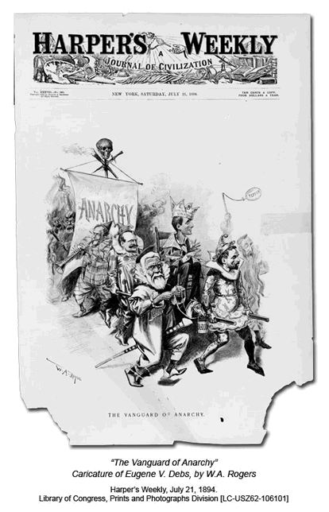

Slide 11
Event Viewed Today
Largest and most influential labor dispute
Set in motion more workers’ rights
Myth that Chicagoans would desecrate Pullman’s body because Pullman now viewed as hostile
https://www.youtube.com/watch?v=8MlIVH1DiZY
8:07-8:38

Slide 12
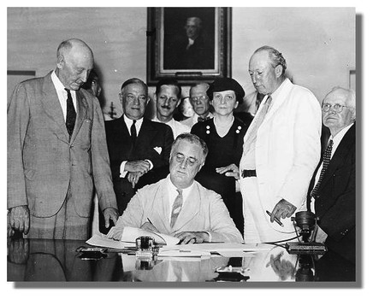
Historical Significance
First time an indictment prevented a strike
Federal troops
Magnitude of unions across nation demonstrated need for workers’ rights
1935 Wagner Act: bill passed under Roosevelt establishing the National Labor Relations Board that protected workers’ rights
organize labor unions
collective bargaining
Strikes
Cleveland designated Labor Day a federal holiday to mend relations with unions

Slide 13
Works Cited
Works Cited
"History of the Federal Judiciary." History of the Federal Judiciary. N.p., n.d. Web. 06 Apr. 2016.
Lawrence. "THE PULLMAN STRIKE." Pullman Strike, Chicago, 1894. N.p., 03 Nov. 2009. Web. 06 Apr. 2016.

