Slide 1
Politics
Politics=Power
(Anyone who tells you otherwise is trying to sell you something)

Slide 2
The Political Spectrum
Range of political philosophies
VERY difficult to classify
Based on ideas of personal freedom, economic philosophy, and foreign policy
Left=Liberal
Middle=Moderate
Right=Conservative
Also affected by
Social Class
Race
Gender
Some spectrums focus on individual liberty, others focus on social stratification and existing hierarchy.

Slide 3
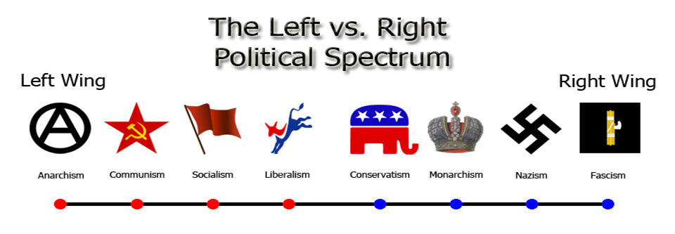
Political Spectrum

Slide 4
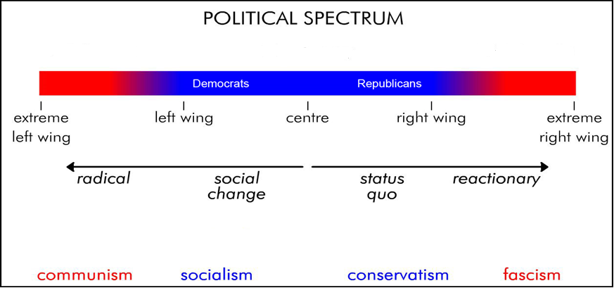
Political Spectrum

Slide 5
Definitions…well sort of
Radical: Seeks systemic social change
Liberal: Progressive change through existing social system
Moderate: Combination of liberal and conservative ideas
Conservative: Maintains existing status quo
Reactionary: Pushes back against social change

Slide 6
How would you classify these people on the political spectrum?
Remember, the spectrum is not absolute, you need to consider the context of the time they lived in…

Slide 7
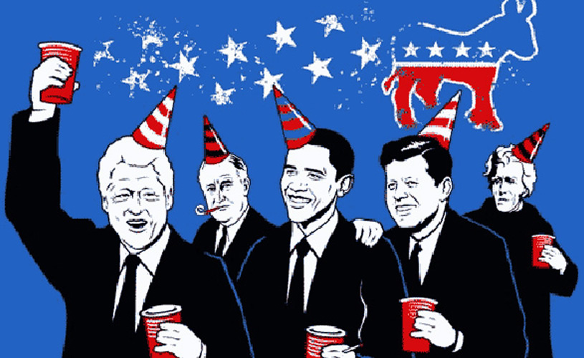

Slide 8
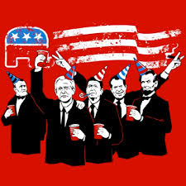

Slide 9
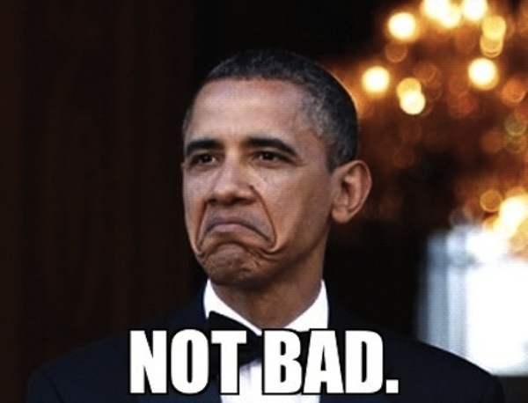

Slide 10
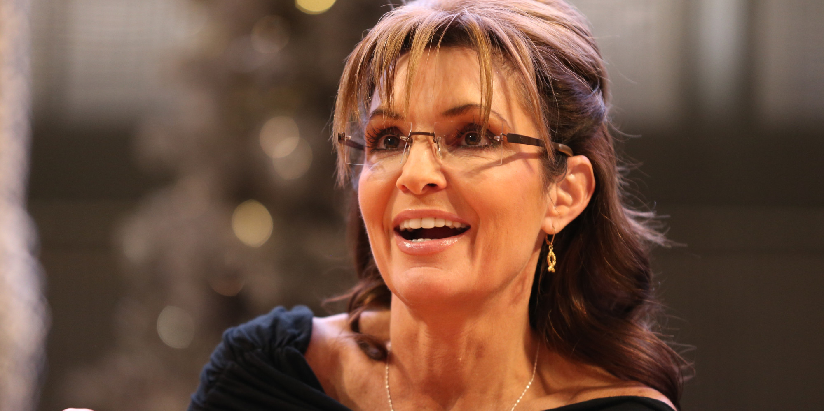

Slide 11
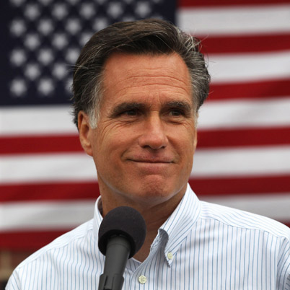

Slide 12
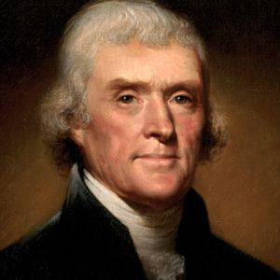

Slide 13
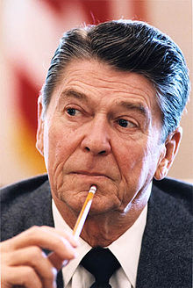

Slide 14
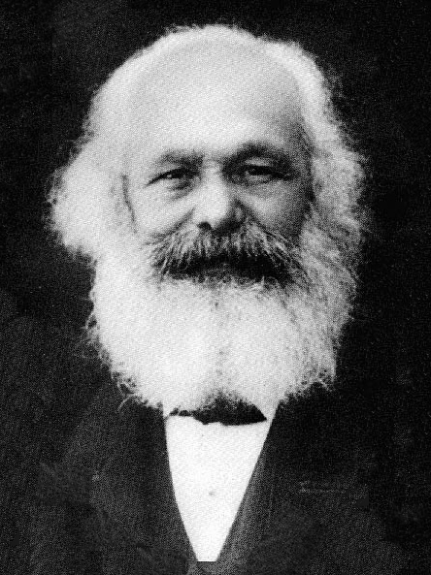

Slide 15
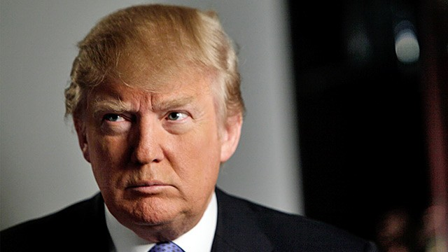

Slide 16
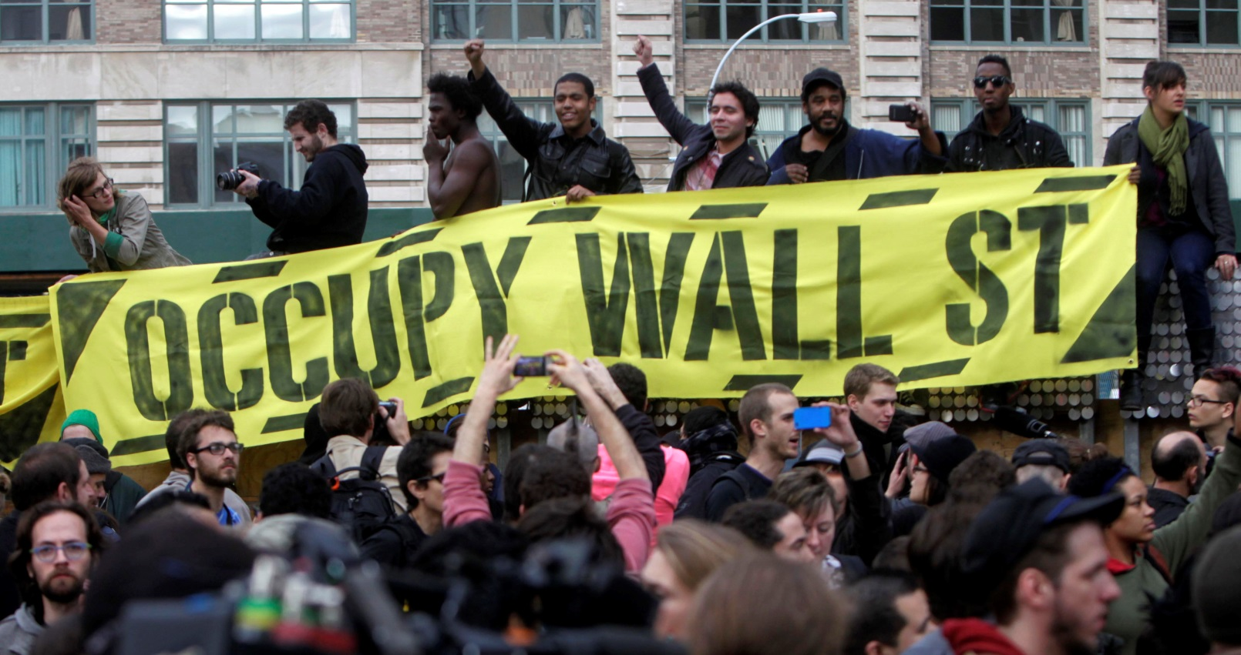

Slide 17
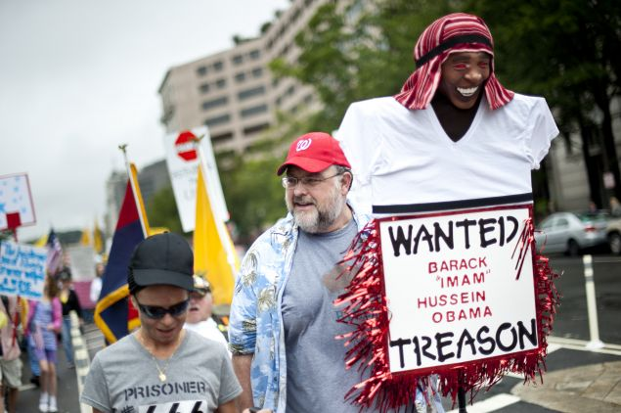

Slide 18
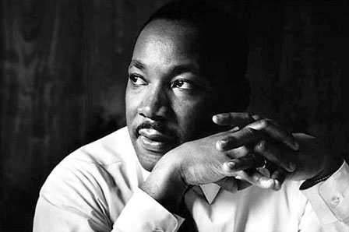

Slide 19
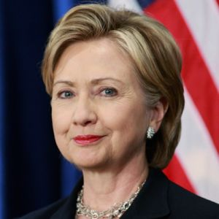

Slide 20
Political Parties
Group of persons who seek to control government through the winning of elections and holding public office
United States has a two-party system

Slide 21
Democratic Party
Liberal Party
Highest support among women, minorities, labor unions, and young people
Made up of
Moderates
Liberals
Democratic Socialists

Slide 22
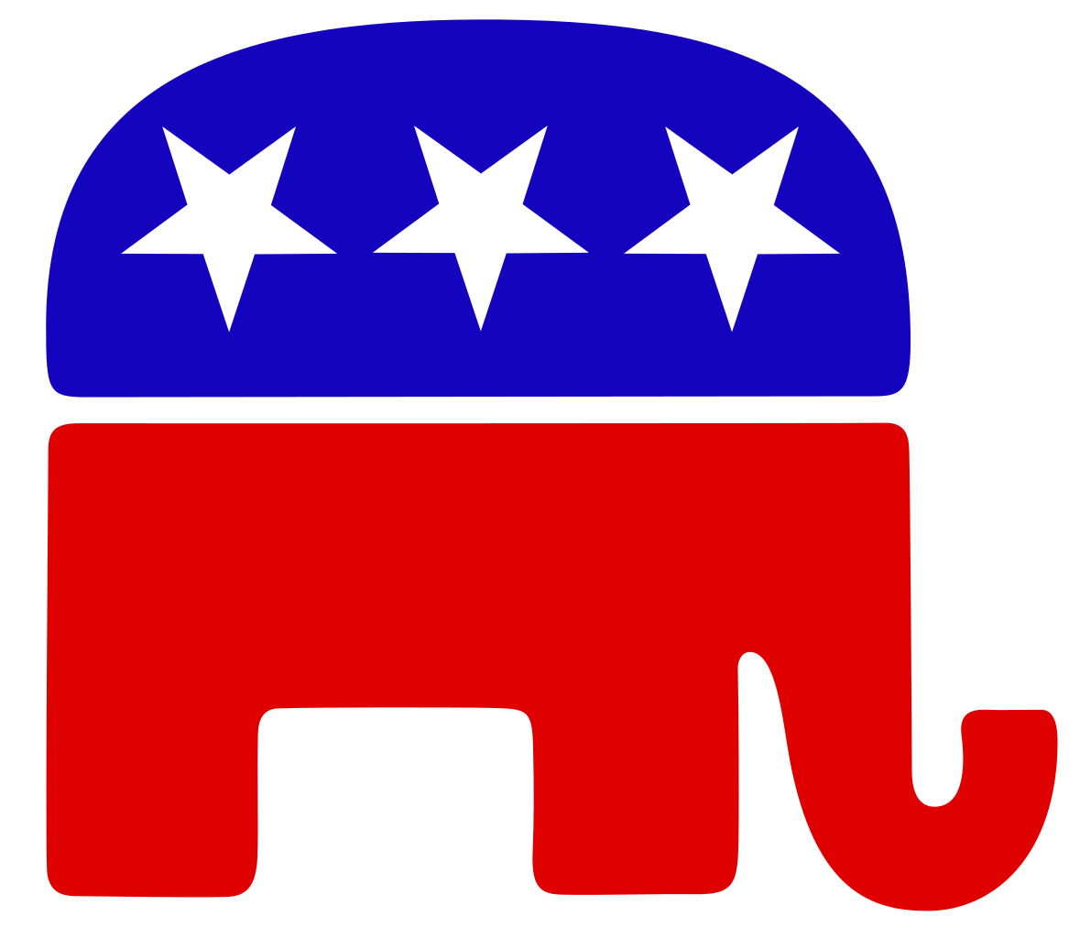
Republican Party
Conservative Party
Highest support from white, male, corporations, and older voters
Made up of
“The Establishment”
Evangelicals
Neo-Conservatives
Libertarians
Tea Party

Slide 23
Third Parties
Rarely win at national level
Currently there are two independent senators
Ideological Parties
Based on a broad set of beliefs
Single-Issue Parties
Focus on just one public-policy matter. Often single issue candidates will run just to force the major parties to address their issue
Economic Protest Parties
Discontent with struggling economy. Often feel that major parties do not represent their interests. Usually target banking system, foreign trade, railroads, ect.
Splinter Parties
Break away from major parties because candidate did not get nomination
Ex. Henry Wallace- “Dixiecrats”
Teddy Roosevelt- BullMoose
…Donald Trump?

Slide 24
Media and Politics
What is the purpose of TV, news, and internet?

Slide 25
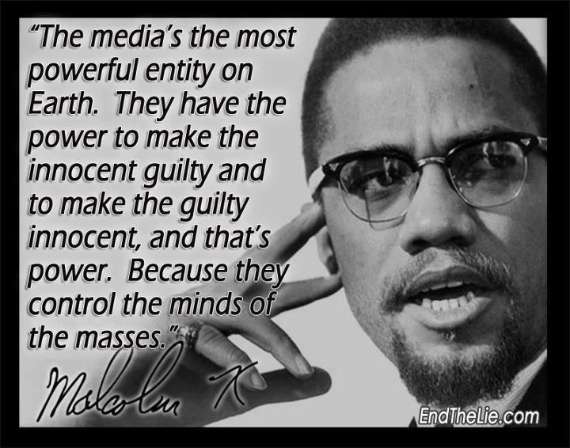

Slide 26
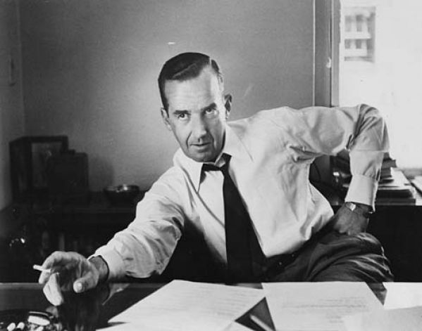
Ed Murrow
CBS News Anchor
Helped bring an end to the “Red Scare”
https://www.youtube.com/watch?v=FQQaX2h1plo
Felt it was the media’s duty to educate and inform citizens
Separation of “church and state”
“A nation of sheep will beget a government of wolves.”

Slide 27
Media Bias
Objectivity: Reporting that is NOT affected by bias and personal feelings
Subjectivity: Reporting that IS affected by bias and personal feelings
Is it really possible to be objective?
The media’s coverage of certain events depends on their political leanings.
http://thedailyshow.cc.com/videos/vvq88q/inauguration-2013---the-first-black-president-2---guns-and-god

Slide 28
Media Bias
Sensationalism: Certain aspects of a story are overhyped to manipulate the truth in order to boost ratings.
https://www.youtube.com/watch?v=cXc5fn6b9RI
Witch Hunt: When the media targets a person or group of people using fear or anger to boost ratings.
False Equivalency: When two sides of an issue are presented with equal treatment, even though they are not equally valid.
Horse-race coverage: Focuses on winners and losers rather than issues or policy

Slide 29
Political Campaigns
Political Campaign: Organized effort to win an election for public office.
Propaganda: Communication aimed at convincing others of particular idea or position
Tricks of the Trade: Strategies or methods employed for a particular purpose
Slogans: Catchy phrases conveying the goals of campaign
Endorsements: Statements of support
Testimonials: Statements about a person’s or idea’s worth

Slide 30
Interest Groups
Group of people with common goals who organize to influence government.
Examples: Business groups, labor unions, agricultural groups, environmental groups, professional associations ect.
Lobbyist: Interest group representative who makes direct contact with government officials to support the policies their interest group favors.

Slide 31
Funding Campaigns
Political Action Committees: Organizations specifically designed to collect money and provide financial support for a political candidate.
Citizens United: Supreme Court ruling giving personhood to corporations and unions. Anonymous political donations=protected speech.
Super PACs
independent political committees that support a candidate with unlimited, often anonymous, donations from companies, unions, or individuals. The groups can't contribute directly to a candidate, but they can run favorable ads about a candidate—or negative ones about their favored candidate's opponent.

Slide 32
Registering to Vote
To vote In Illinois:
You must be a United States Citizen.
You must be 17 years old on or before the date of the Primary Election and turn 18 on or before the date of the General Election (Nov 8).
You must live in your election precinct at least 30 days prior to Election Day.
Not be convicted and in jail.
Not claim the right to vote anywhere else.
https://ova.elections.il.gov/

Slide 33
https://www.youtube.com/watch?v=zLfFKJFV0Yc

Slide 34
Colbert PAC
http://www.cc.com/video-clips/pfzzi1/the-colbert-report-viacom-ruins-stephen-s-pac-dream

Slide 35
Colbert Super PAC
http://www.cc.com/video-clips/dtl1ew/the-colbert-report-colbert-pac---trevor-potter

Slide 36
Corps Constituency
http://www.cc.com/video-clips/1ssaiz/the-colbert-report-corp-constituency

Slide 37
Corps Constituency
http://www.cc.com/video-clips/nfv0i1/the-colbert-report-corp-constituency---trevor-potter

Slide 38
Personal Use
http://www.cc.com/video-clips/fgthom/the-colbert-report-sarah-palin-s-bus-tour

Slide 39
FEC Questions
http://www.cc.com/video-clips/bmwaxh/the-colbert-report-fec-questions---trevor-potter

