Slide 1
Competition and Monopolies

Slide 2
Perfect Competition
Competition happens when two or more companies strive against each other to convince consumers to buy their products or services
This benefits consumers in two ways
Provides us with choices
Drives down prices

Slide 3
Market Structure and Perfect Competition
Market Structure: The extent to which competition prevails in particular markets
Perfect Competition: Market situation in which there are numerous buyers and sellers, and no single buyer or seller can affect price.

Slide 4
Conditions for Perfect Competition
Large Market: Numerous buyers and sellers must exist for the product
Nearly Identical Product: The goods or services being sold must be nearly the same
Easy Entry and Exit: Sellers already in the market cannot prevent competition, or entrance into the market. In addition, the initial costs of investment are small, and the good or service is easy to learn to produce
Easily Obtainable Information: Information about prices, quality, and sources of supply is easy for both buyers and sellers to obtain
Independence: The possibility of sellers or buyers working together to control the price is almost nonexistent.

Slide 5
No Control Over Price
When there is perfect competition, the producers have no control over price because attempting to raise the price would cause consumers to buy elsewhere.
Perfect Competition=Market Equilibrium

Slide 6
Monopoly
A market situation in which a single supplier makes up an entire industry for a good or service with no close substitutes
Characteristics
A single seller
No substitutes
Barriers to entry
Almost complete control of market price

Slide 7
Types of Monopolies
Natural Monopolies
Government grants exclusive rights to companies that provide things like utilities.
Economies of Scale: Low production costs resulting from large size of output
Geographic Monopoly
Business exists in an area with little competition
Technological Monopoly
A new invention that is protected by patent or copyright
Government Monopoly
Government exclusively produces good or service. Example: Roads, bridges, fire departments, ect.

Slide 8
Oligopoly
Industry dominated by few suppliers who exercise some control over price.
Examples: Airlines, vehicles, cereal
Engage in product differentiation
Nonprice competition
Is price the only thing you consider when buying a car?
Interdependent Behavior

Slide 9
Monopolistic Competition
Market situation in which a large number of sellers offer similar but slightly different products and in which each has some control over price
Characteristics
Numerous sellers
Relatively easy entry
Differentiated products
Some control over price

Slide 10
Monopsonies

Slide 11
Monopsonies
Monopsony: Market structure in which one buyer faces many sellers.
Usually occurs in labor markets when there is one company paying for all the labor in one area or when there is only one employer for that specific skill set
Examples: company towns, sweat-shops, wal-mart, school districts, single payer health care systems
Workers face the decision of working for that company or not working at all
Who has all the power in this relationship?

Slide 12
Dangers of Competition
When competition is especially excessive and concentrated on financial concerns above all else it can cause problems.
Race to the Bottom: A situation in which companies attempt to lower costs by offering lower wages or poorer working conditions
Governments also fall into this trap when they compete with one another to offer lower taxes or lower environmental regulations.
The Prisoner’s Dilemma: a situation in which two players each have two options whose outcome depends crucially on the simultaneous choice made by the other

Slide 13
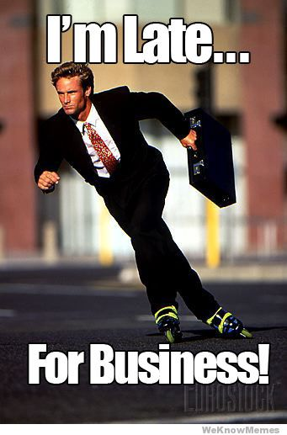
Business Organizations
Entrepreneur: Person who organizes, manages, and assumes the risks of a business in order to gain profits
Starting any business involves risk
“You have to spend money to make money”

Slide 14
Help from the Government
The Small Business Administration often helps finance startups
Small-business incubator: Private or government funded agency that assists new businesses by providing advice or low-rent buildings and supplies.

Slide 15
Types of Businesses
Sole Proprietorships
Partnerships
Corporations

Slide 16
Sole Proprietorship
Business owned and operated by one person
Proprietor: Owner of a business
Unlimited Liability: Requirement that an owner is personally and fully responsible for all losses and debts of a business.
Personal assets, or items of value such as houses, cars, ect. May be seized to pay off business debts.

Slide 17
Partnerships
Business that two or more individuals own and operate.
Increases borrowing potential
Limited Partnership: Special form of partnership in which one or more partners have limited liability but no voice in management
Limited Liability Company: Type of business enterprise that protects members against losing all of their personal wealth; members are taxed as if they were in a partnership
Joint Venture: Partnership set up for a specific purpose for a short period of time

Slide 18
Corporations
Business organization owned by many people but treated by law as though it were a person; it can own property, pay taxes, make contracts, and make anonymous political donations!

Slide 19
Corporations
Stock: Share of ownership in a corporation that entitles the buyer to a certain part of the future profits and assets of the corporation
Limited Liability: Requirement in which an owner’s responsibility for a company’s debts is limited to the size of the owner’s investment in the firm.
Common Stock: Shares of ownership in a corporation that give stockholders voting rights and a portion of future profits.
Dividend: Portion of a corporation’s profits paid to its stockholders
Preferred Stock: Shares of ownership in a corporation that give stockholders a portion of future profits (before profits go to common stock, no voting rights)

Slide 20
The Labor Force
Civilian labor force: Total number of people 16 years old and up who are either employed or actively seeking work
Blue-collar workers: Workers who provide manual labor
White-collar workers: Workers employed in offices or sales
Service workers: People who provide services directly to individuals

Slide 21
Categorizing by Skill Level
Unskilled workers: People whose jobs require no specialized training.
Skilled workers: People who have learned a trade or craft either through vocational school or as an apprentice to an experienced worker
Professionals: Highly educated individuals with college degrees and usually additional education or training

Slide 22
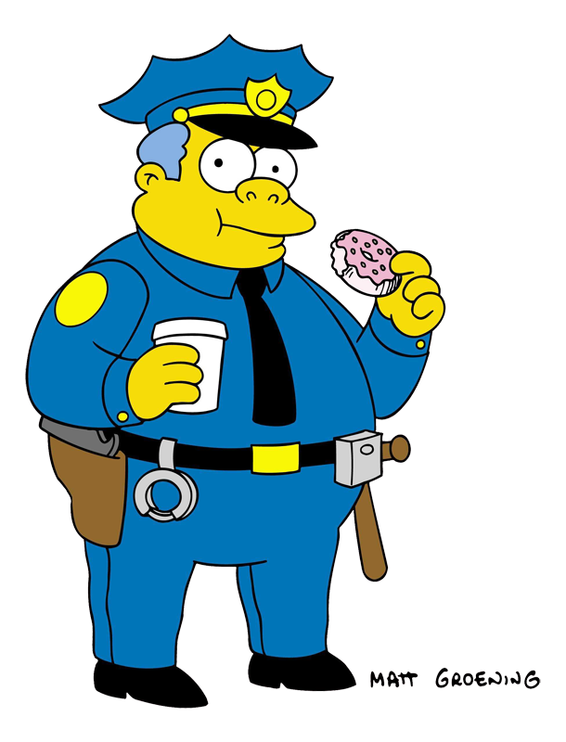
Type of Worker?

Slide 23
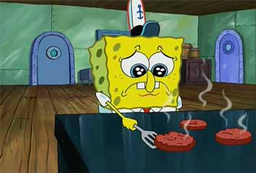
Type of Worker?

Slide 24
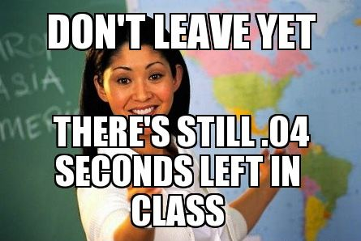
Type of Worker?

Slide 25
Labor Unions
Association of workers organized to improve wages and working conditions for its members
Craft Union: Made up of skilled workers in a specific industry
Industrial Union: Made up of all workers in an industry regardless of job or skill level
Local union: Members of a union in a particular factory, company, or geographic area

Slide 26
How Unions are organized
Closed shop: Company in which only union members could be hired
Union shop: Company that requires new employees to join a union after a specific period of time
Agency shop: Company in which employees are not required to join the union but must pay union dues.
Right-to-work laws: State laws forbidding unions from forcing workers to join and pay union dues. Why might these be controversial?

Slide 27
Collective Bargaining
Process by which unions and employers negotiate the conditions of employment
Cost-of-living-adjustment: provision calling for a wage increase each year if the general level of prices rises.
Mediation: A neutral person tries to get both sides to reach an agreement during negotiations
Arbitration: Union and management submit the issues they cannot agree on to a third party for a final decision

Slide 28
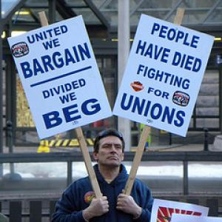

Slide 29
Strikes
Deliberate work stoppage by workers to force employers to give into their demands
Picketing: Action of strikers who walk in front of a workplace carrying signs that state their disagreement with the company. Why is this a useful tactic?
Boycott: Economic pressure exerted by unions urging the public not to purchase the goods or services produced by a company.
Lockout: Situation that occurs when management prevents workers from returning to work until they have agreed upon a new contract

Slide 30
Externalities
Costs or benefits from an economic transaction that third parties “external” to the transaction receive or incur
Externalities can be either positive or negative, and they can be generated from both the production and the consumption side of a transaction

Slide 31
Types of Externalities
Positive Consumption Externality: An external benefit generated from consuming a good or service.
An example could be the reduction in flu that results when some people receive a flu vaccine.
Negative Consumption Externality: An external consequence generated from consuming a good or service.
An example could be the secondhand smoke that results when people smoke cigarettes in public.

Slide 32
Types of Externalities
Negative Production Externality: An external consequence generated from producing a good or service.
Example: pollution or depletion of natural resources. Fish and forests are examples of a “common property” resource, and the depletion of these resources is sometimes referred to as the “tragedy of the commons.”
Positive Production Externality: An external benefit generated from producing a good or service.
Example: A public park is built near your house, which raises its property value

Slide 33
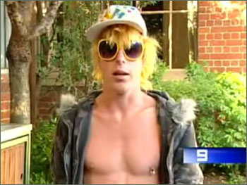
Positive or Negative?

Slide 34
Positive or Negative?

Slide 35
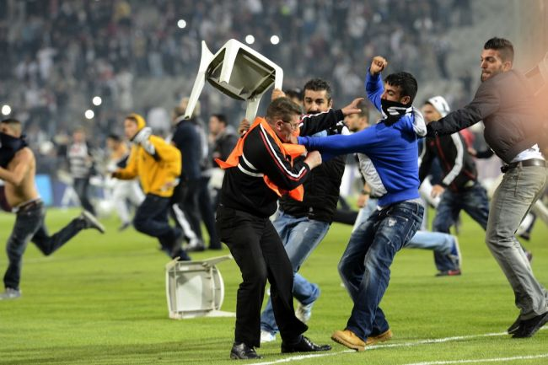
Positive or Negative?

Slide 36
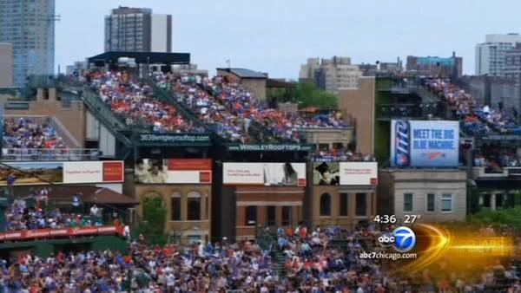
Positive or Negative?

Slide 37
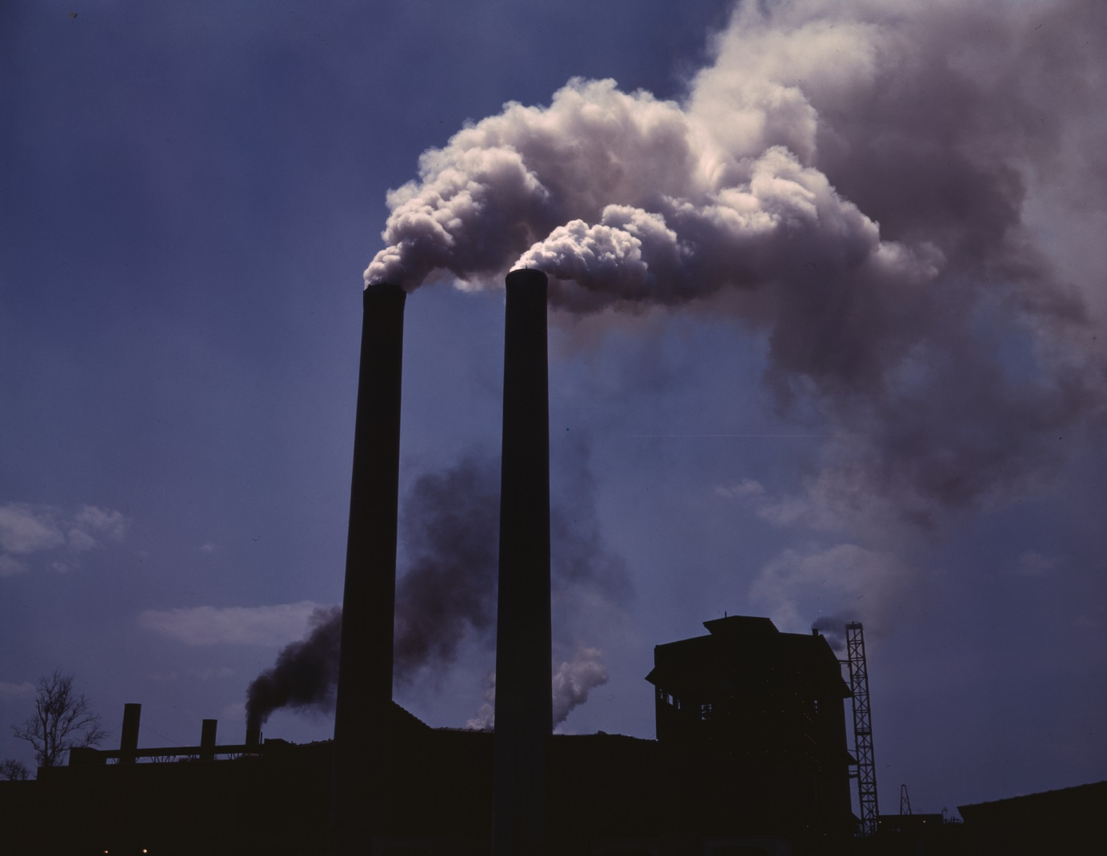
Positive or Negative?

Slide 38
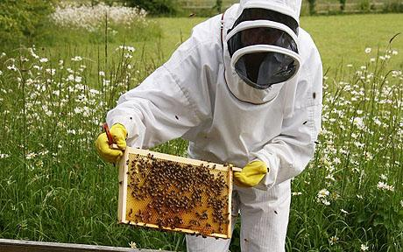
Positive or Negative?

