Slide 1
Macroeconomics
The branch of economic theory dealing with the economy as a whole and decision making by large units such as governments

Slide 2
How do we measure the strength of a nation’s economy?
We use national income accounting!
Measurement of the national economy’s performance, dealing with the overall economy’s output and income.
Five major statistics that measure the national economy
Gross domestic product
Net domestic product
National income
Personal income
Disposable personal income

Slide 3
Gross Domestic Product
Also known as GDP
Total dollar value of all final goods and services produced in a nation in a single year
We only count the value of FINAL goods and services to avoid double counting. An economist would not include all of the parts of a computer being made and then the computer itself. They would just count the value of the computer.
Only new goods are counted in GDP. If you sell something in a garage sale you aren’t really contributing to economic growth.

Slide 4
Calculating GDP
Consumer Sector: Goods and services bought directly by consumers
Investment Sector: Business purchases of items used to produce other goods
Government Sector: Government purchases of goods and services
Net exports: Difference between what the nation sells to other countries and what it buys from other countries.
GDP does not include all aspects of the economy, such as unpaid labor.

Slide 5
Net Domestic Product
Also known as NDP
Value of the nation’s GDP minus the total value lost through depreciation on equipment.
Depreciation: loss of value because of wear and tear to durable goods and capital goods.

Slide 6
Measurements of Income
National Income (NI): total income earned by everyone in the economy
Personal Income (PI): total income that individuals receive before taxes are paid
Disposable Personal Income (DPI): Income remaining for people to spend or save after all taxes have been paid
GDP Per Capita: The value of GDP divided by the size of a county’s population.

Slide 7
Inflation

Slide 8
Inflation
When calculating GDP economists need to take inflation into account.
Inflation: The prolonged rise in the general price level of final goods and services.
Deflation: Prolonged decline in the general price level of goods and services.

Slide 9
So why is this important?
Inflation and deflation affect the purchasing power of the dollar.
Purchasing Power: The real goods and services that money can buy; determines the value of money

Slide 10
Example Please!
When Mr. Hollister was just a lad, pop in the vending machine at school only cost 50 cents. Today the machines charge more. Just because the pop costs more money does not mean that the soda companies are more productive. This just tells us that the purchasing power of the dollar has gone down.

Slide 11
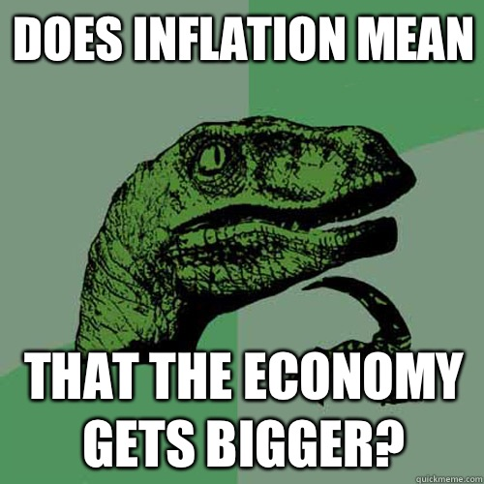
Why is this important when calculating GDP?
If we don’t take changes in purchasing power into account, it will mislead us when interpreting GDP growth. Just because there’s more money in the system doesn’t necessarily mean that we are making more stuff.

Slide 12
How do we measure inflation?
Consumer Price Index: A statistical measure of the average of prices of a specified set of goods and services purchased by typical consumers in city areas.
Market Basket: Representative group of goods and services used to compile the consumer price index.
Base Year: Year used as a point of comparison fro other years in a series of statistics

Slide 13
Producer Price Index: Measure of the change in price over time that U.S. producers charge for their goods and services.
GDP Price Deflator: Price index that removes the effect of inflation from GDP so that the overall economy in one year can be compared to another year.
Real GDP: GDP that has been adjusted for inflation
Nominal GDP: GDP that has NOT been adjusted for inflation.

Slide 14
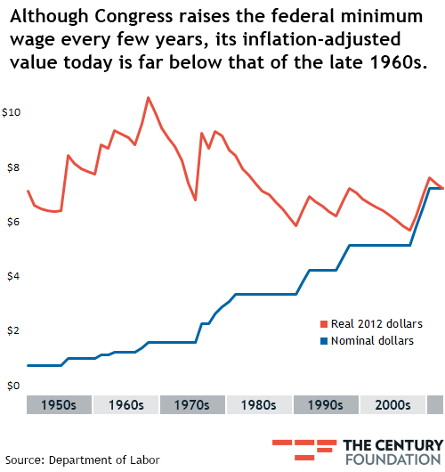

Slide 15
Aggregate Demand
Aggregates: Summation of all the individual parts in the economy.
Aggregate Demand: The total of all planned expenditures in the entire economy
Aggregate Demand Curve: A graphed line showing the relationship between the aggregate quantity demanded and the average of all prices as measured by the implicit GDP price deflator.

Slide 16
Aggregate Supply
Real domestic output of producers based on the rise and fall of the price level.
Aggregate Supply Curve: A graphed line showing the relationship between the aggregate quantity supplied and the average of all prices as measured by the implicit GDP price deflator.

Slide 17
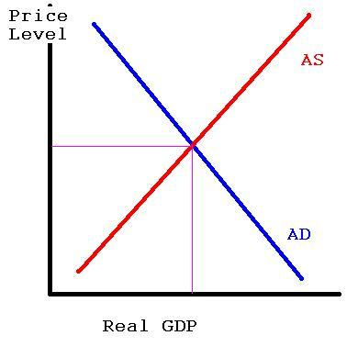
What does this look like on a graph?

Slide 18
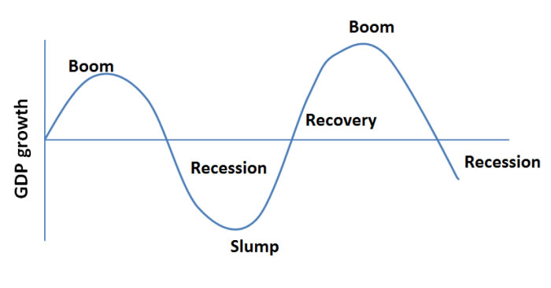
Business Fluctuations
The ups and downs of the economy
Business cycle: Irregular changes in the level of total output measured by real GDP

Slide 19
Business Fluctuations
Peak/Boom: Period of prosperity in a business cycle in which economic activity is at its highest point.
Contraction: Part of the business cycle during which economic activity is slowing down.
Recession: Part of the business cycle in which the nation’s output declines for at least six months

Slide 20
Business Fluctuations
Depression: Major slowdown of economic activity
Trough: Lowest part of the business cycle in which the downward spiral of the economy levels off
Expansion/recovery: Part of the business cycle in which economic activity slowly increases

