Slide 1
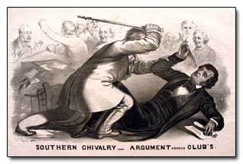
Legislative Branch
The Quagmire of Democracy!
Pages 120-200

Slide 2
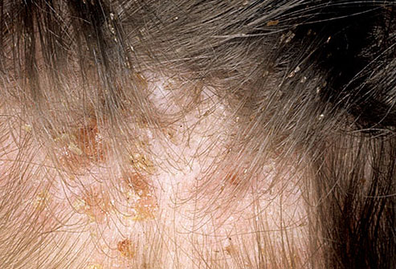
Fun Fact
Congress is less popular than head lice!

Slide 3
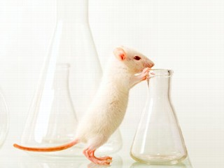
Question
Why are scientists considering using congressmen instead of lab rats for their experiments?

Slide 4
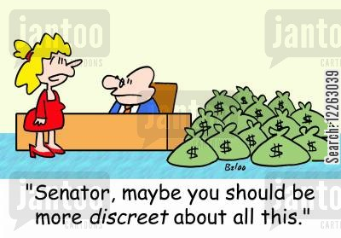
Answer
The scientists don’t get emotionally attached to the congressmen and there are some things even lab rats won’t do.

Slide 5
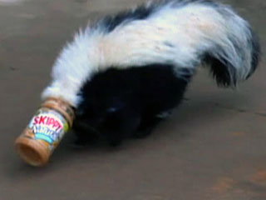
"I'm not saying this Congress is bad at its job. I'm just saying that this Congress is equivalent to a skunk with its head in a jar of Skippy peanut butter." –Jon Stewart
"Chris Christie also lashed out at Congress for doing nothing for the victims of Hurricane Sandy. But in their defense Congress says, 'Hey, we don't do anything for anybody.'" –Jay Leno
"The Senate swore in a record 20 female senators. Yep, the women said they’re very excited, and look forward to proving they can accomplish just as little as male senators." –Jimmy Fallon

Slide 6
Congress
Bicameral: Two Chambers
House of Representatives
Senate
Congress is meant to represent constituents (the people living in their states/districts)

Slide 7
Congressional Terms and Sessions
Each term of Congress starts on January 3rd of odd numbered years.
Example: 114th congress started in January 2015. 115th congress will start in January 2017.
Each term contains two sessions, or meetings. Each session is one year. Congress remains in session until members vote to adjourn.
President may call Congress for a special session.
http://www.cc.com/video-clips/hz7n2n/the-daily-show-with-trevor-noah-the-congressional-swearing-in-ceremony-gets-weird

Slide 8
The House of Representatives
Pages 132-137
Lower chamber
435 members
Qualifications
25 years old
Citizen of U.S. for 7 years
Resident of state
Elections every two years.
Incumbent: Person running for reelection.
Incumbency rate: Percentage of incumbents who win reelection. (90%)
Approval Rating: 13%

Slide 9
If Congress has such a LOW approval rating, how come 90% of congressmen get reelected?

Slide 10
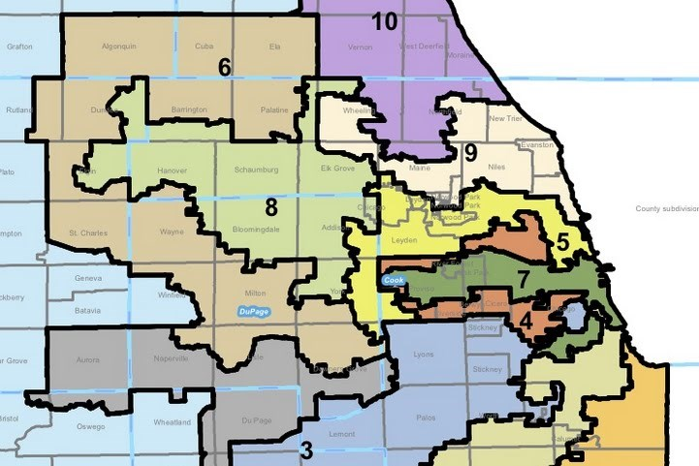
And why are the districts shaped so strangely?

Slide 11
Redistricting
Process of setting new district lines.
Gerrymandering: Political parties draw district boundaries to gain an advantage in elections.
https://www.youtube.com/watch?v=Mky11UJb9AY

Slide 12
How is Representation Determined?
Census: Population Count
Taken every ten years since 1790
Population of each state determines the new number of representatives. Called reapportionment.
Example: Populations of Texas and California have been growing so representatives have been added to the state.
Each congressional district must have roughly the same population.

Slide 13
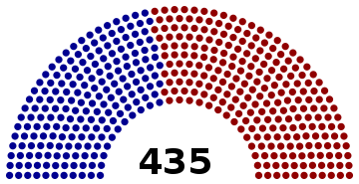
The 115th Congress
What does each color represent?

Slide 14
The 115th Congress
240 Republicans, 193 Democrats, 2 Vacancies
84 Women, 349 Men

Slide 15
Speaker of the House
Current Speaker of the House: Paul Ryan (WI)
Third in line for the presidency

Slide 16
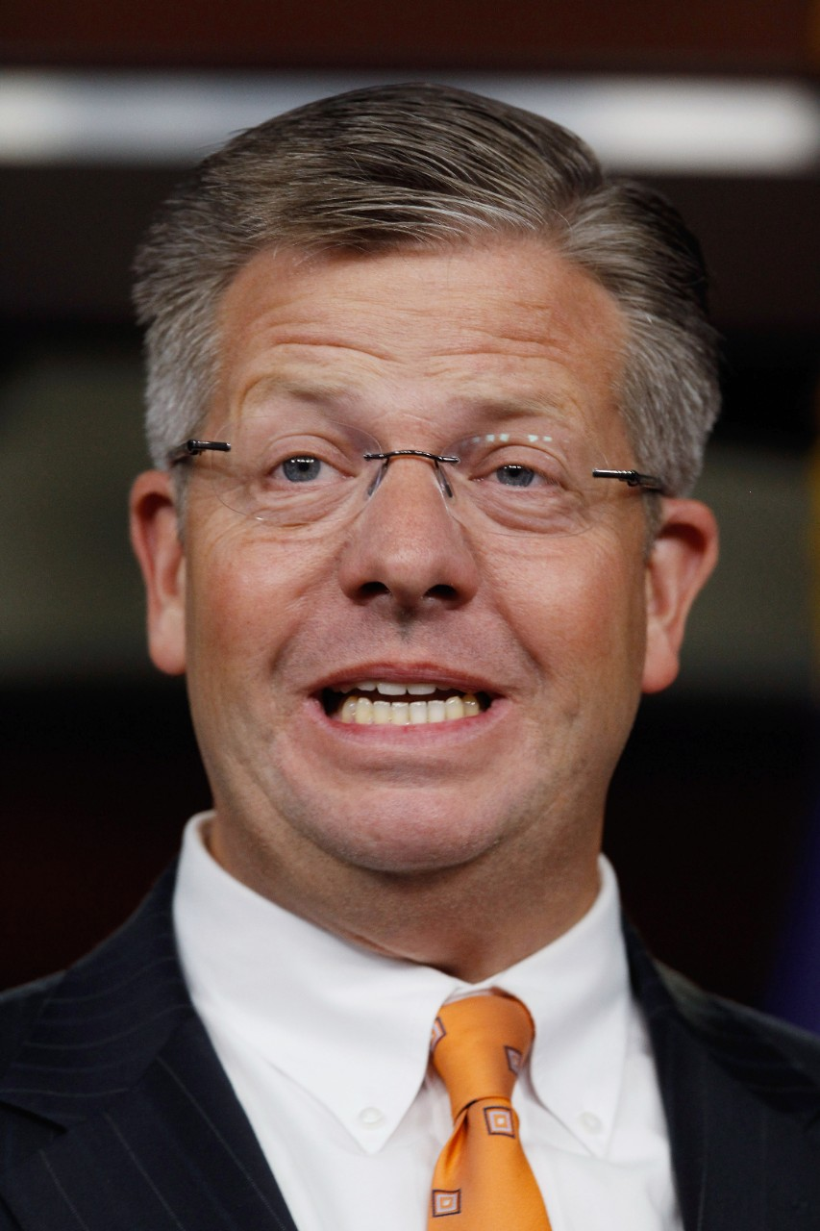
Your Representative
Randy Hultgren
14th District (Hampshire & Pingree Grove)
Republican Party
One the Issues…
Anti-abortion
Against same-sex marriage
Voted against violence against women act
Voted to repeal Affordable Care Act
Pro-war in Afghanistan and Iraq
Opposes pathway to citizenship
Against background checks or assault weapons ban

Slide 17
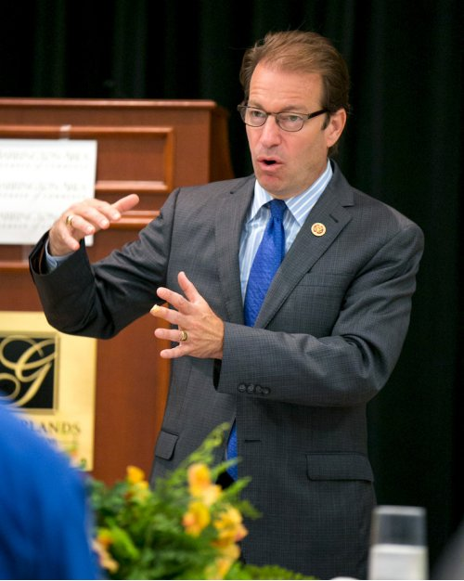
Your Representative
Peter Roskam
6th District (Gilberts & Carpentersville)
Republican Party
On the issues…
Anti-abortion
Against same-sex marriage
Voted against violence against women act
Voted to repeal Affordable Care Act
Pro-war in Afghanistan and Iraq
Opposes pathway to citizenship
Against background checks or assault weapons ban

Slide 18
The Senate
Pages 138-140
100 Senators
2 from each state
Senators are elected to six year terms
1/3rd up for reelection every two years
Referred to as the “Cooling Saucer”
Qualifications
U.S. Citizen for 9 years
30 years old
Resident of State

Slide 19
Roles in the Senate
Vice President: Leader of the Senate. Casts a vote in case of tie.
President Pro Tempore: Presides over Senate when Vice President is absent. Most senior member of majority party.
Majority Party: Political party with the most Senators
Minority Party: Political party with less Senators

Slide 20
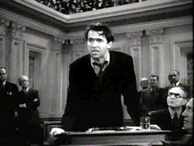
The Filibuster
When senators intentionally stall the legislative process and prevent a vote.
Cloture: 3/5ths vote (60 members) allowing each senator to speak for only one hour.
Longest filibuster was Strom Thurman (24 hours and 18 minutes).

Slide 21
115th Senate
Who are these guys?

Slide 22
The 115th Senate
44 Democrats, 54 Republicans, 2 Independents (Bernie Sanders and Angus King)
Vice President: Mike Pence
President Pro Tempore: Orrin Hatch (Utah)
Majority Leader: Mitch McConnell (Kentucky)
Minority Leader: Chuck Schumer (New York)

Slide 23
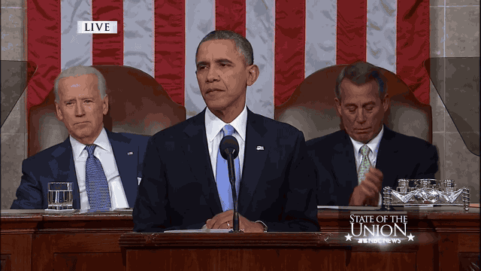
Joe Biden Highlights
https://www.youtube.com/watch?v=RLAw2_1IFx0

Slide 24
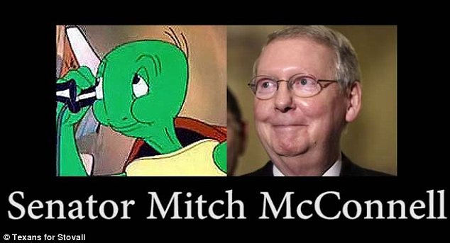
Senate Majority Leader

Slide 25
#McConnelling
https://www.youtube.com/watch?v=nrdTX8m5G98
https://www.youtube.com/watch?v=iEViWMxPuYc
https://www.youtube.com/watch?v=bE7_5k4YXp4
https://www.youtube.com/watch?v=HIJBA0YP470
https://www.youtube.com/watch?v=qE0aUqUxyuQ

Slide 26
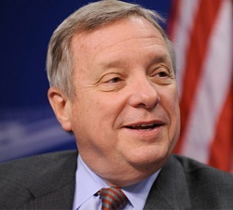
Richard Durbin
Senior Senator
Democratic Party
Senate Minority Whip
Whips assist party leaders
One the issues…
Pro Choice
Supports Same-sex marriage
Voted for the Affordable Care Act
Voted against war in Iraq
Supports pathway to citizenship
Supports background checks and assault weapons ban

Slide 27
Tammy Duckworth
Junior Senator
Democratic Party
One the issues…
Pro Choice
Supports Same-sex marriage

Slide 28
Legislation
Mr. Hollister will lose his teaching license if he doesn’t show you this video…
https://www.youtube.com/watch?v=FFroMQlKiag
Page 185
Bill can start in House or Senate
Committee Action
Floor Action
Conference Action
Approved Bill sent to President

Slide 29
Congress and the President
President has the authority to veto or sign bills.
Congress may override Veto with 2/3rds vote in both houses.

Slide 30
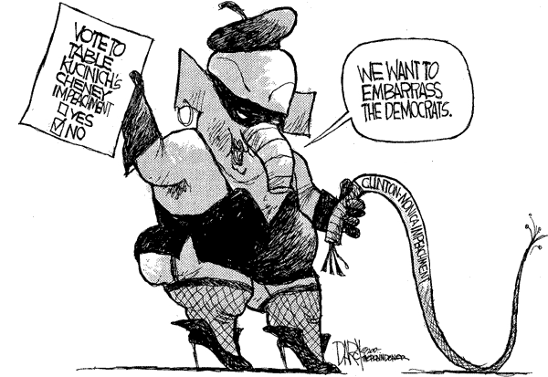
Removal Powers
Congress has the power to remove any federal official from office for “Treason, Bribery, or other high crimes and misdemeanors.”
Majority in House needed for impeachment, a formal accusation of misconduct in office.
2/3rds of Senate needed to convict.

Slide 31
The Federal Budget
Authorization Bill
Sets up a federal program and specifies how much money may be set aside for that program.
Appropriations Bill
Authorizes spending money.
Budget Surplus/Deficit
How much is spent in a year.
Debt
Total of all Deficit/Surpluses
https://www.youtube.com/watch?v=KIbkoop4AYE

Slide 32
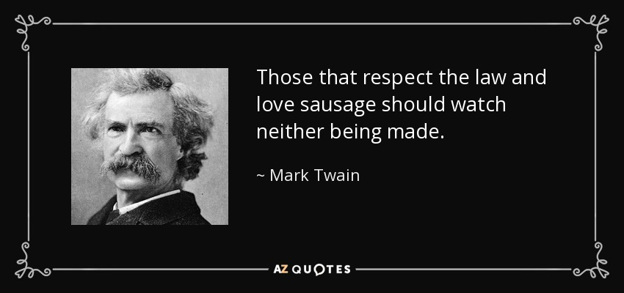

Slide 33
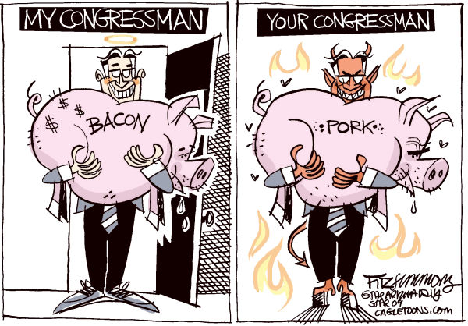
Behind the Scenes
Pork-Barrel Legislation
Congress appropriates money to fund local federal projects.
Often leads to “logrolling”
An agreement between two legislators to support each others’ bills.
Example
Congressmen A wants to pass a bill.
Congressmen B may loose an election in his district.
Congressmen B promises to vote for Congressmen A’s bill IF Congressmen A votes to spend money on a federal project in Congressmen B’s district.
http://www.opensecrets.org/orgs/summary.php?id=d000000085

Slide 34
The “Revolving Door”
Movement of personnel between roles as legislators and regulators and the industries affected by the legislation and regulation.
Lawmakers will intentionally create loopholes in legislation and then work for companies, teaching them how to exploit those loopholes.

Slide 35
Conflicts of Interest “The foxes are guarding the hen house.”
Industrial Complex
Industry Leaders make political contributions in exchange for favorable legislation. (Federal grants, tax cuts, less regulation, ect.)
https://www.opensecrets.org/industries/
Applies to areas where industry meets legislation
Military
Prison
Energy
Medical
Educational

