Slide 1
“I didn’t know what to do…
So I just chucked it.”
~Erin Doyle

Slide 2
“GAAAAHHHH!!”
~Nicole Cermak

Slide 3
“OW!
…MOTHER…”
~Kiera Guerrero-Gay

Slide 4
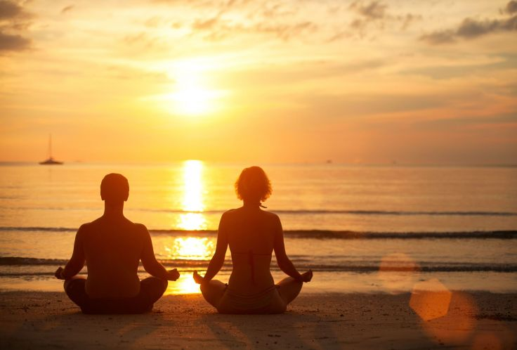
“So can we get Starbucks?”
~Katie Swichtenberg

Slide 5
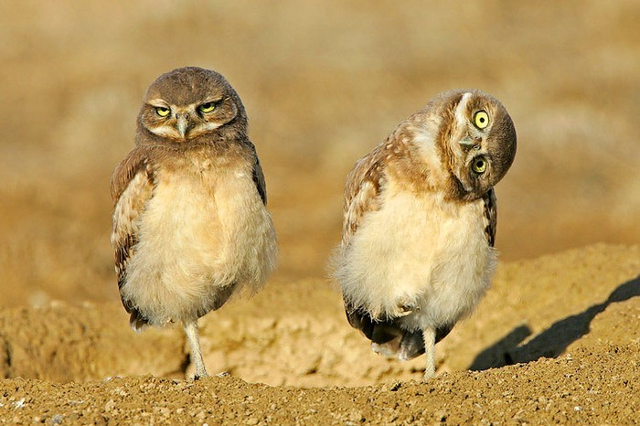
“Wait…
…What?”
~Maggie Goad

Slide 6
“Okay so...
I have a question.”
~Nicole Jachec

Slide 7
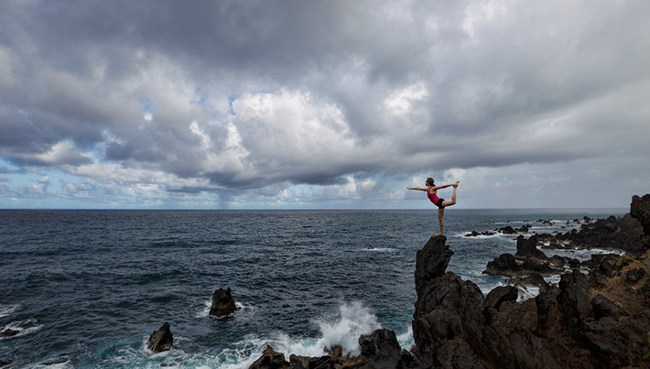
“Wait…
…I have another question.”
~Sam Johnson

Slide 8
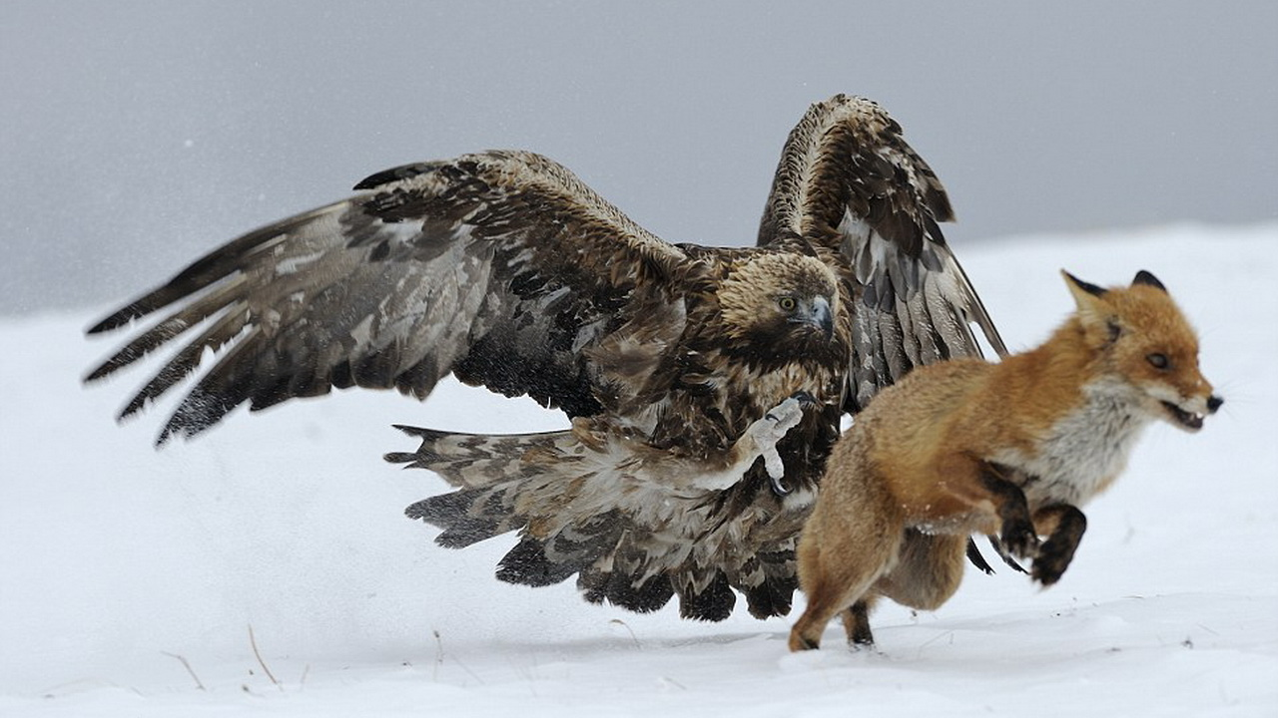
“OOOOOOOOH
MY
GOD!”
~Hunter Penrod

Slide 9
“So what am I supposed to do?”
~Dermeei Perez

Slide 10
“Coach, do you have another band aid?”
~Ashley Williams

Slide 11
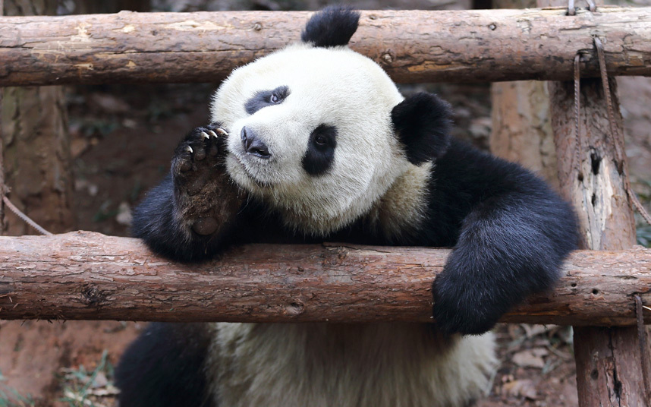
“So I feel like…”
~McKenzie Rasmussen

Slide 12
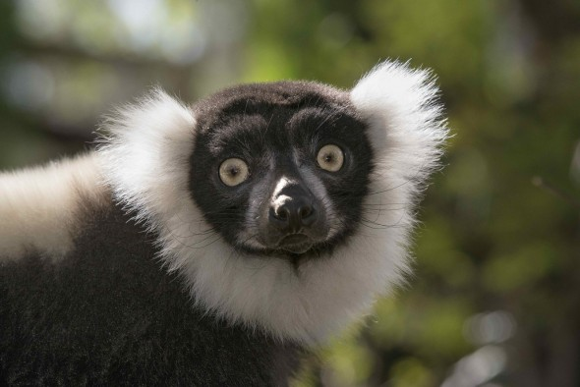
“…”
~Lauren Herrmann

Slide 13
Fur
On the Coat

