Slide 1
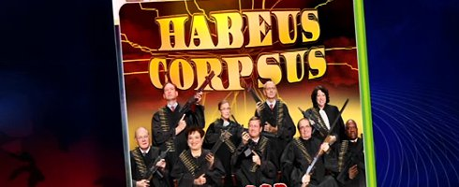
The Judicial Branch
It Rules!
Pages 302-348

Slide 2
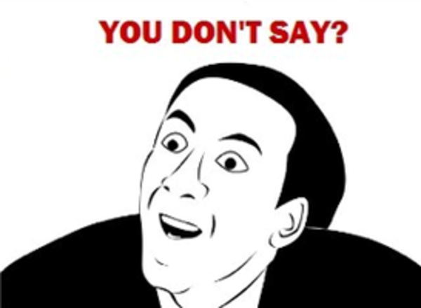
Judicial System
Consists of federal and state courts
Jurisdiction: The authority to hear certain cases.
State courts and jurisdiction dealing with state laws and federal courts have jurisdiction dealing with federal laws.

Slide 3
Concurrent Jurisdiction
Cases when both courts have jurisdiction. A person may sue in either court. If the defendant insists, however, the case must be tried in federal court.
Case originally starts in trial court (known as original jurisdiction) but decision can be appealed to the appellate court (known as appellate jurisdiction). That decision can be appealed to the Supreme Court.

Slide 4
Who is who in a lawsuit?
Litigants
People engaged in a lawsuit
Defendant
Person accused of committing a crime
Plaintiff
Person suing the defendant in a civil case
Prosecutor
Government attorney in a criminal case

Slide 5
Judicial Branch
Based on English Common Law. Use of precedent.
Precedent: Act, decision, or case that serves as a guide or justification for similar situations.
Judicial Review: Power of the court to examine the actions of legislative and executive branches and to determine whether such actions are constitutional. Created by the court in the case of Marbury v. Madison. Chief Justice John Marshall created this power in his majority opinion.
Justices make decisions based on constitutional interpretation, not personal or religious opinions.

Slide 6
Due Process
Due Process Clause of 14th Amendment
Gov’t may not deprive any person of life, liberty, or property without due process of law

Slide 7
Lower Federal Courts
Courts established by Congress are constitutional courts
District Courts serve as trial courts
Grand Jury: 16-23 people hears charges of crime. If they feel there is enough evidence they issue a indictment (formal accusation charging a person with a crime)
Trail Jury(Petit Jury): 6-12 people. Weighs evidence
Criminal case: Renders a verdict of guilty or not guilty
Civil case: Finds for either defendant or plantiff

Slide 8
Federal Court of Appeals
13 U.S. Courts of Appeals
Divided into 12 circuits. (13th is a special appeals court with national jurisdiction)

Slide 9
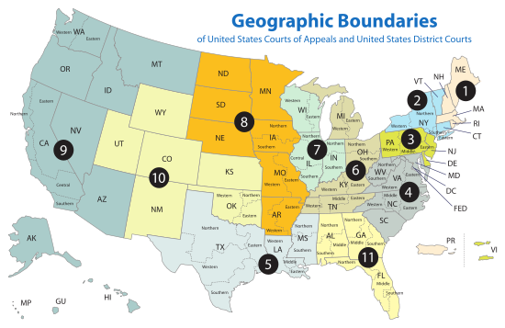

Slide 10
Supreme Court Process
Lawyers from each side submit a brief: written statement setting forth legal arguments, relevant facts, and precedents supporting one side of a case.
Oral Arguments: Lawyers from both sides present their arguments. The Justices can ask questions at any time. There is no jury.
Decision: The nine justices vote to decide the winner of the case.
Majority Opinion: The majority assigns one justice to write out and explain the court’s decision.
Concurring Opinion: Written by a justice who sided with the majority but feels that they need to elaborate on the majority opinion or give other reasons as to why they made their decision
Dissenting Opinion: Written by a justice who opposes the majority ruling.

Slide 11
Important Supreme Court Decisions
Brown v. Board of Education
Miranda v. Arizona
Korematsu v. United States
Gideon v. Wainwright

Slide 12
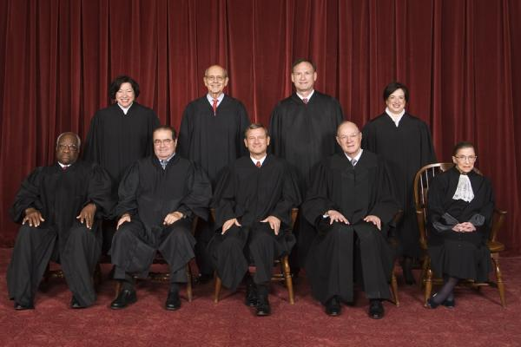
The Current Supreme Court

Slide 13
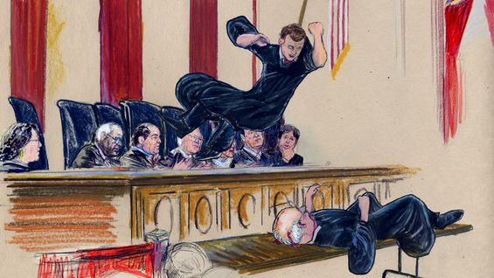
The Supreme Court
Made up of one Chief Justice and eight Associate Justices.
Named for Chief Justice
Right now it is called “The Roberts Court”
Current Supreme Court is split (four liberals, four conservatives, and one swing vote)
Justices are nominated by the President and confirmed by the Senate
Each Justice oversees at least one of the twelve Federal Judicial Circuit Courts

Slide 14
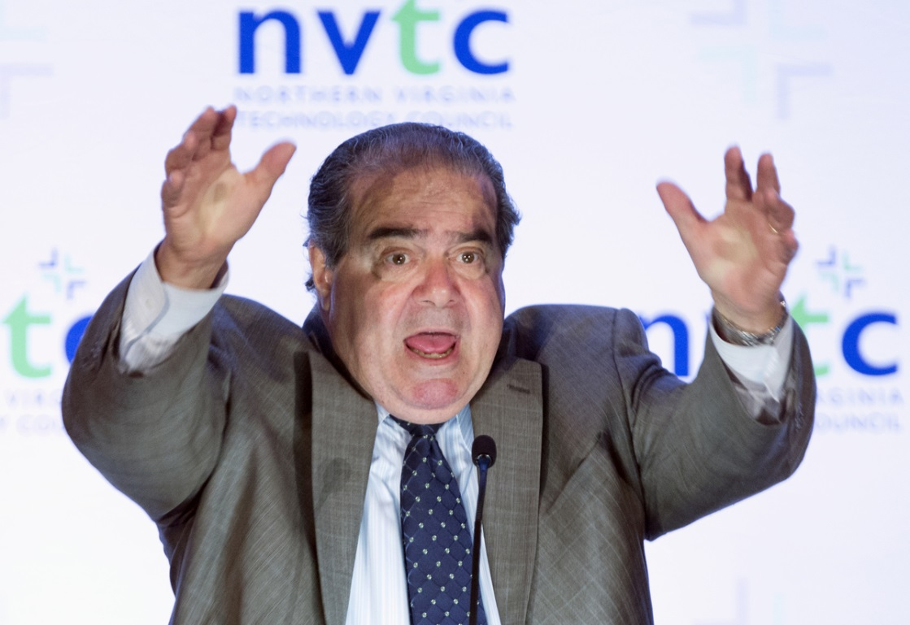
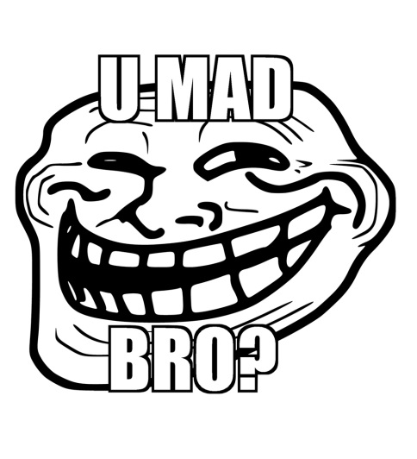
Antonin Scalia
Born: 1936
Nominated by Reagan
Sworn in Sept. 26, 1986
Conservative
Oversees the Fifth Circuit

Slide 15
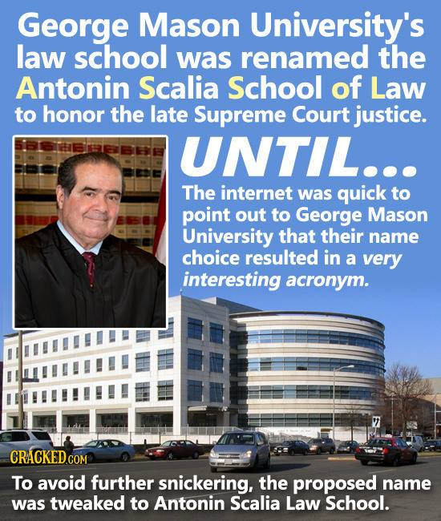

Slide 16
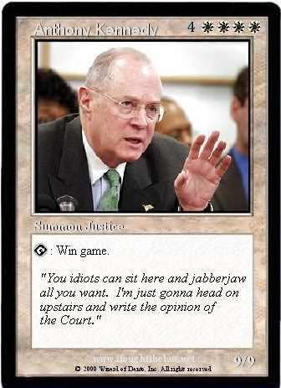
Anthony Kennedy
Born: 1936
Nominated by Reagan
Sworn in Feb. 18, 1988
Swing vote
Tends to lean conservative on fiscal issues and liberal on social issues
Oversees the Ninth Circuit

Slide 17
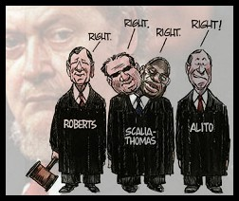
Clarence Thomas
Born: 1948
Nominated by Bush (41)
Sworn in October 23, 1991
Conservative
Oversees the Eleventh Circuit

Slide 18
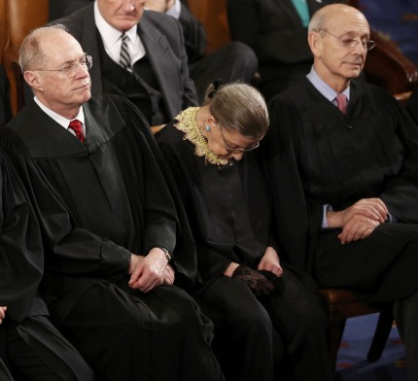
Ruth Bader Ginsberg
Born: 1933
Nominated by Clinton
Sworn in August 10, 1993
Liberal
Oversees the Second Circuit

Slide 19
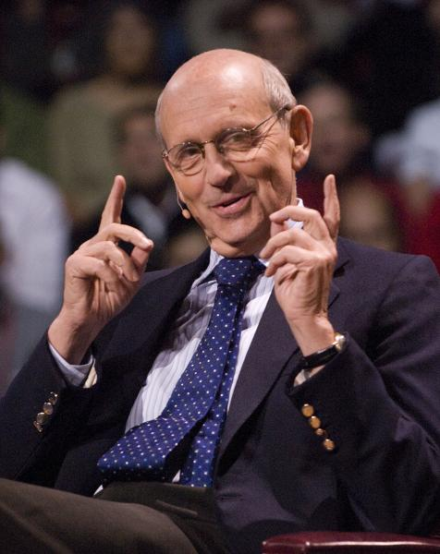
Stephen Breyer
Born: 1938
Nominated by Clinton
Sworn in August 3, 1994
Liberal
Oversees the First Circuit

Slide 20
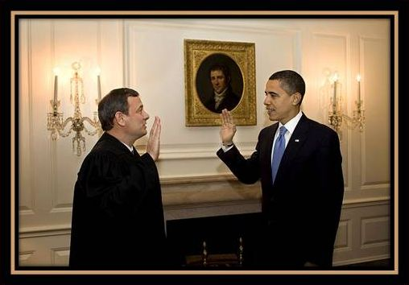
John Roberts
Born: 1955
Chief Justice
Nominated By Bush (43)
Sworn in September 29, 2005
Conservative
Oversees the Fourth, Federal, and D.C. Circuits
As Chief Justice, it is John Roberts’ duty to administer the Oath of Office to the President. Here he is seen administering the high five of office.

Slide 21
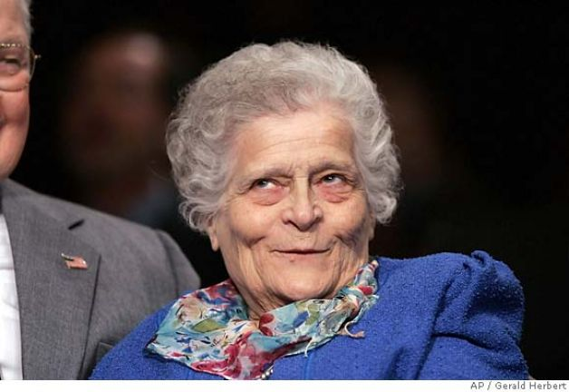
Samuel Alito
Born 1950
Nominated by Bush (43)
Sworn in January 31, 2006
Conservative
Oversees the Third and Eighth Circuits
This is not Samuel Alito. I googled him and for some reason, this picture came up. It makes me smile.

Slide 22
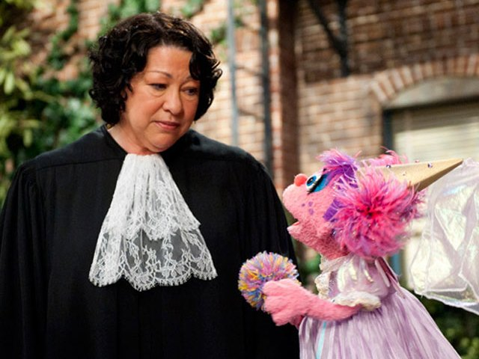
Sonia Sotomayor
Born 1954
Nominated by Obama
Sworn in August 8, 2009
Liberal
Oversees the Tenth Circuit

Slide 23
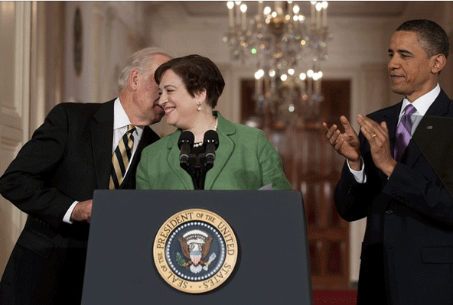
Elena Kagan
Born 1960
Nominated by Obama
Sworn in August 7, 2010
Liberal
Oversees the Sixth and Seventh Circuit
Illinois is in the 7th
You don’t wanna know what he’s whispering to her…

Slide 24
Fun Facts about the court
America (The Book) featured images of the naked Supreme Court Justices and was banned from Wal-Mart
There are no official qualifications for becoming a Supreme Court Justice
Although Ruth Bader Ginsberg and Antonin Scalia disagree on just about every case, they are good friends. They even appeared on stage at on opera together and admitted to being hung over at the State of the Union Address.
The most recent appointee to the court is in charge of taking notes, answering phones, opening the door, and pouring coffee. (In other words, they are freshmen)
The Supreme Court building has a basketball court inside
About 10,000 cases are on the docket every year. They usually only agree to hear 80-90.
Cameras are not allowed inside while the Supreme Court is in session.

Slide 25
And now for some awesomeness…
https://www.youtube.com/watch?v=OaRpVBbSHcg
https://www.youtube.com/watch?v=VxPVjRPx40k
https://www.youtube.com/watch?v=dh4_JL5nitk

Slide 26
Roberts Court Rulings
Citizens United v. Federal Election Commission,
Question: Can the government restrict the amount of spending by corporations for political campaigns?
The Supreme Court ruled, 5–4, that the government cannot restrict the spending of corporations for political campaigns, maintaining that it's their First Amendment right to support candidates as they choose. This decision upsets two previous precedents on the free-speech rights of corporations. President Obama expressed disapproval of the decision, calling it a "victory" for Wall Street and Big Business.

Slide 27
Roberts Court Rulings
National Federation of Independent Business v. Kathleen Sebelius, Secretary of Health and Human Services, one of the most anticipated rulings in recent history, the Supreme Court heard arguments on President Barack Obama's healthcare law—the signature legislation of his first term, including the individual mandate, which requires that most Americans buy health insurance or pay a fee. The individual mandate was the centerpiece of the law.
The court ruled, 5–4, that the individual mandate is constitutional under Congress's taxing authority. "Because the Constitution permits such a tax, it is not our role to forbid it, or to pass upon its wisdom or fairness," Chief Justice John Roberts wrote in the majority decision. The Court also upheld the expansion of Medicaid, the government's health insurance program for low-income Americans, but limited the provision, saying states will not necessarily lose their funding if they choose not to expand the program. The ruling was considered a major victory for Obama in an election year.

Slide 28
Roberts Court Rulings
Shelby County v. Holder, Section 4 of the Voting Rights Act, which established a formula for Congress to use when determining if a state or voting jurisdiction requires prior approval before changing its voting laws. Currently under Section 5 of the act nine—mostly Southern—states with a history of discrimination must get clearance from Congress before changing voting rules to make sure racial minorities are not negatively affected.
The 5–4 decision did not invalidate Section 5, it made it toothless. Chief Justice John Roberts said the formula Congress now uses, which was written in 1965, has become outdated. "While any racial discrimination in voting is too much, Congress must ensure that the legislation it passes to remedy that problem speaks to current conditions," he said in the majority opinion. In a strongly worded dissent, Judge Ruth Bader Ginsburg said, "Hubris is a fit word for today’s demolition of the V.R.A." (Voting Rights Act).

Slide 29
Obergefell v. Hodges
Groups of same-sex couples sued their relevant state agencies in Ohio, Michigan, Kentucky, and Tennessee to challenge the constitutionality of those states' bans on same-sex marriage or refusal to recognize legal same-sex marriages that occurred in jurisdictions that provided for such marriages. The plaintiffs in each case argued that the states' statutes violated the Equal Protection Clause and Due Process Clause of the Fourteenth Amendment, and one group of plaintiffs also brought claims under the Civil Rights Act. In all the cases, the trial court found in favor of the plaintiffs. The U.S. Court of Appeals for the Sixth Circuit reversed and held that the states' bans on same-sex marriage and refusal to recognize marriages performed in other states did not violate the couples' Fourteenth Amendment rights to equal protection and due process.
Questions
Does the Fourteenth Amendment require a state to license a marriage between two people of the same sex?
Does the Fourteenth Amendment require a state to recognize a marriage between two people of the same sex that was legally licensed and performed in another state?

