Slide 1
Introduction to the Legal System
Did you hear about the crime that happened in the parking garage?
It was wrong on so many levels

Slide 2
What is Law?
Laws, or statutes, are rules and regulations made and enforced by government that regulate the conduct of people in society.
Jurisprudence: The study of law and legal philosophy

Slide 3
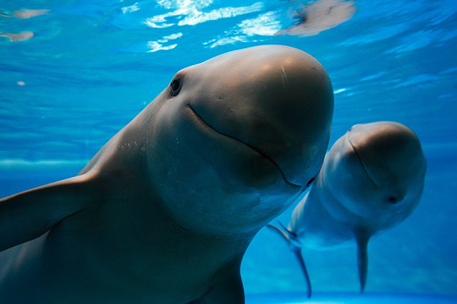
Purpose of Law
Protecting basic human rights
Promoting fairness
Helping resolve conflicts
Promoting order and stability
Promoting desirable social and economic behavior
Representing the will of the majority
Protecting rights of minorities

Slide 4
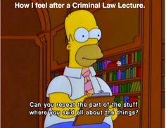
Kinds of Laws
Criminal Law
Regulate public conduct and set out duties owed to society. Government brings legal action against individual.
Felonies
Serious criminal offenses punished with more than a year in prison
Misdemeanors
Less serious criminal offenses punished with less than a year in prison

Slide 5
Kinds of Laws
Civil Law
Regulate relations between individuals or groups of individuals.
Civil Action
Lawsuit brought against an individual who feels wronged by another. Usually results in fine, settlement, or community service.

Slide 6
Who is Who?
Defendant
Person accused of committing a crime
Plaintiff
Person suing the defendant in a civil case
Prosecutor
Government attorney in a criminal case

Slide 7
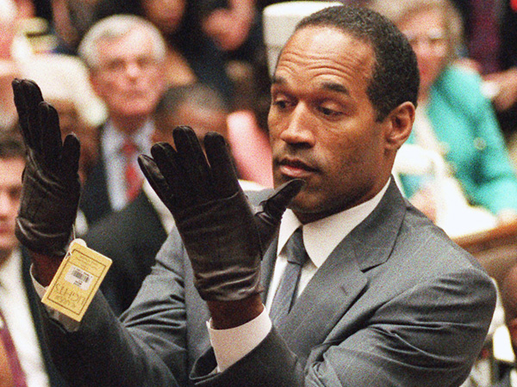
Winners and Losers
Defendants in a criminal case are considered innocent until proven guilty beyond a reasonable doubt
Plaintiffs can win a civil case by convincing the jury by a preponderance of evidence
One side has more evidence than the other

Slide 8
How Laws are Made
Statutory Law: Law created by a legislative body.
Common Law/Case Law: Law that is based on a judicial decision and precedent
Precedent: A ruling that is used to guide future court decisions.
Why do we need Common Law?

Slide 9
Amendment IV
The right of the people to be secure in their persons, houses, papers, and effects, against unreasonable searches and seizures, shall not be violated, and no warrants shall issue, but upon probable cause, supported by oath or affirmation, and particularly describing the place to be searched, and the persons or things to be seized.

Slide 10
Case 1: Watson’s Car
Watson was suspected of having stolen credit cards. The police searched him and found no cards. They then asked him if they could search his car. He said “Go ahead,” and the officer’s found two stolen credit cards under the floor mat. He was convicted and sent to jail.

Slide 11
Case 2: Cocoa Lane
An armed robber entered the offices of a taxi company, stole $363, and ran. Tow taxi drivers who heard shouts of “holdup,” followed the robber to 2111 Cocoa Lane. Police proceeded to the house and were let in by a woman. Officers spread out through the house and found Hayden upstairs pretending to sleep. He was arrested and convicted.

Slide 12
Case 3: Gas Station
During the middle of the night a gas station was robbed at gunpoint. Witnesses saw a blue station wagon leaving the gas station with four men inside, one in a green sweater and one in a trench coat. Police found the station wagon about an hour later and observed two men matching the description inside. Chambers was arrested and the car was searched. Under the dashboard police found two guns and cards that belonged to the gas station attendant.

Slide 13
Case 4: Horton’s Rings
Horton was suspected of robbing a coin collector. Police got a warrant to search his house for three rings that were stolen. Police did not find the rings during the search, but they did find guns that matched the description of those used in the robbery lying on a bed in one of the rooms.

Slide 14
No Vehicles in the Park
The town of Beautifica has a lovely park in its center. The city council wishes to preserve the feeling of nature, undisturbed by city noise, traffic, pollution and crowding. It is a place where people can go to find grass, trees, flowers and quiet. In addition, there are playgrounds and picnic areas. In order to make sure the park stays as it is, the city council passed a law, called an ordinance. At all entrances to the park, the following sign is posted: "NO VEHICLES IN THE PARK."
The law seems clear, but some disputes have arisen over the interpretation of the law

Slide 15
State v. Smith
John Smith – a government lawyer – lives on one side of town and works on the other side. To avoid being late for an important meeting, he drives his Honda Accord through the park on a paved street. A police officer arrests him and he is tried and convicted for violating the city’s law.

Slide 16
State v. Stodd
Stevie Stodd, a 3-year old child, “drives” a non-motorized toy car that his father gave him into the park. A police officer arrests young Stevie. He is tried and convicted for violating the city’s law.

Slide 17
State v. Edwards
A bee stings Sally, a little girl who is playing in the park. She has a life-threatening allergic reaction. Her father uses his cell-phone to call an ambulance. The ambulance arrives and very carefully enters the park to save sally. A police officer arrests the ambulance driver, Mary Edwards. She is tried and convicted for violating the city’s law.

Slide 18
State v. Budd
Julie Budd rides her bicycle through the park on her way to a girl-scout charity event. A police officer arrests Budd. She is tried and convicted for violating the city’s law.

Slide 19
State v. Karlberg
Kevin Karlberg, a commercial airline pilot, flies a Delta Airlines “Whisper Jet” over the park at approximately 1000 feet on his approach for landing. A police officer arrests him. He is tried and convicted of violating the city’s law.

Slide 20
State v. Wadsworth
A monument to the town’s citizens who died in an overseas war is being built. A full-size military tank, donated by the government is placed in the park as part of the monument. A group of anti-war activists gives a police officer a tip about this activity, On the day the tank is installed, the police officer arrests the project manager, Walter Wadsworth, who ordered the tank to be installed. He is tried and convicted for violating the city’s law.

Slide 21
How might the statute be improved?
What are some problems that need clarification?
How could we rewrite this to make it better?

Slide 22
State v. Charles
Andy Charles, a 4-year old boy, is playing the park with his remote control speed racecar. The car goes 40 kilometers per hour and makes a loud buzzing sound. A dutiful police officer arrests him.

Slide 23
Settling Disputes
Negotiation
Process by which people involved in a dispute talk to each other about their problem and try to reach a settlement before a case goes to trial
Arbitration
Third party listens to dispute and makes final decision
Mediation
Third party attempts to guide those involved in the dispute to a solution

Slide 24
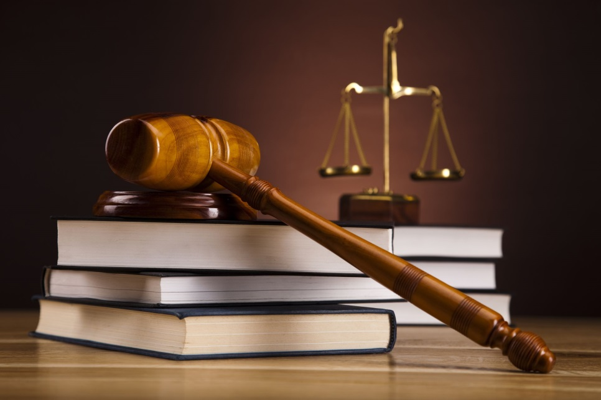
Courts
Trial Courts
Listen to testimony, consider evidence, and decide the facts of disputed situations.
U.S. uses adversary system: Each party presents their side in front of impartial judge/jury

Slide 25
The Court System
Appeals Court
One party takes argument to higher court asking for change in trial court’s decision.
Often heard by more than one judge
No juries, witnesses, or new evidence
Appeal made on error of law (Judge makes a legal mistake by misapplying the law or giving jury wrong instructions

Slide 26
Constitutional Law
U.S. Constitution=Highest law in the land
Based on the principle of limited government
Founders were concerned that if government, even a democracy, were given too much power it would become tyrannical
Used the separation of powers to prevent abuse of power.

Slide 27
Constitutional Law
Supreme Court holds power of Judicial Review
Created in the case of Marbury v. Madison
Allows court to cancel out laws that conflict with the Constitution.

Slide 28
Lawyers
Santa Claus, the tooth fairy, and honest lawyer, and an old drunk were walking along when they simultaneously spotted a hundred-dollar bill laying in the street. Who gets it?

Slide 29
The Old Drunk
…The other three are mythical creatures

Slide 30
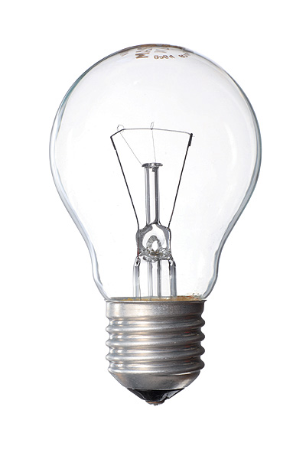
How many lawyers does it take to change a light bulb?

Slide 31
Three
One to climb the ladder, one to shake it, and one to sue the ladder company.

Slide 32
Lawyers
Give legal advice, draft legal opinions, negotiate settlements, or provide out-of-court legal assistance.
Lawyers who go to court are called trial attorneys or litigators.

Slide 33
Lawyers
Lawyers must first pass a Bar Examination in order to practice law in a given jurisdiction
Bar Associations: Organizations that license lawyers
Enforce Code of Professional Responsibility
Lawyers who violate code my be disbarred (license is taken away)

Slide 34
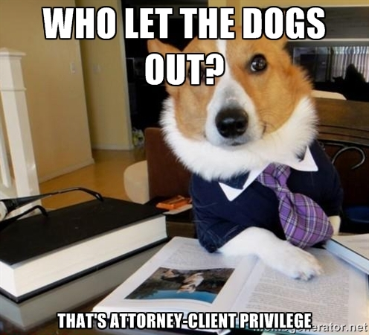
Working with your Attorney
Attorney-Client Privilege
Whatever you tell your attorney is secret and confidential
Why do we have this?
Lawyers can be sued by their clients for legal malpractice

