Slide 1
Demand & Supply

Slide 2
MARKETS DEFINED
POTENTIAL
BUYERS
POTENTIAL
SELLERS
MARKETS

Slide 3
DEMAND DEFINED
P
Q_{D}
A schedule or a curve that shows the various amounts of a product that consumers are willing and able to purchase at each of a series of possible prices.
$5
4
3
2
1
10
20
35
55
80

Slide 4
LAW OF DEMAND
An inverse relationship exists between price and quantity demanded
As Price Falls…
…Quantity Demanded Rises
As Price Rises…
…Quantity Demanded Falls

Slide 5
LAW OF DEMAND
Diminishing Marginal Utility
Additional satisfaction a consumer gets from purchasing one more unit of a product will lessen each additional unit purchased

Slide 6
LAW OF DEMAND
Diminishing Marginal Utility
Income Effect
individuals cannot keep buying the same quantity of a product if its price rises while their income stays the same

Slide 7
LAW OF DEMAND
Diminishing Marginal Utility
Income Effect
Substitution Effect
If two items satisfy the same need and the price of one rises people will buy the other.

Slide 8
LAW OF DEMAND
Diminishing Marginal Utility
Income Effect
Substitution Effect
Demand Curve
Individual and Market Demand

Slide 9
GRAPHING DEMAND
Price of Corn
P
CORN
$5
4
3
2
1
Plot the Points
P
Q_{D}
$5
4
3
2
1
10
20
35
55
80
o
Q
10 20 30 40 50 60 70 80
Quantity of Corn

Slide 10
GRAPHING DEMAND
Price of Corn
P
CORN
$5
4
3
2
1
Plot the Points
P
Q_{D}
$5
4
3
2
1
10
20
35
55
80
o
55
Q
10 20 30 40 50 60 70 80
Quantity of Corn

Slide 11
GRAPHING DEMAND
Price of Corn
P
CORN
$5
4
3
2
1
Plot the Points
P
Q_{D}
$5
4
3
2
1
10
20
35
55
80
o
Q
10 20 30 40 50 60 70 80
35
Quantity of Corn

Slide 12
GRAPHING DEMAND
Price of Corn
P
CORN
$5
4
3
2
1
Plot the Points
P
Q_{D}
$5
4
3
2
1
10
20
35
55
80
o
Q
10 20 30 40 50 60 70 80
Quantity of Corn

Slide 13
GRAPHING DEMAND
Price of Corn
P
CORN
$5
4
3
2
1
Plot the Points
P
Q_{D}
$5
4
3
2
1
10
20
35
55
80
o
Q
10 20 30 40 50 60 70 80
Quantity of Corn

Slide 14
GRAPHING DEMAND
Price of Corn
P
CORN
$5
4
3
2
1
Connect the Points
P
Q_{D}
$5
4
3
2
1
10
20
35
55
80
D
o
Q
10 20 30 40 50 60 70 80
Quantity of Corn

Slide 15
GRAPHING DEMAND
Price of Corn
What if
Demand
Increases?
P
CORN
$5
4
3
2
1
P
Q_{D}
$5
4
3
2
1
10
20
35
55
80
D
o
Q
10 20 30 40 50 60 70 80
Quantity of Corn

Slide 16
GRAPHING DEMAND
Price of Corn
Increase
in Quantity
Demanded
P
CORN
$5
4
3
2
1
P
Q_{D}
$5
4
3
2
1
10
20
35
55
80
30
40
60
80
+
Increase
in
Demand
D’
D
o
Q
10 20 30 40 50 60 70 80
Quantity of Corn

Slide 17
GRAPHING DEMAND
Price of Corn
What if
Demand
Decreases?
P
CORN
$5
4
3
2
1
P
Q_{D}
$5
4
3
2
1
10
20
35
55
80
D
o
Q
10 20 30 40 50 60 70 80
Quantity of Corn

Slide 18
GRAPHING DEMAND
Price of Corn
P
Decrease
in Quantity
Demanded
CORN
$5
4
3
2
1
P
Q_{D}
$5
4
3
2
1
10
20
35
55
80
--
10
20
40
60
Decrease
in
Demand
D
D’
o
Q
10 20 30 40 50 60 70 80
Quantity of Corn

Slide 19
DETERMINANTS OF DEMAND
Tastes
Number of Buyers
Income
Normal (Superior) & Inferior Goods
Prices of Related Goods
Substitutes & Complements
Unrelated Goods
Expectations

Slide 20
SUPPLY DEFINED
CORN
P
Q_{S}
Supply is a schedule or a curve showing the amounts of a product that producers are willing and able to make available for sale at each of a series of possible prices.
$1
2
3
4
5
5
20
35
50
60

Slide 21
LAW OF SUPPLY
A direct relationship exists between price and quantity supplied
As Price Rises…
…Quantity Supplied Rises
As Price Falls…
…Quantity Supplied Falls

Slide 22
GRAPHING SUPPLY
Price of Corn
Plot the Points
P
$5
4
3
2
1
CORN
P
Q_{S}
$5
4
3
2
1
60
50
35
20
5
o
5
Q
10 20 30 40 50 60 70 80
Quantity of Corn

Slide 23
GRAPHING SUPPLY
Price of Corn
Plot the Points
P
$5
4
3
2
1
CORN
P
Q_{S}
$5
4
3
2
1
60
50
35
20
5
o
Q
10 20 30 40 50 60 70 80
Quantity of Corn

Slide 24
GRAPHING SUPPLY
Price of Corn
Plot the Points
P
$5
4
3
2
1
CORN
P
Q_{S}
$5
4
3
2
1
60
50
35
20
5
o
35
Q
10 20 30 40 50 60 70 80
Quantity of Corn

Slide 25
GRAPHING SUPPLY
Price of Corn
Plot the Points
P
$5
4
3
2
1
CORN
P
Q_{S}
$5
4
3
2
1
60
50
35
20
5
o
Q
10 20 30 40 50 60 70 80
Quantity of Corn

Slide 26
GRAPHING SUPPLY
Price of Corn
Plot the Points
P
$5
4
3
2
1
CORN
P
Q_{S}
$5
4
3
2
1
60
50
35
20
5
o
Q
10 20 30 40 50 60 70 80
Quantity of Corn

Slide 27
GRAPHING SUPPLY
Price of Corn
P
$5
4
3
2
1
S
CORN
P
Q_{S}
$5
4
3
2
1
60
50
35
20
5
Connect the Points
o
Q
10 20 30 40 50 60 70 80
Quantity of Corn

Slide 28
GRAPHING SUPPLY
Price of Corn
P
What if
Supply
Increases?
$5
4
3
2
1
S
CORN
P
Q_{S}
$5
4
3
2
1
60
50
35
20
5
o
Q
10 20 30 40 50 60 70 80
Quantity of Corn

Slide 29
GRAPHING SUPPLY
Price of Corn
P
Increase
in
Supply
S’
$5
4
3
2
1
S
CORN
P
Q_{S}
$5
4
3
2
1
60
50
35
20
5
80
70
60
45
30
Increase
in Quantity
Supplied
o
Q
10 20 30 40 50 60 70 80
Quantity of Corn

Slide 30
GRAPHING SUPPLY
Price of Corn
P
What if
Supply
Decreases?
$5
4
3
2
1
S
CORN
P
Q_{S}
$5
4
3
2
1
60
50
35
20
5
o
Q
10 20 30 40 50 60 70 80
Quantity of Corn

Slide 31
GRAPHING SUPPLY
Decrease
in
Supply
Price of Corn
S’
P
$5
4
3
2
1
S
CORN
P
Q_{S}
$5
4
3
2
1
60
50
35
20
5
45
30
20
0
--
Decrease
in Quantity
Supplied
o
Q
10 20 30 40 50 60 70 80
Quantity of Corn

Slide 32
DETERMINANTS OF SUPPLY
Resource Prices
Technology
Taxes & Subsidies
Prices of Other Goods
Price Expectations
Number of Sellers

Slide 33
DETERMINANTS OF SUPPLY
Resource Prices
Technology
Taxes & Subsidies
Prices of Other Goods
Price Expectations
Number of Sellers
Combining
with
Demand

Slide 34
MARKET DEMAND & SUPPLY
BUSHELS
OF CORN
BUSHELS
OF CORN
P
Q_{D}
MARKET
DEMAND
P
Q_{S}
MARKET
SUPPLY
200
B
U
Y
E
R
S
200
S
E
L
L
E
R
S
$5
4
3
2
1
10
20
35
55
80
2,000
4,000
7,000
11,000
16,000
$5
4
3
2
1
60
50
35
20
5
12,000
10,000
7,000
4,000
1,000
x
x
EQUILIBRIUM
Graphically…

Slide 35
MARKET DEMAND & SUPPLY
Price of Corn
CORN
MARKET
P
CORN
MARKET
$5
4
3
2
1
S
P
Q_{D}
P
Q_{S}
$5
4
3
2
1
2,000
4,000
7,000
11,000
16,000
Market
Clearing
Equilibrium
$5
4
3
2
1
12,000
10,000
7,000
4,000
1,000
D
o
7
2 4 6 8 10 12 14 16
Q
Quantity of Corn

Slide 36
MARKET DEMAND & SUPPLY
Price of Corn
CORN
MARKET
P
CORN
MARKET
$5
4
3
2
1
Surplus
S
P
Q_{D}
P
Q_{S}
At a $4 price
more is being
supplied than
demanded
$5
4
3
2
1
2,000
4,000
7,000
11,000
16,000
$5
4
3
2
1
12,000
10,000
7,000
4,000
1,000
D
o
7
2 4 6 8 10 12 14 16
Q
Quantity of Corn

Slide 37
MARKET DEMAND & SUPPLY
Price of Corn
CORN
MARKET
P
CORN
MARKET
$5
4
3
2
1
S
P
Q_{D}
P
Q_{S}
At a $2 price
more is being
demanded than
supplied
$5
4
3
2
1
2,000
4,000
7,000
11,000
16,000
$5
4
3
2
1
12,000
10,000
7,000
4,000
1,000
Shortage
D
o
7
11
2 4 6 8 10 12 14 16
Q
Quantity of Corn

Slide 38
MARKET DEMAND & SUPPLY
Price of Corn
CORN
MARKET
P
CORN
MARKET
$5
4
3
2
1
Surplus
S
P
Q_{D}
P
Q_{S}
$5
4
3
2
1
2,000
4,000
7,000
11,000
16,000
$5
4
3
2
1
12,000
10,000
7,000
4,000
1,000
Shortage
D
o
7
11
2 4 6 8 10 12 14 16
Q
Quantity of Corn

Slide 39
MARKET EQUILIBRIUM
Equilibrium Price & Quantity
Rationing Function of Prices
Changes in Demand
Changes in Quantity Demanded
Changes in Supply
Changes in Quantity Supplied

Slide 40
Complex Cases
Multiple Shifts…
Supply Increases; Demand Decreases
Prices Decrease
Quantity Indeterminate
Supply Decreases; Demand Increases
Price Increases
Quantity Indeterminate

Slide 41
Complex Cases
Multiple Shifts…
Supply Increases; Demand Increases
Prices Indeterminate
Quantity Increases
Supply Decreases; Demand Decreases
Price Indeterminate
Quantity Decreases

Slide 42
Government Set Prices
Price Ceilings
Shortages
Rationing Problem
Black Markets
Rent Controls
Price Floors
Surpluses

Slide 43
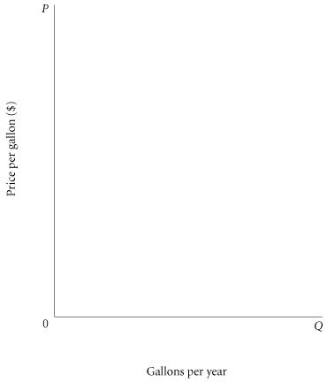
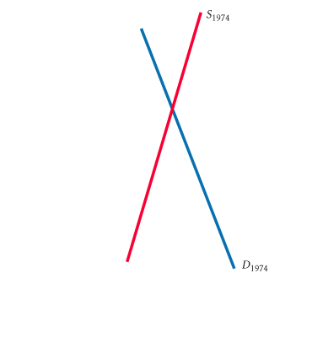
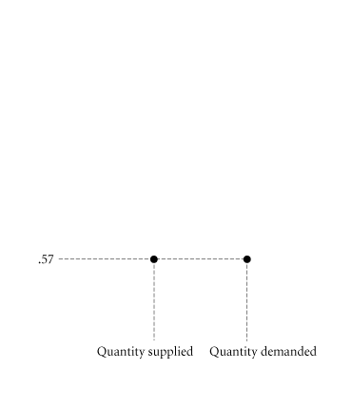
Price Ceiling
A maximum price that sellers may charge for a good, usually set by government.
Excess Demand (Shortage) Created by a Price Ceiling

Slide 44
Price ceiling
Price Rationing :The process by which the market system allocates goods and services to consumers when quantity demanded exceeds quantity supplied.
Ration coupons Tickets or coupons that entitle individuals to purchase a certain amount of a given product per month.
Black market A market in which illegal trading takes place at market-determined prices.

Slide 45
PRICE FLOORS
Price floor A minimum price below which exchange is not permitted.
Minimum wage A price floor set under the price of labor.
Agricultural Products

