Slide 1
Introduction to Economics
Chapter 1 Section 1: The Basic Problem in Economics

Slide 2
Scenario
You are on a sinking ship in the middle of the ocean. There is an island that you can see in the distance but only ten people can fit in the lifeboat. It can be assumed that anyone not in the lifeboat will be devoured by sharks. There is no way of contacting the outside world and you could have to spend years living on this island.

Slide 3
Who would you save?
The following people are on the boat with you. Remember you can only save nine (plus yourself).
Captain of the ship
Teacher
Cook
Farmer
Construction Worker
Police Officer
Drug Dealer
Prostitute
Investment Banker
Stay-at-home mom
A four month old baby
Terminally ill five year old
Historian
Writer
Politician
Lawyer
Professional Athlete
College Student
Priest
An attractive member of the opposite sex who is the same age as you

Slide 4
Defining Economics
4. Economics is a social science that examines how people choose among the alternatives available to them.
5. It is social because it involves people and their behavior. It is a science because it uses, as much as possible, a scientific approach in its investigation of choices.

Slide 5
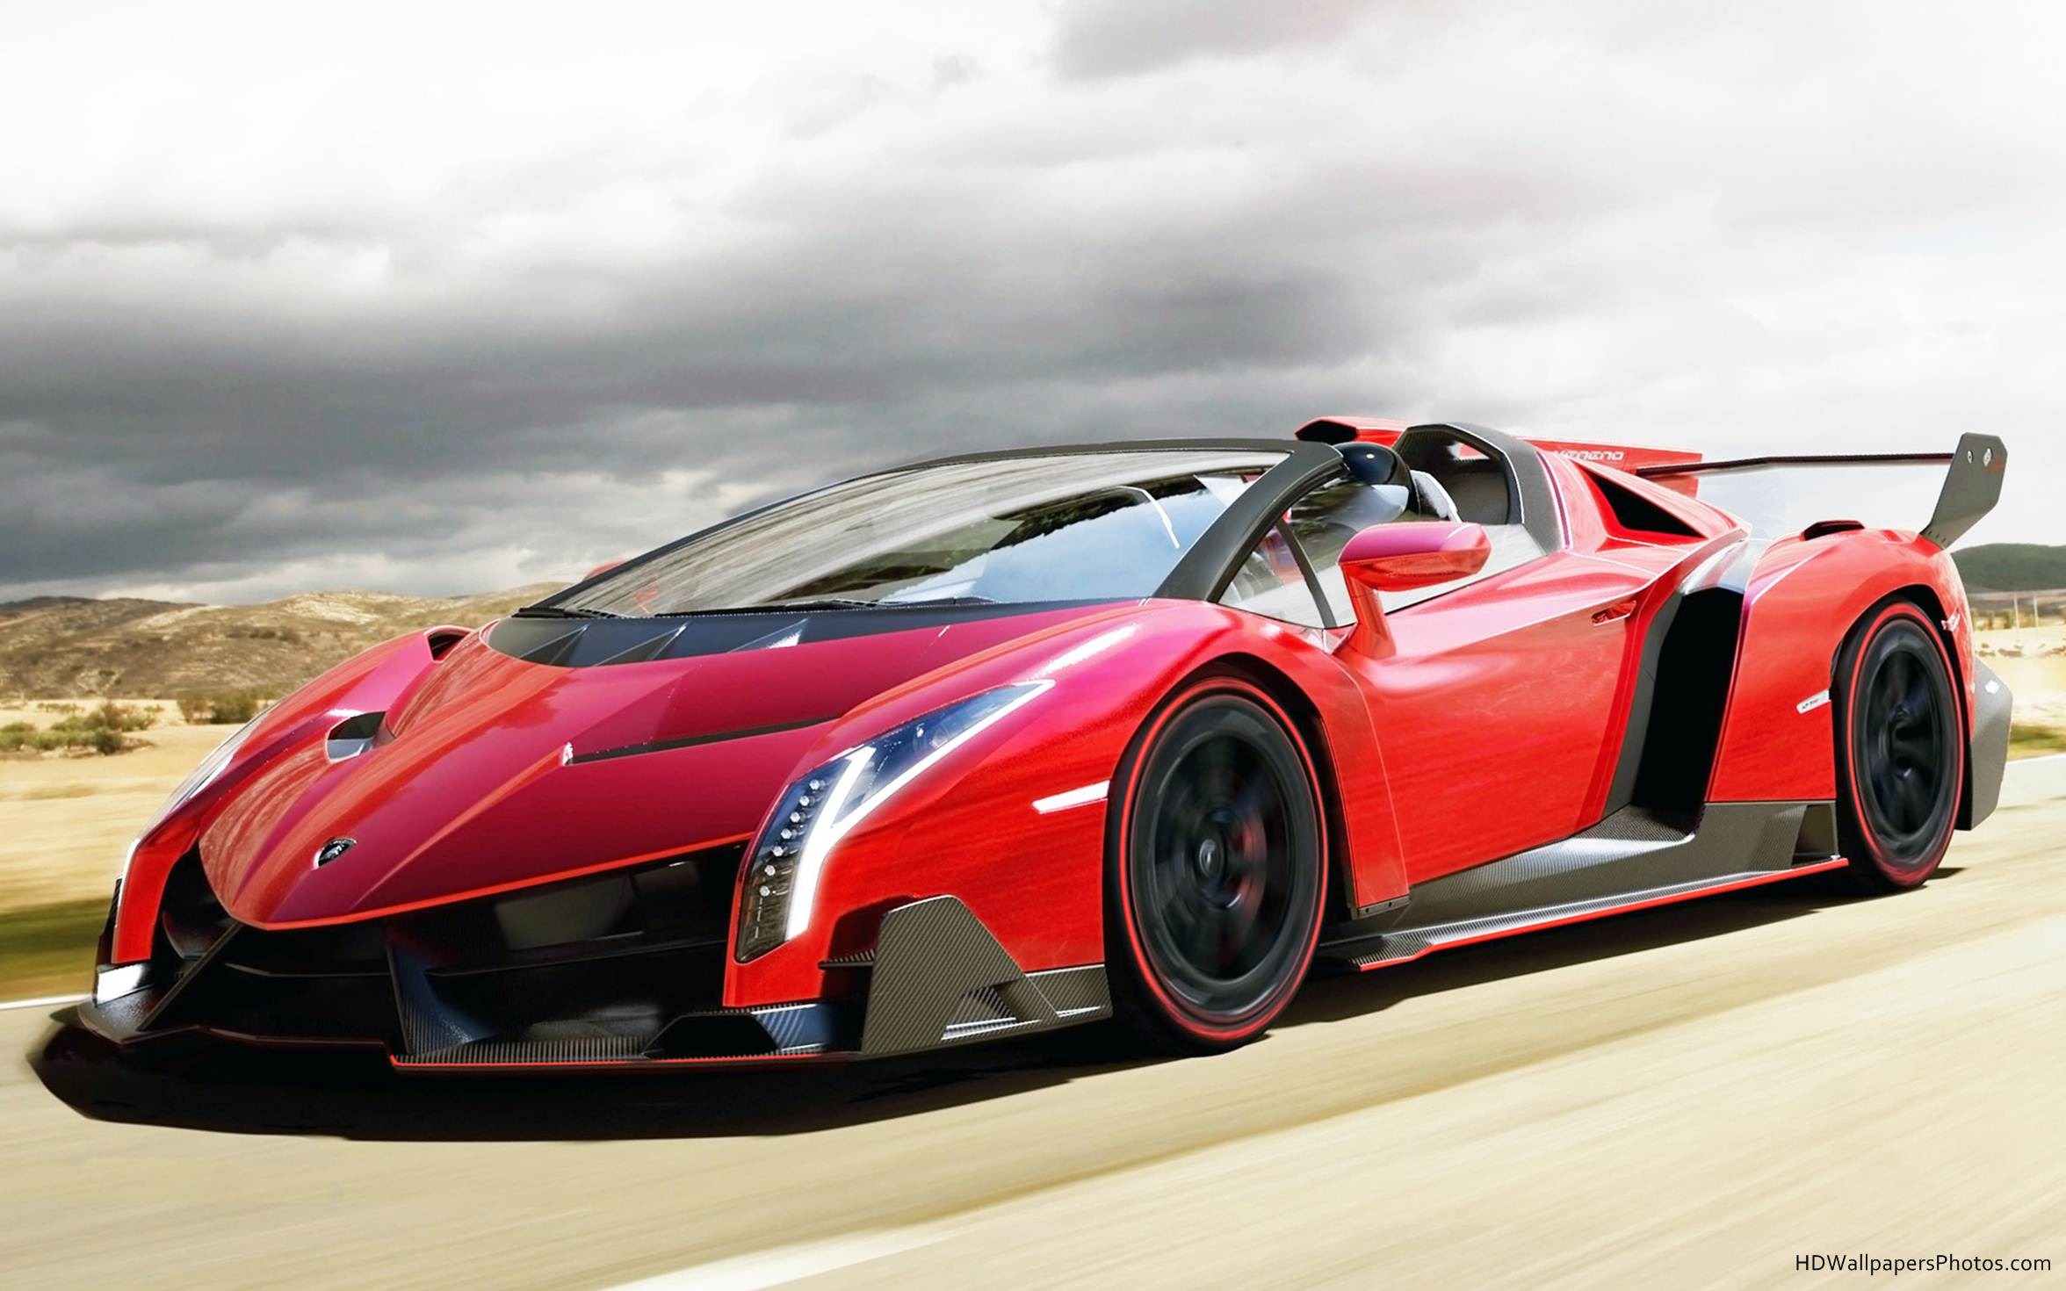
How much would you pay?

Slide 6
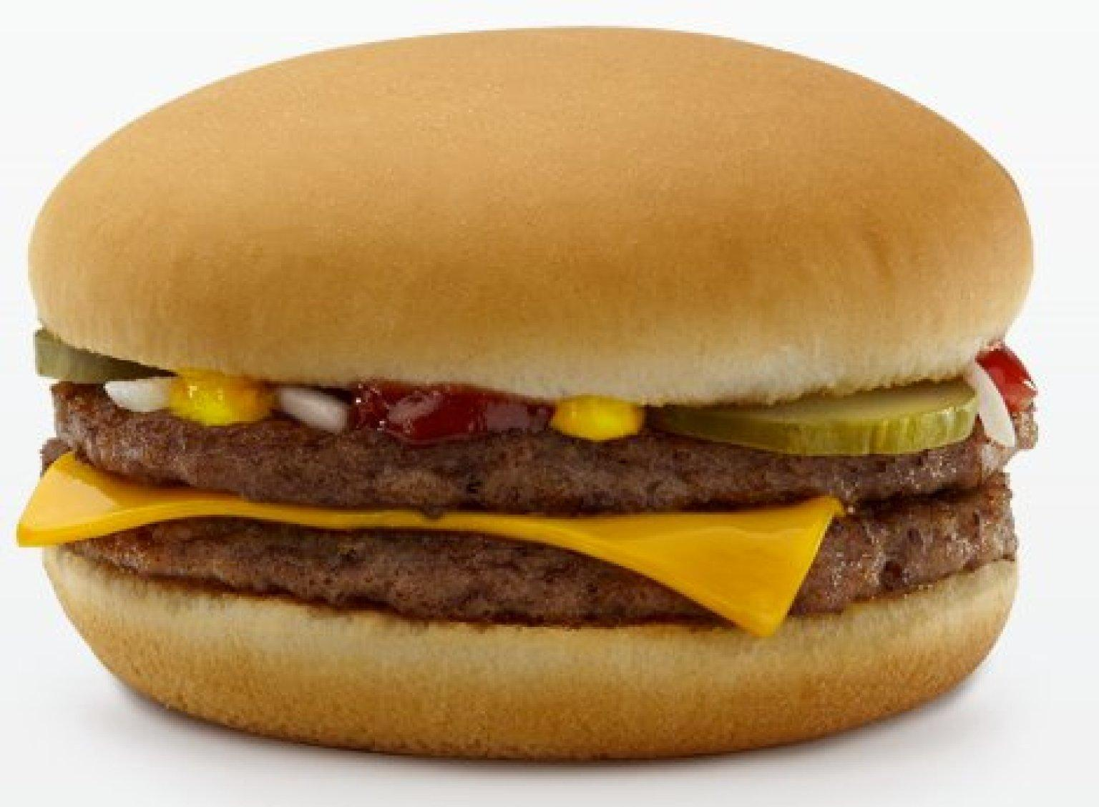
How much would you pay?

Slide 7
How much would you pay?

Slide 8
How much would you pay?

Slide 9
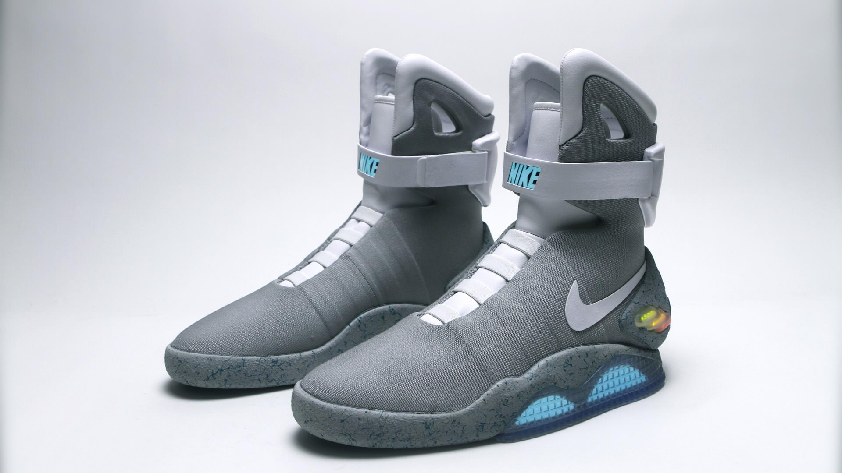
How much would you pay?

Slide 10
How much would you pay?

Slide 11
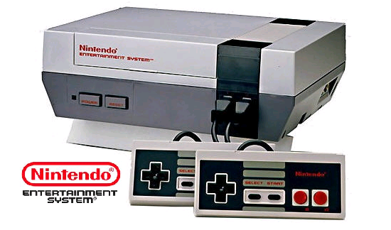
How much would you pay?

Slide 12
How much would you pay?

Slide 13
The Basic Economic Problems
What is economics?
What is Macro or Micro Economics?
What is scarcity?

Slide 14
Definition of Economics
Economics: The study of how people make choices about ways to use limited resources to fulfill their wants.
Microeconomics: The branch of economic theory that deals with behavior and decision making by small units such as individuals and firms
Macroeconomics: Large units such as governments

Slide 15
The Problem of Scarcity
Scarcity: basic economic problem that results from a combination of limited resources and unlimited wants.
Scarcity always exists!
Name some scarce resources...

Slide 16
Factors of Production
Factors of Production: resources of land, labor, capital, and entrepreneurship used to produce goods and services
Goods: tangible objects
Services: Actions that satisfy people’s wants or needs

Slide 17
Wants and Needs
What is the difference between a WANT and a NEED?
With a partner divide your packet and determine what is a want, and what is a need.

