Slide 1
Illinois State Government

Slide 3
Illinois
Became a state in 1818
21st State
There have been four Constitutions
State Capital: Springfield

Slide 4
State Constitution
Adopted in 1970
3 Branches of Gov’t
Legislative
Executive
Judicial

Slide 5
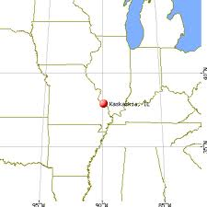
History
In what city was the first capital located?
Kaskaskia

Slide 6
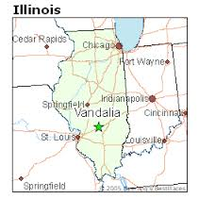
History
In what city was the second capital located?
Vandalia

Slide 7
Symbols
What is the state flower?
Violet

Slide 8
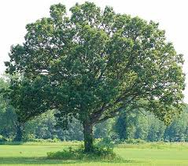
Symbols
What is the state tree?
White Oak

Slide 9
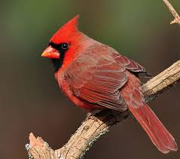
Symbols
What is the state bird?
Cardinal

Slide 10
Symbols
What is the state insect?
Monarch Butterfly

Slide 11
Symbols
What is the state fish?
Bluegill

Slide 12
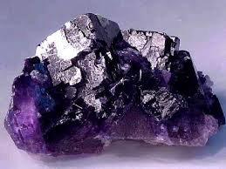
Symbols
What is the state mineral?
Fluorite

Slide 13
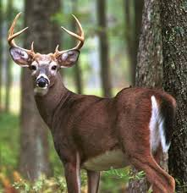
Symbols
What is the state animal?
White Tailed Deer

Slide 14
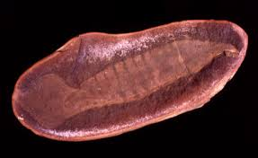
Symbols
What is the state fossil?
Tully Monster

Slide 15
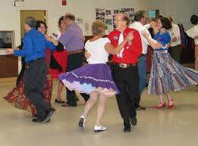
Symbols
What is the state dance?
Square Dance

Slide 16
Legislative Branch
Lawmaking body: General Assembly
House of Representatives
Speaker of the House:
118 Representatives
Senate
President of the Senate
59 Senators
You must be 21 years old to be a General Assembly Member

Slide 17
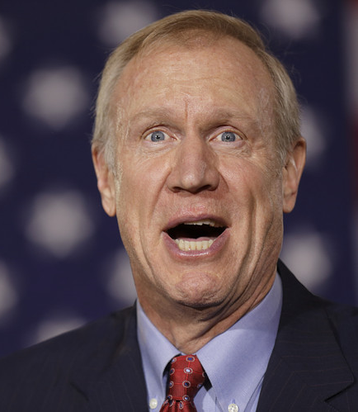
Executive Branch
Head of the Executive: Governor
Current Governor is Bruce Rauner (R)
Elected by popular vote every four years.
Must be at least 25 years old

Slide 18
Executive Branch
Powers of the Governor
Command State Militia
Administer and enforce laws
Grant pardons
Power to call National Guard
Veto bills (Can be overridden with 3/5ths vote)
Item Veto: Can veto certain portions of a bill without vetoing the entire thing

Slide 19
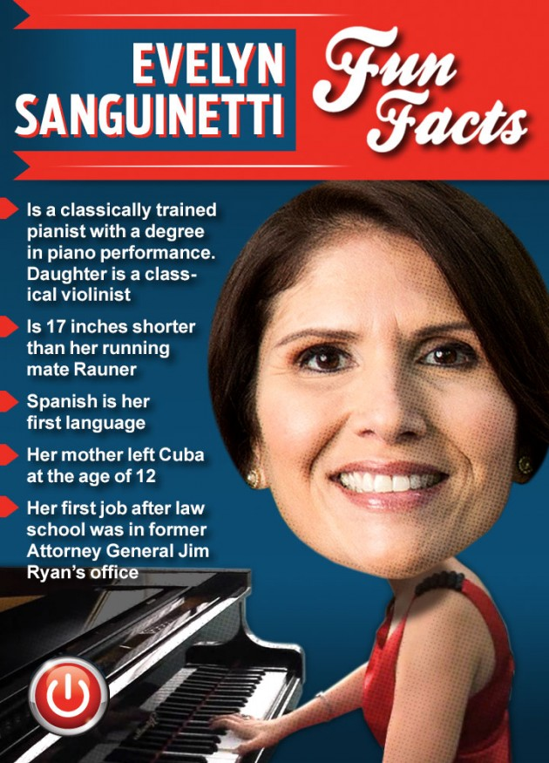
Executive Branch
Lieutenant Governor
“Vice President of the State”

Slide 20
Executive Branch
Attorney General
Legal Officer of the State
Secretary of State
Keeps all state records including birth, death, marriage, and driver’s licenses.

Slide 21
Judicial Branch
3 Types of Courts
Circuit Courts (main trial courts)
Appellate Courts
Illinois Supreme Court
Seven Judges on Illinois State Supreme Court
Illinois Judges are elected to offices

