Slide 1
The Homefront
By: Caleb, liam, & carter

Slide 2
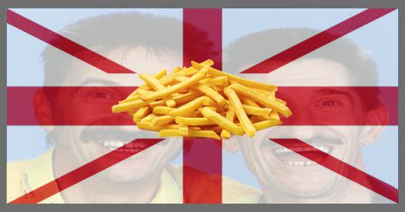
Why was the home front significant?
The home front was extremely important. It produced the weapons, the income, the supply of troops and food that kept the war going. These were all done by civilians at home, not soldiers.

Slide 3
Continued
•The home front refers to the country's involvement in the war. In World War 1, countries like Canada were in the war, but did not have battles on their home soil. The home front however was important because people at home were under things by the government to help the war effort. Women worked in factories. Women took the men's old jobs while they were at war. food was rationed so more could be sent overseas, scrap metal was collected to be melted into bullets. income tax and daylight savings time were both introduced during this time to save/raise money for the war effort. they were both supposed to be temporary but they still remain. women were given the vote (only so they could vote for conscription), conscription is introduced, etc.

Slide 4
Home front refers to...
Keeping up moral
Keeping up military industries
Getting more soldiers
If the home front breaks down typically the country is eliminated from war.

Slide 5
Russian Home Front
WW1 was total war for Russia
Despite entering the war with the largest military, Russia was not prepared.
Russia lacked factories and financial means.
Russia had a weak monarchy and had political chaos at the Home Front.
Russia experienced food shortages
Women worked in factories and took over the men's jobs.

Slide 6
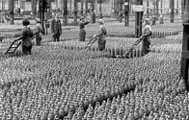
Total War for Russia
Total War is the organization of entire societies for war in a social, economic, and even spiritual sense.
Protests and debates were a major part in the war.

Slide 7
Financial Issues
Russia wasn't prepared financially with supplies and weapons due to low money.
They even had to steal some supplies and weapons.

Slide 8
Food Shortages
People of Russia suffered to to port blockages.
Russia had its origins in urban food riots
The distribution of food broke down

Slide 9
Women's Role
Six thousand women went to combat
Russia was the only country to employ women systematically in sexaully segregated military formations.

Slide 10
How was the Homefront affected
Quality of life decreased.
Inflation and Poverty. (Inflation increased by 400%)
Labor Shortage
Women working in the military and government.
Communism arose.

Slide 11
Austria-Hungary Home Front
Austria-Hungary's nationalities were the Slavs and Romanians. They remained loyal to the Habsburgs as long as their interests could not be better served elsewhere. When consensus broke down on the monarchy's home front it was the result of a severe economic crisis. The empire as a whole had been economically singled out before 1914, but war saw an immediate shortage of grain. This occurred because the Russians had taken the land.
The grain problem was bad. Austria was the empire's agricultural heartland. In fact, the first destination of Hungarian surpluses was the army, although Hungarian civilians' rations were still maintained at a higher level than Austrians' were. Two meatless days per week had to be imposed in Austria. Inflation was the main cause of this.

Slide 12
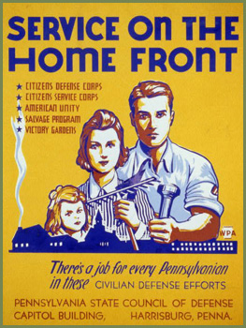
United States Home Front
Women and the Workplace
Mobilization
Government Agencies & Programs
Propaganda in the U.S.
Anti-German Ideals
Asylums and Soldiers Back Home

Slide 13
Women & the Workplace
When men went to fight in the war, women took vacant jobs in various men’s positions
Due to the war, munitions factories were made and women were the highest employed in these factories
Women took many new positions such as railway guards and ticket collectors, buses and tram conductors, postal workers, police, firefighters and as bank ‘tellers’ and clerks
Though, women were paid less than men workers
This sparked equal pay demands

Slide 14
U.S. Mobilization
Although the war began on July 28th, 1914, the U.S. did not enter until April 6th, 1917
Before entry into the war, the U.S. supplied the Allied powers with food, munitions, and other valuable resources
The government enforced an army draft
Upon entry, the Federal Government was not prepared for the conflict
The U.S. had only 300,000 troops with the army and national guard combined
Numerous government agencies were created to aid the war effort in Europe

Slide 15
Government Agencies & Programs
In order to support the war effort while sustaining a stable economy back home, the Federal Government had to invent a series of agencies to deal with varying parts of society
The War Industries Board was created in July of 1917 to coordinate purchases made by the U.S.
The Food Administration was established shortly after entry in the war and it’s job was to maintain reasonable food prices while still being able to supply the Allied Powers in Europe with food
On August 23rd, 1917, the Fuel Administration was made. The purpose of this admin. was to ensure good production and delivery levels of coal and fuel while maintaining decent prices
In 1918, Daylight-Savings Time was adopted to reduce energy by moving more activities to times in which natural light was present

Slide 16
Propaganda in the U.S.
The United States used propaganda to form an opinion for it’s citizens
Propaganda could depict the enemies overseas or call the people to action in many ways from buying war bonds to conserving foods and resources that could be aided to the war effort
President Wilson created the Committee on Public Information which oversaw the development of propaganda
George Creel was a journalist that directed the Committee and he utilized all forms of entertainment for his ideas
Propaganda was used in many different forms such as: posters (most commonly), newspapers, magazines, and any form of advertisement

Slide 17
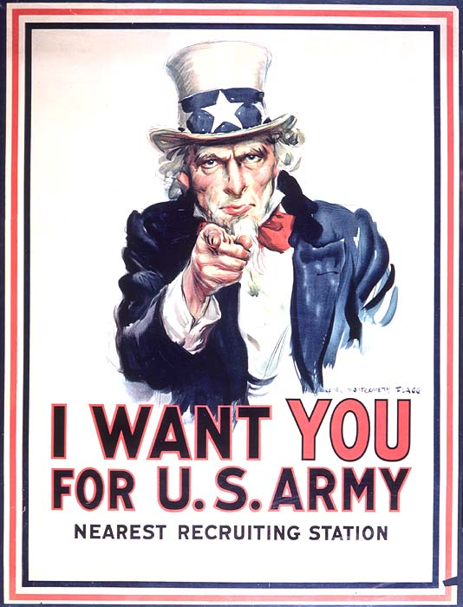
Propaganda in the U.S. Cont...
Artists like James Montgomery Flagg and Charles Dana Gibson were hired to produce the pieces
James Flagg is widely known for his Uncle Sam poster
Creel intended to place propaganda “anywhere an American would travel”
He even created propaganda films such as, “America’s Answer” and “Under Four Flags”
Even Hollywood was involved in the movement with silent propaganda films
https://youtu.be/mGH67KbsHWI

Slide 18
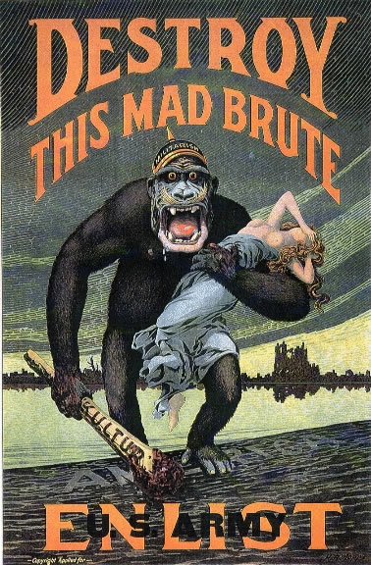
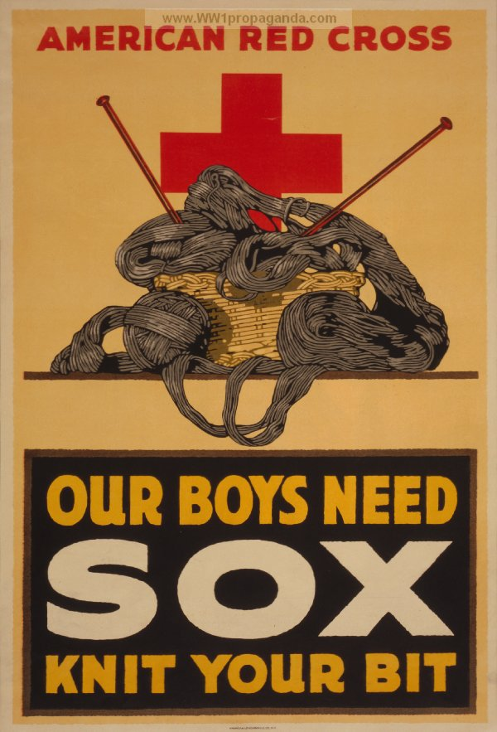
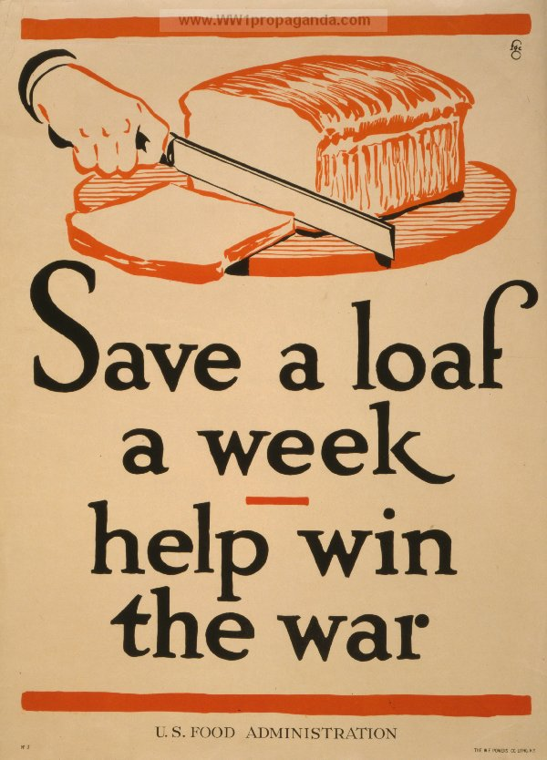

Slide 19
Anti-German Ideals
German citizens had to register with the Federal Government and had to carry the registration at all times
Early in 1917, already 2,048 Germans were imprisoned
Civilians were paranoid of German espionage or plotting
German courses were taken out of school curriculum
A man was even killed just for being German in a bar in Illinois

Slide 20
Soldiers Back Home
Many soldiers returning home from World War 1 experienced psychological issues such as PTSD caused by “shell shock” or other factors
Though, at the time the condition was not diagnosed and people thought that the soldiers were being “weak” or “cowardly”
Sigmund Freud proposed “war neurosis” as a title for these issues
Only until later did “shell shock” or “war neurosis” come to be known as PTSD

Slide 21
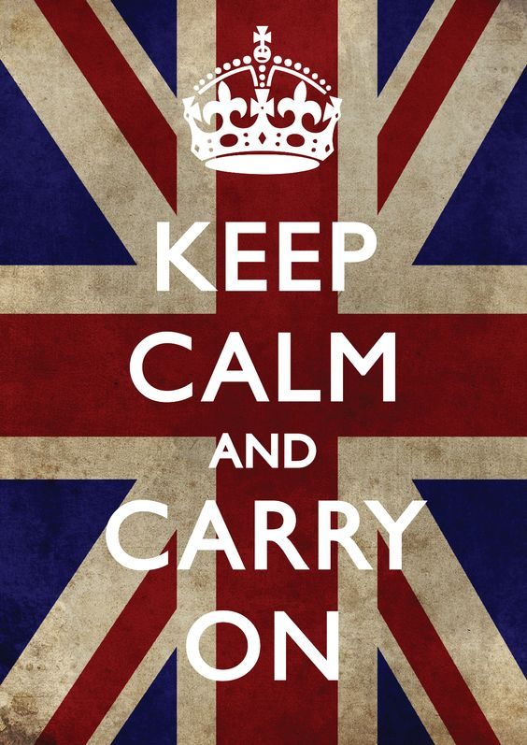
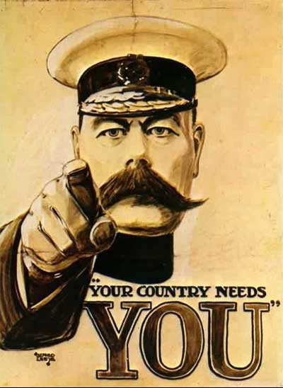
Britain Homefront
Women in the Homefront
German Air raids
Economy During the War
Mental Hospitals
People's Thoughts of the war

Slide 22
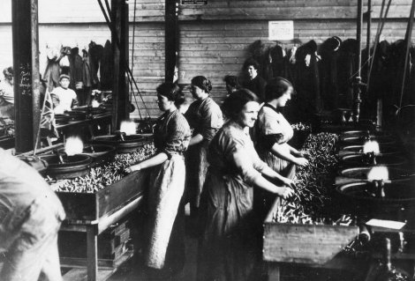
Women in British Homefront
During the war, the women were way more involved in jobs at home.
Due to all the working men leaving to fight in the war, many women took over their husbands jobs to help with the war effort.
Women worked in factories to supply 80% of the weapons to give to the army.
Women were paid lower wages than the men and lost their jobs to the men returning back from war. Those who did not worked alongside the men, but for lower wages.
The total number of women that died during factory work was about 400.

Slide 23
German Air Raids on Britain
In the beginning of the war there was a lot of patriotism and war pride.
However, when Germany started the air raids hope was almost completely lost.
The Germans used Zeppelins to drop bombs all over the British cities.
This was the first time the civilians were being targeted and killed during the war.
The very famous poster that hung on British walls in the streets came out at this time, “Keep calm and carry on”

Slide 24
Britain’s Economy During the War
During the war Britain’s economy was in shambles.
The Government had to rationalize many things just to afford the cost of the military.
Factories worked 24/7 in order to produce the necessary military equipment needed by the soldiers.
Propaganda was also a huge part of the home front in Britain. The Germans were considered the worst enemy of the Central Powers.
Britain used cartoons and slogans to sway the beliefs and thoughts of the people to join the rally for war.
Propaganda was used to mobilize hatred against the enemy; to convince the population of the justness of the cause; to enlist the active support and cooperation of neutral countries; and to strengthen the support of allies.

Slide 25
Mental Hospitals in Britain
There were over 102 psychiatric asylums in England and Wales in 1914. Over 108,000 men, women and children lived permanently in these institutions.
The conditions were awful and patients were poorly treated. Many of the patients were dealing with ptsd and other serious conditions from the war.

Slide 26
People's Thoughts of the War
At first the people were enthusiastic about the war and very proud of fighting or joining the war effort for Britain.
However after the battle of the Marne the hopes of a quick and easy war were lost and the number of casualties shocked the nation. The opinions of the war changed drastically throughout the war.
One man, Siegfried Sassoon, was a famous British poet who wrote about the horrors of the war. His poems were very controversial and he was eventually sent to a mental hospital, almost ending up in jail.

Slide 27
France home front
-Women in the war.
-Economy in France during the war.
-New leaders in France
--Propaganda
-More on women hardships

Slide 28
More on women in the war
-Many bad things happened to women during the war. Mainly factory accidents and deaths occurred which caused issues on the Homefront.
-Also the German occupation of the Northeastern part of France was a horrible place for women and they faced many hardships there. Many were either killed or raped by German officials.
-Many of the jobs gained by women in the war were eventually lost or retaken by returning soldiers from the war.

Slide 29
Women in the home front
-Due to all the men leaving for the war, the women had to take on the role of men at the time.
-Women in the countryside had to take the responsibility of all the farm work. Women in the cities took up jobs in the factories working overtime.
-Many joined nursing for the sick and wounded during the war.
-Also women wrote letters to the soldiers to increase morale. Was known as pen pals.

Slide 30
Economy in France during the war
my was hurt by Germany controlling 14% of France. The areas they controlled produced 58%of the steel and 40% of the coal.
-The national debt rose from 66% of GDP in 1913 to 170% in in 1919.
-Also inflation rose heavily and people were becoming more impoverished.
-The franc lost over half its value against the British pound.

Slide 31
New leaders in France
-Georges Clemenceau became prime minister in November 1917.
-This was a time of loss and defeat in France.
-Georges wanted to boost and restore morale of the people of France.
-He won all party support to fight to victory.

Slide 32
French propaganda in the war
-French propaganda involved a majority of hatred against Germany like Britain.
-Posters and cartoons were also used in order to portray the evil image of Germany.
-Propaganda worked for the most part in gaining support for the war from the people.

Slide 33
Serbia Home front during the war
-Begining of the war
-Serbias military and war effort
-Hardships of the war
-Deaths and casualties
-Propaganda

Slide 34
Beginning of the war
-Serbia had 350,000 men in the Balkans. This was due to a small population of 4.6 million people.
-They basically depended on France for support and leadership.
-Austria attempted a quick raid on Serbia but failed when Serbia pushed them out. Both suffered major losses from the battles.
-1915 was a sort of “peace time” due to no real military action

Slide 35
Serbia’s military
Like previously stated the military was only made up of 350,000 men.
-They were small but experienced and quick. They were faster and more intelligent in the war category then the Austrians.
-Germany took over Serbia with Austrian help. They tried to make Serbia join the empire but they didn't.

Slide 36
Serbia’s hardships
-Serbia had an extremely low supply of food.
-Also many Serbians caught typhus and died during the war.
-As previously stated Germany did take over Serbia.

Slide 37
Deaths and casualties
-The total death toll from the war in Serbia was 615,000 soldiers 600,000 Serbian civilians were dead.
-30,000 Serbian soldiers were taken prisoner during the war.
- Many also died from typhus and other diseases throughout the war.

Slide 38
Propaganda in Serbia during the war
-Like all other nations during the war, Serbia had propaganda to help persuade the people to join the cause.
-The enemy was seen as Austria-Hungaria mainly.
-The people joined the war cry and effort in order to form their own kingdom.
-Eventually they did achieve this goal and formed their own independent kingdom in 1918 after the war.

Slide 39
Citations
"Striking Women." World War I: 1914-1918. N.p., n.d. Web. 31 Aug. 2016.
Alchin, By Linda. "WW1 Mobilization." : US History for Kids ***. N.p., n.d. Web. 05 Sept. 2016.
"World War I Agencies." World War I Agencies. N.p., n.d. Web. 08 Sept. 2016
https://historyofptsd.wordpress.com/world-war-i/

