Slide 1
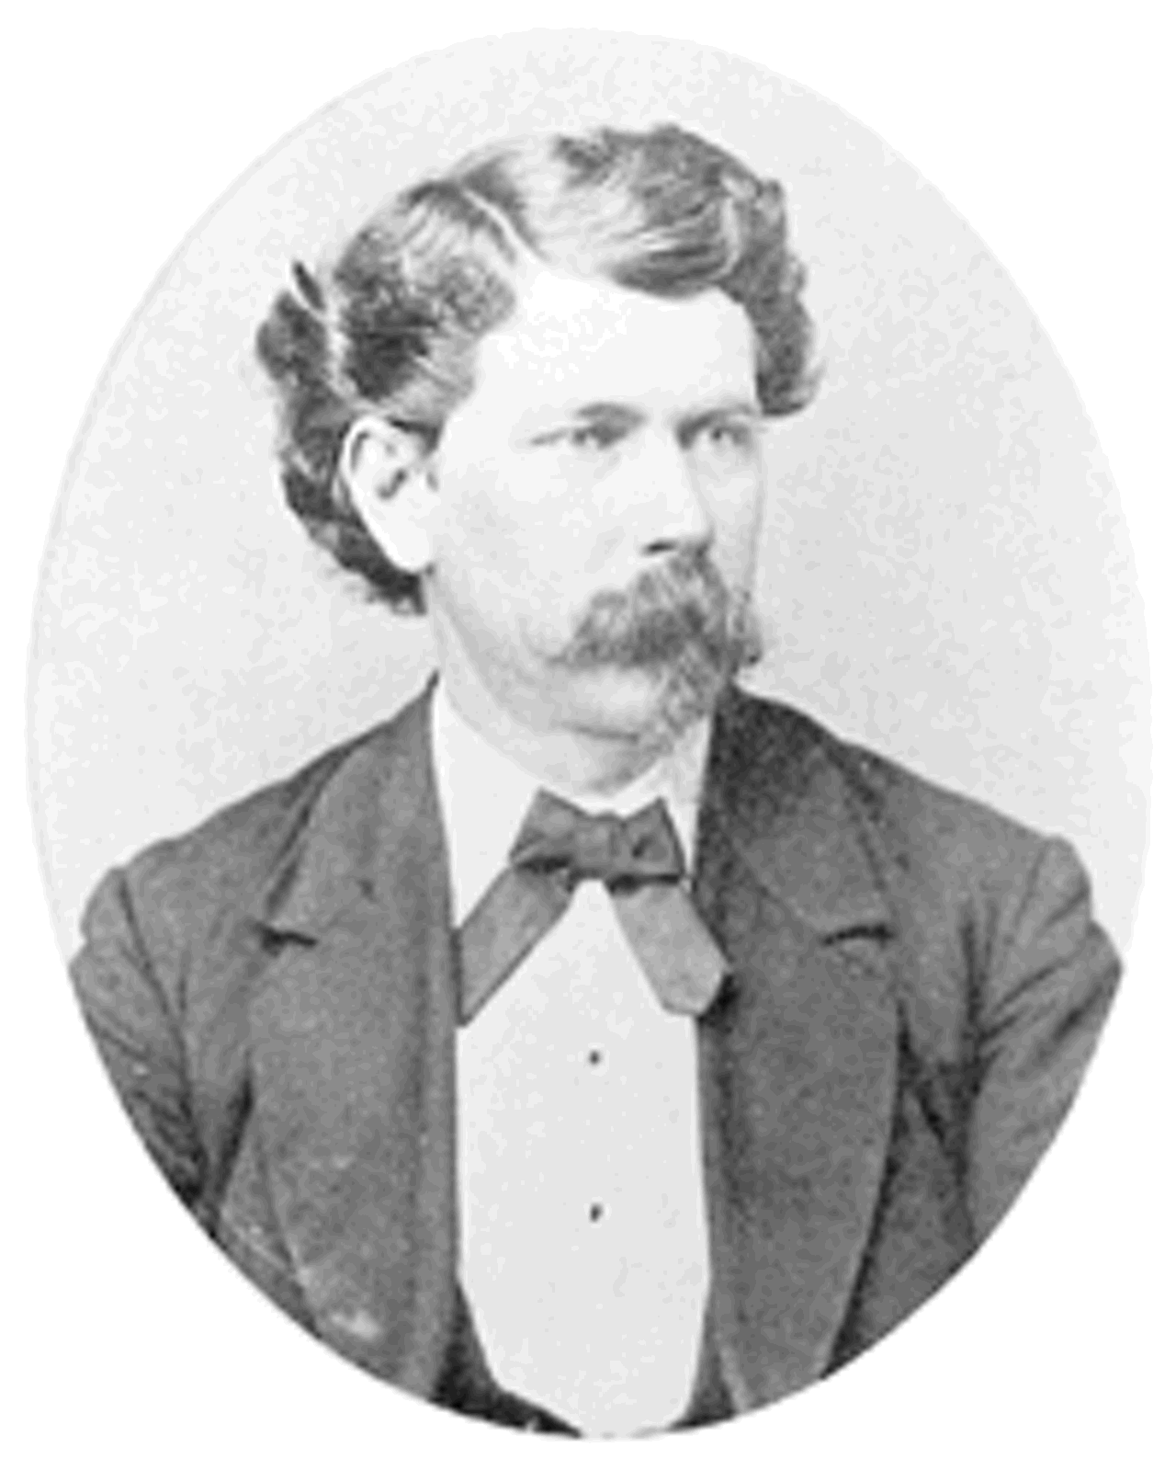
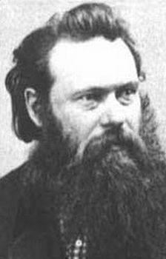
Alexander Gardner and Timothy O’Sullivan

Slide 2
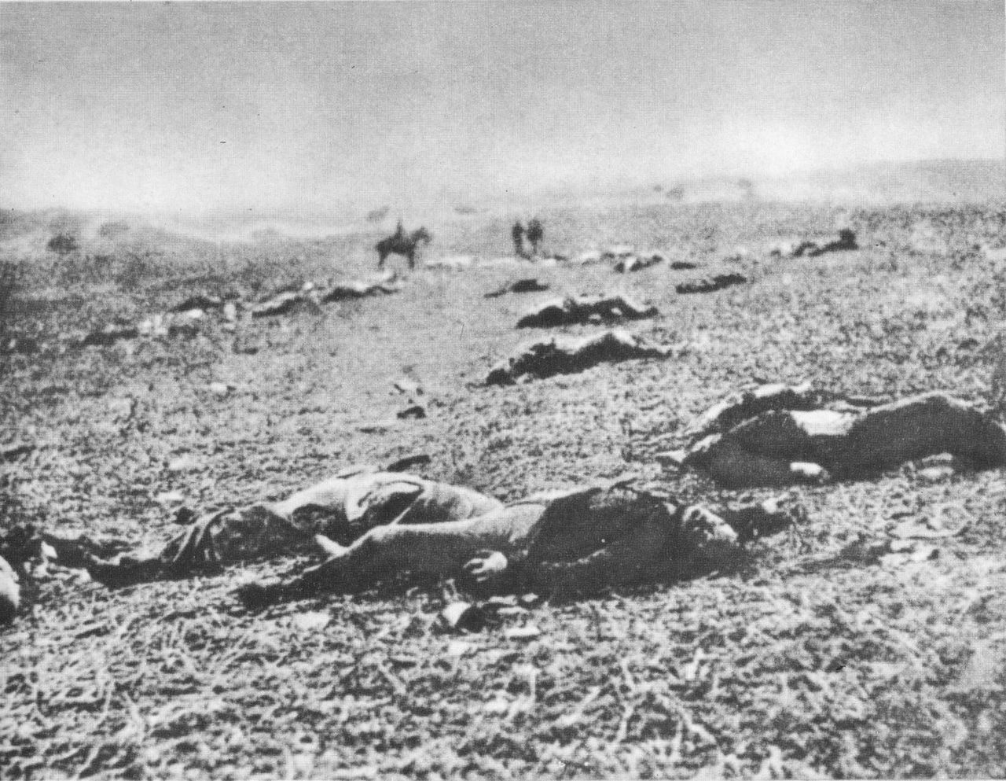
A Harvest of Death
Slowly, over the misty fields of Gettysburg--as all reluctant to expose their ghastly horrors to the light--came the sunless morn, after the retreat by Lee's broken army. Through the shadowy vapors, it was, indeed, a "harvest of death" that was presented; hundreds and thousands of torn Union and rebel soldiers--although many of the former were already interred--strewed the now quiet fighting ground, soaked by the rain, which for two days had drenched the country with its fitful showers.

Slide 3
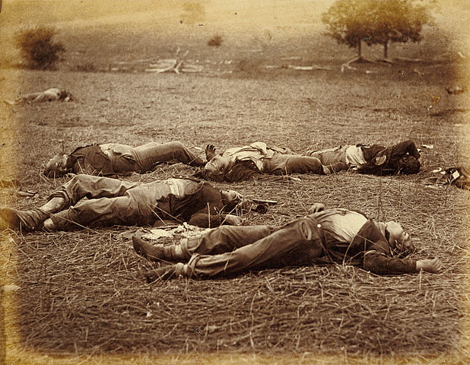
Field Where General Reynolds Fell
The dead shown in the photograph were our own men. The picture represents only a single spot on the long line of killed, which after the fight extended across the fields....The faces all were pale, as though cut in marble, and as the wind swept across the battle-field it waved the hair, and gave the bodies such an appearance of life that a spectator could hardly help thinking they were about to rise to continue the fight.

Slide 4
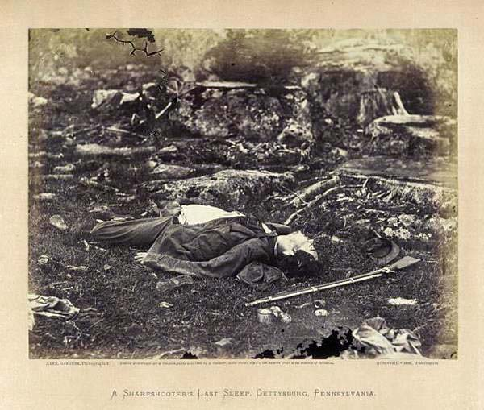
A Sharpshooter’s Last Sleep
A burial party, searching for dead on the borders of the Gettysburg battle-field, found, in a secluded spot, a sharpshooter lying as he fell when struck by the bullet. His cap and gun were evidently thrown behind him by the violence of the shock, and the blanket, partly shown, indicates that he had selected this as a permanent position from which to annoy the enemy. How many skeletons of such men are bleaching to-day in out of the way places no one can tell. Now and then the visitor to a battle-field finds the bones of some man shot as this one was, but there are hundreds that will never be known of, and will moulder into nothingness among the rocks. There were several regiments of Sharpshooters employed on both sides during the war, and many distinguished officers lost their lives at the hands of the riflemen. The first regiment was composed of men selected from each of the Loyal States, who brought their own rifles, and could snuff a candle at a hundred yards. Some of the regiments tried almost every variety of arms, but generally found the Western rifle most effective. The men were seldom used in line, but were taken to the front and allowed to choose their own positions. Some climbed into bushy trees, and lashed themselves to the branches to avoid falling if wounded. Others secreted themselves behind logs and rocks, and not a few dug little pits, into which they crept, lying close to the ground and rendering it almost impossible for an enemy to hit thim. Occasionally a Federal and Confederate Sharpshooter would be brought face to face, when each would resort to every artifice to kill the other. Hats would be elevated upon sticks, and powder flashed on a piece of paper, to draw the opponent's fire, not always with success, however, and sometimes many hours would elapse before either party could get a favorable shot. When the armies were entrenched, as at Vicksburg and Richmond, the sharpshooters frequently secreted themselves so as to defy discovery, and picked off officers without the Confederate riflemen being able to return the fire.

Slide 5
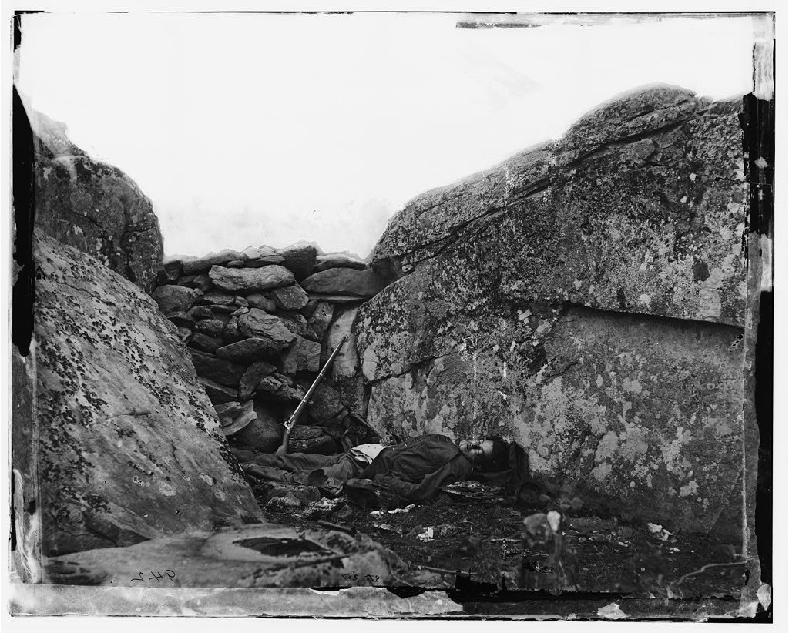
Home of Rebel Sharp-Shooter
On the Fourth of July, 1863, Lee's shattered army withdrew from Gettysburg, and started on its retreat from Pennsylvania to the Potomac. From Culp's Hill, on our right, to the forests that stretched away from Round Top, on the left, the fields were thickly strewn with Confederate dead and wounded, dismounted guns, wrecked caissons, and the debris of a broken army. The artist, in passing over the scene of the previous days' engagements, found in a lonely place the covert of a rebel sharpshooter, and photographed the scene presented here. The Confederate soldier had built up between two huge rocks, a stone wall, from the crevices of which he had directed his shots, and, in comparative security, picked off our officers. The side of the rock on the left shows, by the little white spots, how our sharpshooters and infantry had endeavored to dislodge him. The trees in the vicinity were splintered, and their branches cut off, while the front of the wall looked as if just recovering from an attack of geological small-pox. The sharpshooter had evidently been wounded in the head by a fragment of shell which had exploded over him, and had laid down upon his blanket to await death. There was no means of judging how long he had lived after receiving his wound, but the disordered clothing shows that his sufferings must have been intense. Was he delirious with agony, or did death come slowly to his relief, while memories of home grew dearer as the field of carnage faded before him? What visions, of loved ones far away, may have hovered above his stony pillow! What familiar voices may he not have heard, like whispers beneath the roar of battle, as his eyes grew heavy in their long, last sleep!

Slide 6
Do these pictures tell the Truth about war?

Slide 7
Anything seem suspicious about these pictures?

Slide 8
Ecclesiastes 1:17 “I applied my heart to know wisdom, and to know madness and folly. I perceive that this also was a chasing at the wind. For in much wisdom, is much grief. And he that increaseth knowledge, increaseth sorrow.”

Slide 9
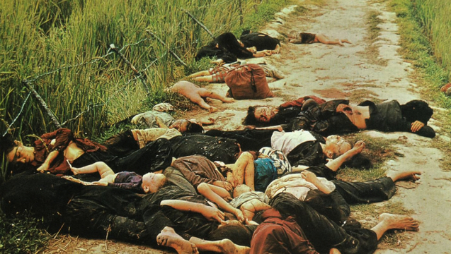

Slide 10
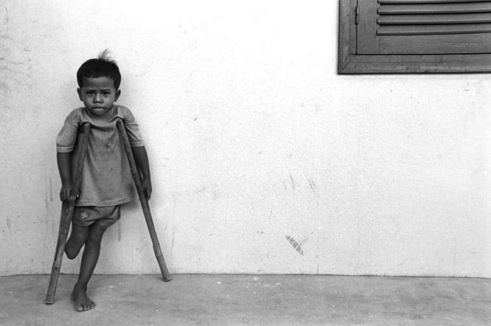

Slide 11
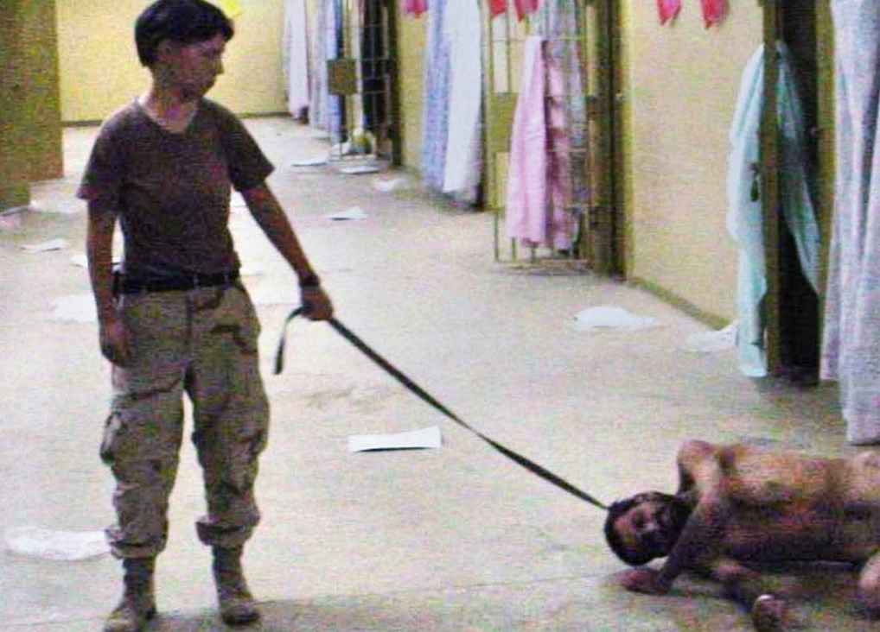

Slide 12
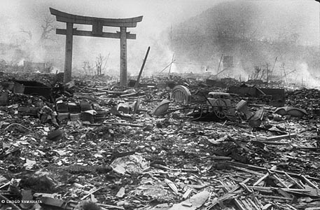

Slide 13
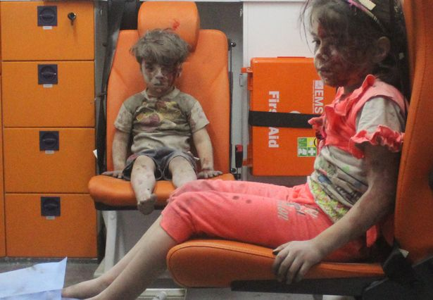

Slide 14
