Slide 1
Gallipoli
By: Kally Lorentz, Owen Sherman, Joe Thorgersen

Slide 2
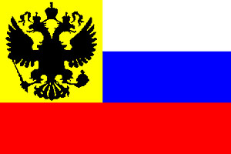
Countries Involved
Central Powers involved Austria Hungary, Ottoman Empire(modern day Turkey), Germany, Bulgaria
Allied Powers involved were Russia, France, Australia, USA, United Kingdom

Slide 3
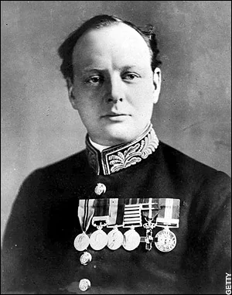
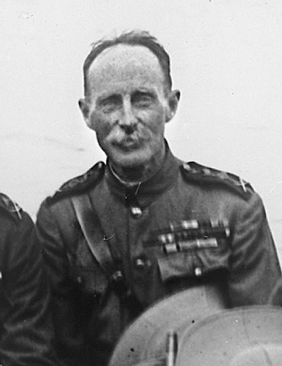
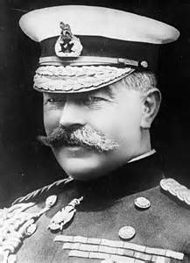
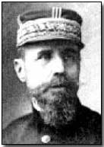
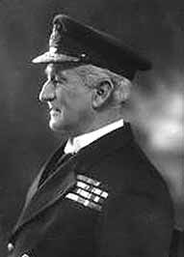
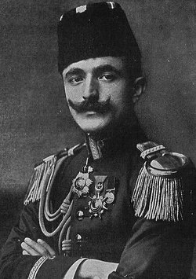
Important Figures
Winston Churchill 1874-1964. First Lord of the Admiralty. Resigned in 1915
Herbert Kitchener 1850-1916. Appointed Secretary of State in 1914. Played a crucial role
Generals
John De Robeck 1875-1924 Royal navy officer.
Ian Hamilton 1853-1947 officer in British Army, commanded Gallipoli campaign.
Henri Gouraud 1890-1937 French general
Enver Pasha 1914-1918 Ottoman General.
Otto Liman Von Sanders 1874-1918. German general.

Slide 4
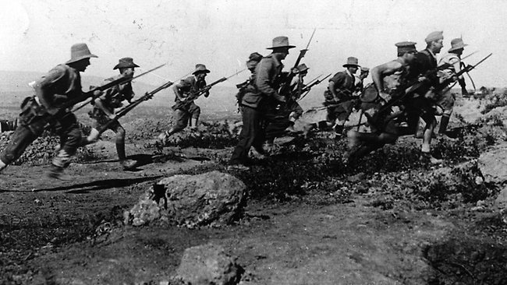
What was It?
The Gallipoli Campaign, or Dardanelles Campaign, of 1915-16, was an unsuccessful attempt by the Allied Powers to control the sea route from Europe to Russia during World War I.

Slide 5
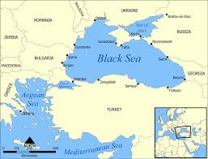
What was at stake?
What was at stake during the Gallipoli campaign was the Black Sea to the east and the Mediterranean to the west.
The stakes were high for both sides. British control over the straight would allow them a direct line to the Russian navy in the Black Sea, enabling the supply of munitions to Russian forces.
The Allies and the Central Powers were competing for support in the Balkans.
Britain hoped that a win in the region would persaud one or all of the neutral States to join the war on the allies side.

Slide 6
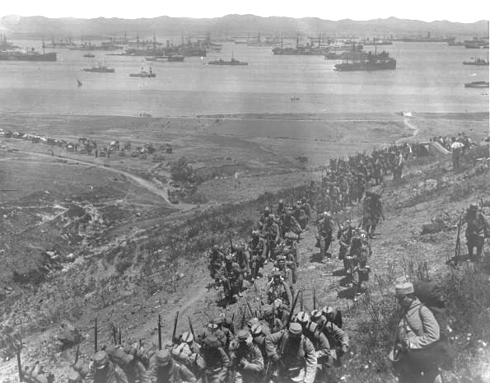
Launch of Gallipoli Campaign
Allied Powers were debating going on the offensive in another region of the conflict, rather than continuing with attacks in Belgium and France.
Russia’s Grand Duke Nicholas appealed to Britain for aid in confronting a Ottoman invasion. (The Ottoman Empire had entered World War I on the side of the Central Powers)
Allies decided to launch a naval expedition to seize the Straits, and the narrow passage connecting the two seas in the northwestern part of the Ottoman Empire.
Capture of the straits would allow the Allies to link up with the Russians in the Black Sea, where they could take out the Ottoman Empire.
the naval attack on the began with a long-range bombardment by British and French battleships on February 19, 1915.

Slide 7
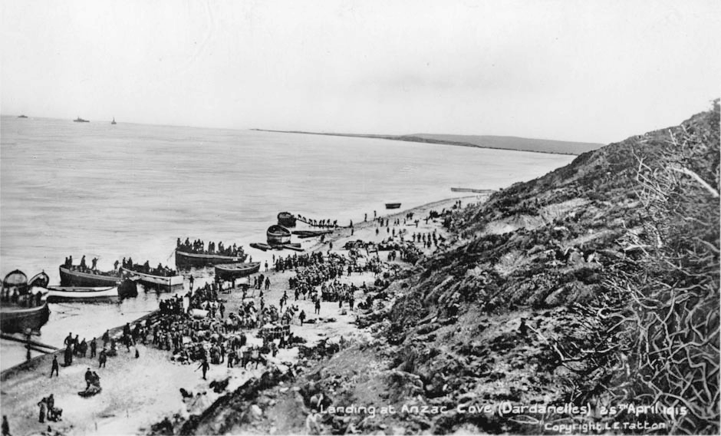
Gallipoli Land Invasion Begins
In the wake of the failed naval attack, preparations began for large scale troop landings on the Gallipoli Peninsula.
General Ian Hamilton command, troops from Australia, New Zealand and the French colonies assembled with British forces.
The Ottomans boosted their defenses, and began positioning troops along the shore where they expected the landings would take place.
On April 25, 1915, the Allies launched their invasion of the Gallipoli Peninsula. Despite suffering heavy casualties, they managed to establish two beachheads.
After the initial landing, the Allies were able to make little progress from their initial landing sites, because of the Ottomans.
The surprise landings at the Bay proceeded against little opposition, but Allied indecision and delay stalled their progress, allowing Ottoman reinforcements to arrive and increase their defenses.

Slide 8
Video:

Slide 9
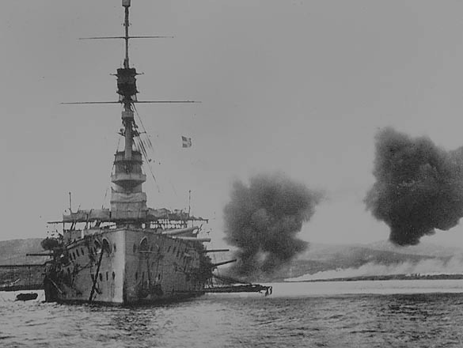
Decision to Evacuate
With Allied casualties in the Gallipoli Campaign mounting, Hamilton petitioned Kitchener for 95,000 reinforcements.
In mid-October, Hamilton argued that a proposed evacuation of the peninsula would cost up to 50 percent casualties.
By early November, Kitchener had visited the region himself and recommendation that the remaining 105,000 Allied troops should be evacuated.
The British government authorized the evacuation to begin from on December 7; the last troops left on January 9, 1916.

Slide 10
VIDEO:

Slide 11
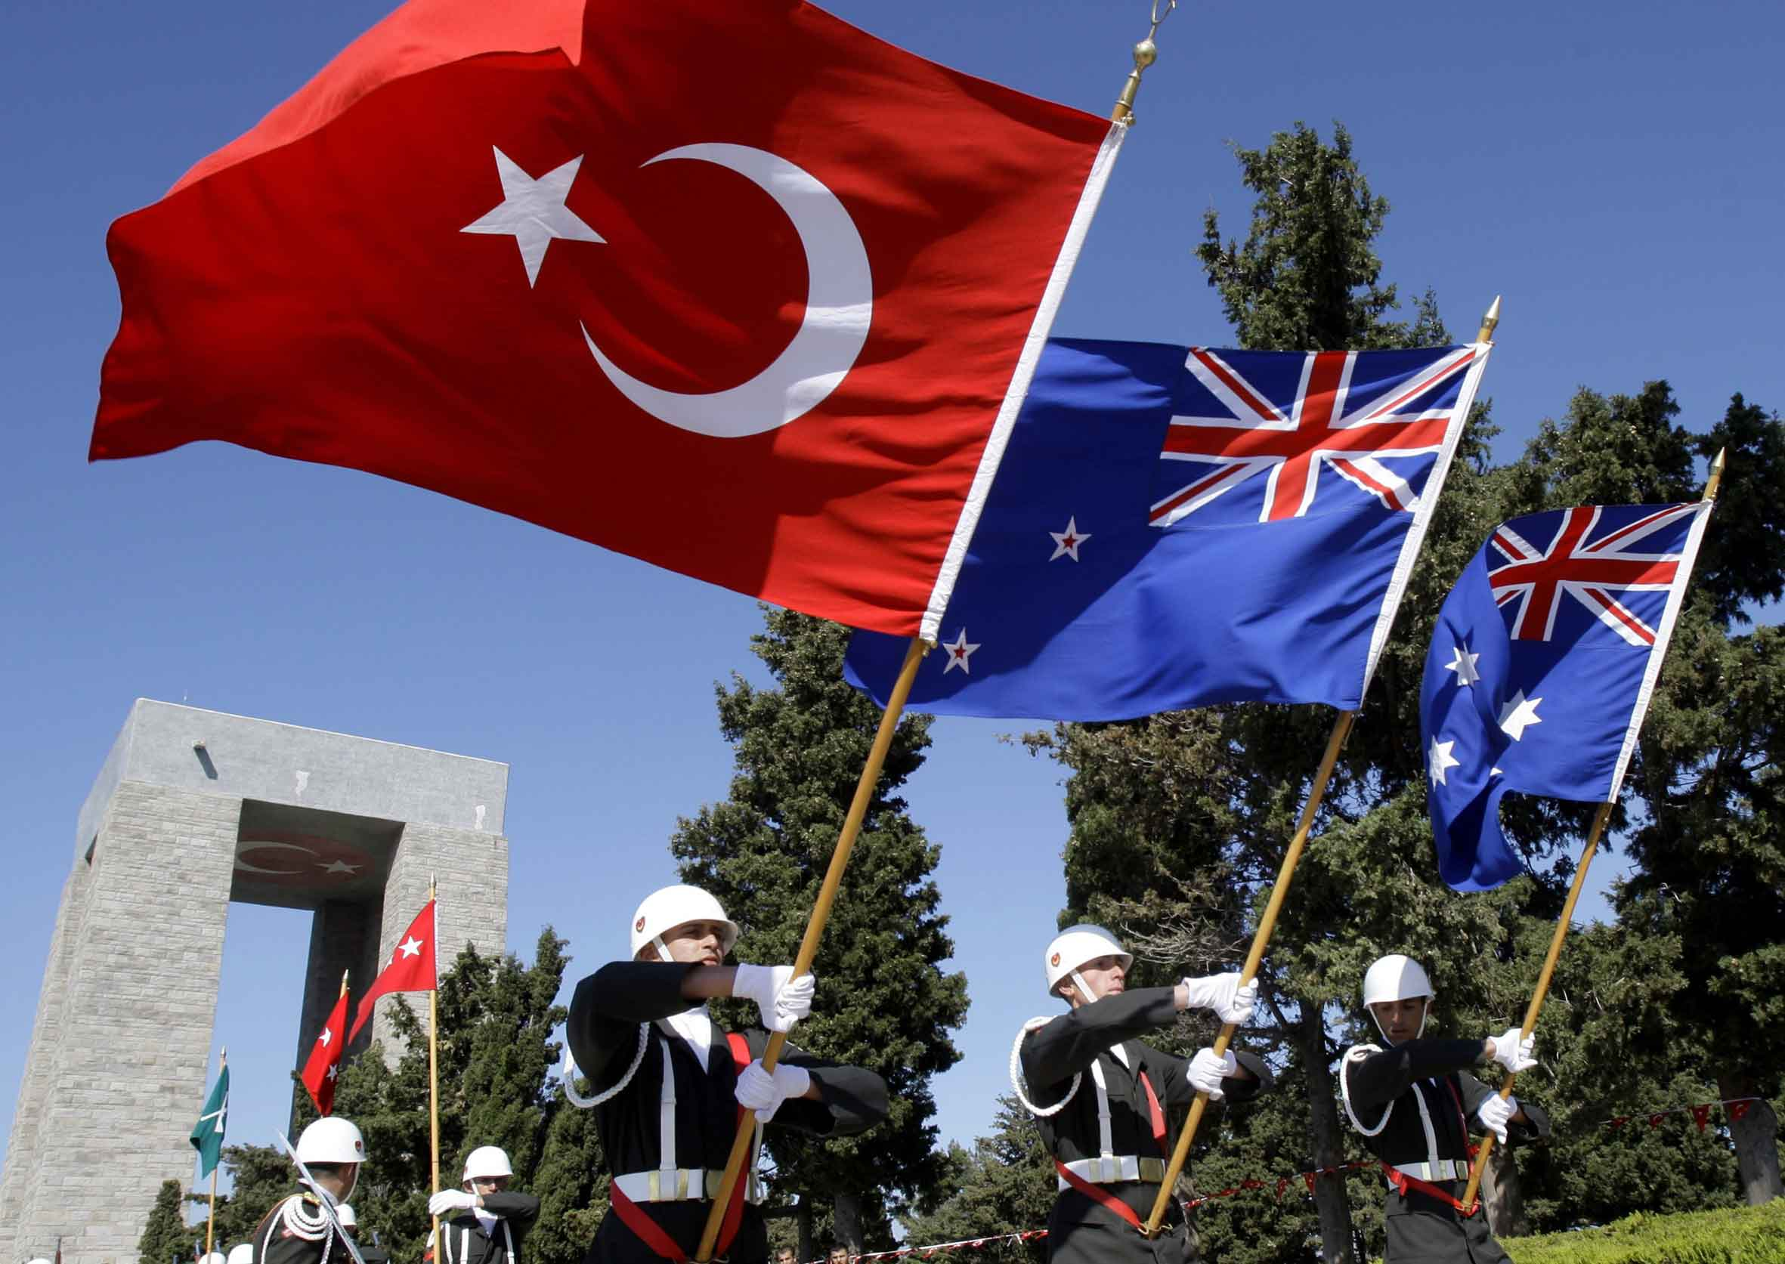
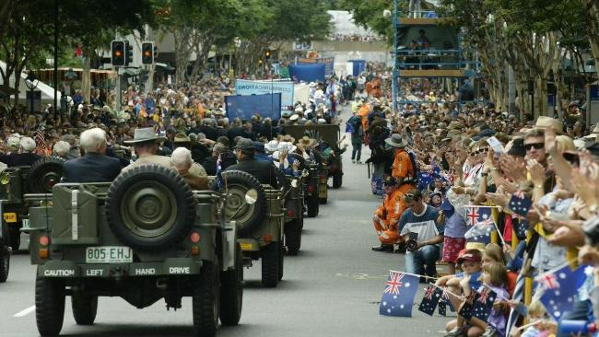
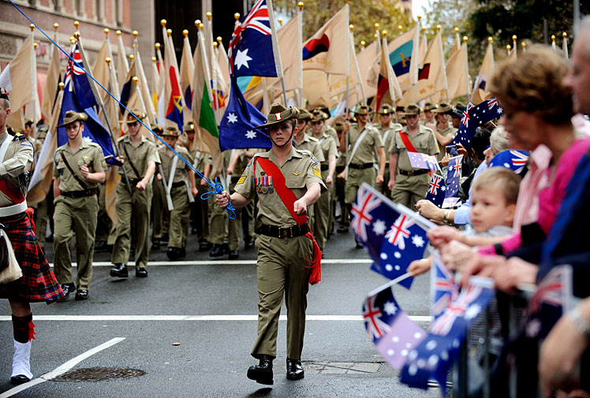
Legacy
The significance of the Gallipoli Campaign is felt strongly in both New Zealand, and Australia.
The campaign proved significant in the emergence of a unique Australian ientity, which became known as “Anzac Spirit”.
The landing on April 25th is commemorated every year in both countries as Anzac Day
In Turkey the battle is thought of as significant in the state’s emergence, although it is primarily remembered for the fighting that took place around the port.

Slide 12
VIDEO:

Slide 13
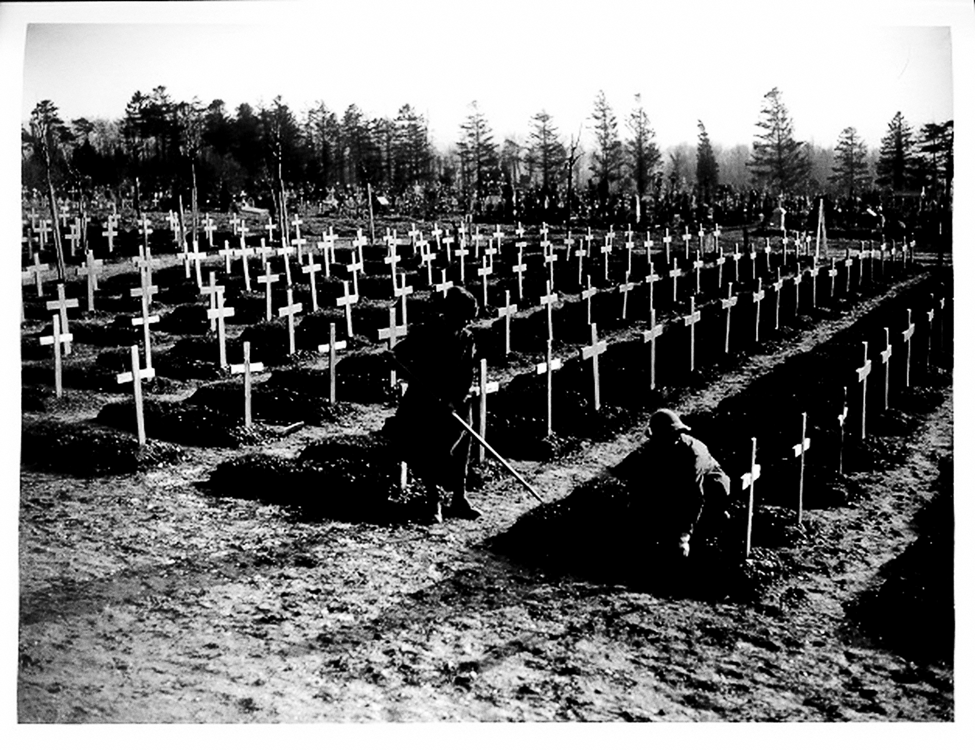
Aftermath
In all, some 480,000 Allied forces took part in the Gallipoli Campaign.
An estimated 505,000 soldiers were killed and 262,000 wounded
27,169 french
28,150 Australians
7,473 New Zealand
4,779 Indian
142 Newfoundland
And 329,338 Ottoman Empire casualties

Slide 14
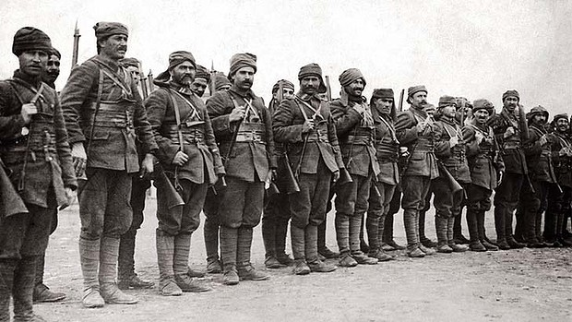
Fun Facts:
The Allies never made it past the beach.
Submarines played a big role in the battle.
The failure of Gallipoli almost derailed Winston Churchill's career.
Three separate national identities were forged at Gallipoli.
The last Gallipoli survivor made it to the 21st Century.

Slide 15
Works Cited
Neiberg, Michael S. Fighting the Great War: A Global History. Cambridge, MA: Harvard UP, 2005. Print
Tucker, Spencer C. World War I: Encyclopedia. Santa Barbara, CA: ABC-CLIO, 2005. Print. "Battle of Gallipoli." Http://www.history.com/topics/world-war-i/battle-of-gallipol. N.p., n.d. Web"Famous
People of the First World War." Http://www.biographyonline.net/military/wwi/people-first-world-war.html. N.p., n.d. Web.
History.com Staff. "Dardanelles Campaign." History.com. A&E Television Networks, 2009. Web. 30 Aug. 2016.
"Gallipoli Campaign (WW1) – Overview." History Clicking. N.p., n.d. Web. 30 Aug. 2016.
Greenspan, Jesse. "8 Things You May Not Know About the Gallipoli Campaign." History.com. A&E Television Networks, 24 Apr. 2015. Web. 30 Aug. 2016

Slide 16
Works Cited Con.
https://www.youtube.com/watch?v=B3E_OcZXRVk
https://www.youtube.com/watch?v=BuaIpBMWiuA
http://www.gallipoli.gov.au/north-beach-and-the-sari-bair-range/evacuation-of-anzac.php

