Slide 1
Economic Systems
“ism’s” in the hiz-isms-ouse!

Slide 2
Capitalism
The U.S. economy is usually described as capitalist, or free enterprise
Five characteristics of capitalism
Private ownership and control of property/economic resources
Free enterprise
Competition among businesses
Freedom of choice
Possibility of profits

Slide 3
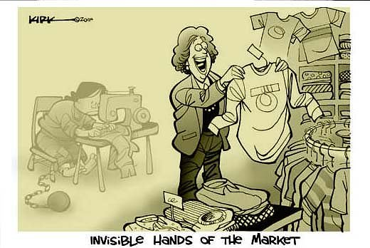
Origins of Capitalism
Adam Smith
Scottish philosopher and enlightenment thinker
Suggested a free market system in which government plays no role in making economic decisions
Also known as Laissez-faire, meaning “to let alone”

Slide 4
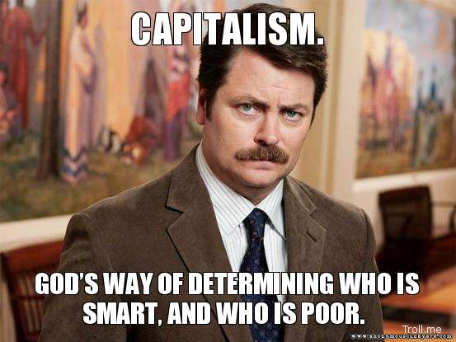
Just remember…
Capitalism= free market = free enterprise = laissez faire

Slide 5
Capitalism in America
No countries actually use a purely capitalist system.
America, like most countries has a mixed economy in which free enterprise is combined with and supported by government decisions in the marketplace.
Examples?

Slide 6
Features of Modern Capitalism
Deregulation: Reduced size of government and regulation of business activity
Privatization: Selling publicly owned goods and services to private, for-profit individuals and companies
Reduce or cutting government social benefits
Minimum wage
Welfare
Social Darwinism- “Survival of the Fittest”
Globalization
Growing Income Inequality
High Production Levels

Slide 7
Marxism
Karl Marx: German sociologist who studied capitalism.
Believed that human history could be best understood as class conflict between the “haves” and the “have nots”
Examples?
Studied the French Revolution where the working class overthrew the ruling class.
Capitalists, also known as bourgeoisie, control the means of production
Workers, also known as the proletariat, provide goods and services.

Slide 8
Haves=Capitalists=Bourgeoisie
Have Nots=Workers=Proletariat

Slide 9
Communism
Marx believed that the proletariat would overthrow the bourgeoisie and redistribute all resources equally, dissolve government, and build a classless society.
All resources in a communist society would be public property
Private property, not the same as personal property

Slide 10
Socialism
Socialists believe that economic inequality can be eliminated democratically
Socialism: the government owns the basic means of production and attempts to distribute resources equally
Authoritarian Socialism: Ruling party controls all aspects of economy. Citizens are subjects to the state.
Examples?
Democratic Socialism: Citizens have basic rights and free elections.

Slide 11
What does a Democratic Socialist society look like?
Government provides
Health care
Education (college too)
Higher taxes on the wealthy, redistributed to the poor
Examples
Norway
Denmark
Sweden

