Slide 1
Unit 2
Consumer Economics

Slide 2
Consumer Economics
Focuses on the decision making of individuals and households.
Everyone in a capitalist society is a consumer (any person or group that buys or uses goods and services to satisfy personal needs and wants).
What is an example of a consumer economics activity we have already done?

Slide 3
Two types of Income
Consumers use their income to buy goods and services
Disposable income is the money a person has left after all taxes have been paid.
Remember that people have needs and wants.
Any money that is left after paying for needs is called discretionary income.

Slide 4
Rational Choice
When consumers make decisions based on opportunity cost, they are engaging in rational choice.
The rational choice is the alternative that has the greatest perceived value.
You want the best-quality item for the cheapest amount
Can you give an example of a time when you made an irrational choice when buying something?

Slide 5
Impulse Buying
When people buy items without making a rational choice it’s called impulse buying.
Can you think of any examples?
Impulse buys usually happen when there is a limited amount of time for buyers to consider their options.
Can you think of any examples?

Slide 6
Buying Principles and Strategies
As a consumer, your goal should be to obtain the most satisfaction from your limited income and time.
What are some strategies you could use to make smart purchases?

Slide 7
Three Basic Buying Principles
Gathering Information
Using Advertising Wisely
Comparison Shopping

Slide 8
Gathering Information
Obtain information on what you are buying
Research on the internet
Read reviews
Remember, you have a scarce amount of time to research and make decisions

Slide 9
Use Advertising Wisely
Competitive advertising: Advertising that attempts to persuade consumers that a product is different from and better than others.
Informative advertising: Aids consumers by providing useful information about a product
Some companies use false advertising or bait and switch
Bait and switch: The bait is an advertised item at an unrealistically low price. When the consumer gets to the store, a salesperson points out all the bad features of the item and shows them higher priced models

Slide 10
Comparison Shopping
Comparison Shopping: Getting information on the types and prices of products available from different stores and companies.
Use competition to your benefit!
What are some situations where it’s good to comparison shop?

Slide 11
Homework: Hurray!
You need to create three advertisements for the same product.
One that is informative
One that is competitive
One that appeals to impulse buying
Your ads should be NEAT and COLORED

Slide 12
Consumerism
As a consumer, you have a number of rights and responsibilities to keep in mind.
There are some government agencies in place to look out for consumers.
Ultimately it is up to YOU to spend your money wisely

Slide 13
Consumer Rights
Consumerism is a movement to educate buyers about the purchases they make and to demand better and safer products from manufactures
The idea of consumerism has roots from the progressive movements in the early 1900s.
Journalists called muckrakers exposed corruption in business and government
Upton Sinclair’s The Jungle was published in a socialist paper. It exposed the filthy sanitation and abysmal working conditions in the stockyards and meat packing industry

Slide 14
Consumer Rights
The work of Sinclair and other muckrakers led to tighter government regulations to protect the public
Lead to the creation of the Food and Drug Act and the Meat Inspection Act
Why is consumer protection important today?

Slide 15
Financial Crisis
Result of deregulation
Banks loaned to irresponsible home owners
Banks foreclose on houses when the irresponsible owners don’t make payments and try to resale the homes for profit
Market is flooded with empty houses
Value of homes plummet
Homeowners find out that the CDO’s (Collateralized debt obligations) they were talked into buying are actually useless

Slide 16
Consumer Protection Agency

Slide 17
Okay so besides the whole “banks destroying the economy dealio,” would things really be so bad without consumer rights?
Well let’s take a look…
http://www.hbogo.com/#series/video&assetID=GOROSTGP39832?videoMode=embeddedVideo?showSpecialFeatures=false/

Slide 18
Buying the Necessities
Food
Clothing
Home
Vehicle

Slide 19
Food
Purchasing food involves comparison shopping
Things to consider
Price
Quality
How much time do you have to spend looking around
Transportation
All of these factors must be considered when making a decision

Slide 20
Clothing
Style
Durability: The ability of an item to last a long time
Service Flow: The amount of use a person gets from an item over time and the value a person places on this use
If you buy a jacket for $400 and wear it for 4 years the annual service flow is $100.
Cost of Care (maintenance)

Slide 21
Buying/Renting a Home
The average American family spends 25-33% of their income on housing
Choosing to rent or buy a home is a BIG decision.
Most people rent homes before they buy

Slide 22
Renting
Requires a security deposit: Funds a renter lets an owner hold in case the rent is not paid or the apartment is damaged.
Renters don’t pay maintenance or real estate taxes
Allows for greater mobility
You don’t have to sell the property if you want to move
Renters sign a lease: long term agreement describing the terms in which the property is rented

Slide 23
Purchasing a House
Mortgage: An installment of debt owed on houses, buildings, or land
Closing Costs: Fees involved in arranging for a mortgage or in transferring ownership of property.
Legal costs
Loan application
Credit report
House inspections
Taxes
Buying a home in a long-term investment!

Slide 24
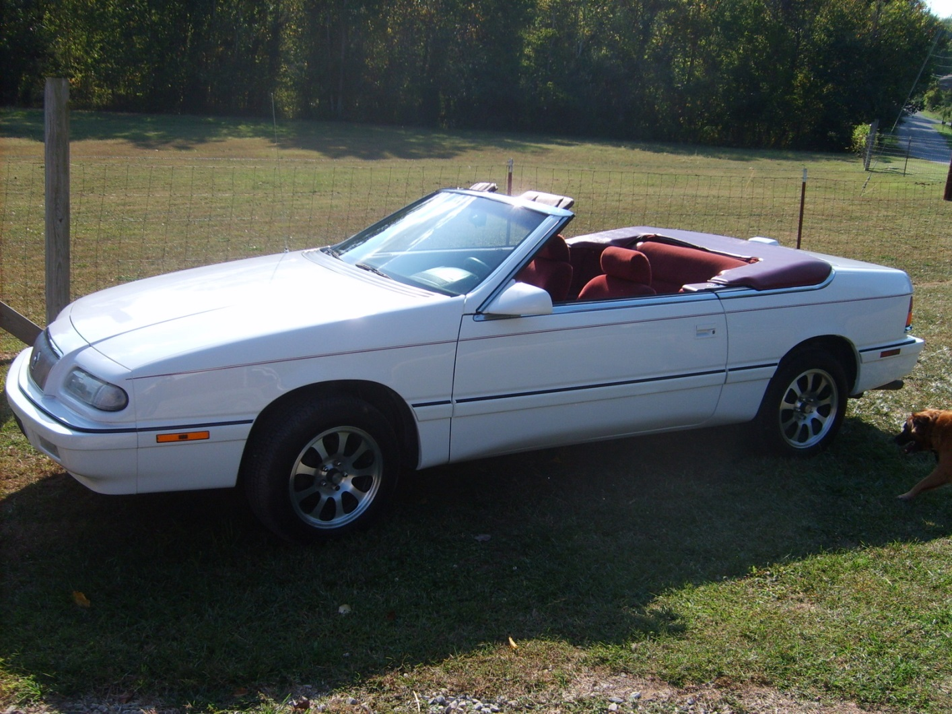
Buying a Vehicle

Slide 25
New or Used
New
used
More expensive
Lower maintenance costs
Often come with a warranty to protect owners for all major repairs.
Usually last a certain number of years or miles
Less expensive
High maintenance costs
You may not know the vehicle’s history
Always have a mechanic check out any used car you buy!

Slide 26
Owning a Car
Depreciation: A decline in value over time
All durable goods depreciate
“Wear and tear”
Outdated technology
Liability Insurance: Insurance that pays for bodily injury and property damage
Flip to page 132 in your textbook to see some of the factors insurance companies consider

Slide 27
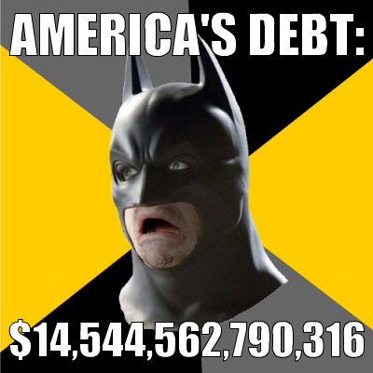
Going into Debt!

Slide 28
Going into Debt!
Credit: The receiving of funds either directly or indirectly to buy goods and services today with the promise to pay for them in the future.
Principal: The amount originally borrowed
Interest: The amount the borrower must pay for the use of someone else’s funds. (The bank)
Installment Debt: type of loan repaid with equal payments, or installments, over a specific period of time

Slide 29
Why People Use Credit
People go into debt in order to buy expensive necessities such as cars, homes, education, and equipment.
While no one in particular is forcing them to go into debt, debt in needed to survive.
Reasons while debt is useful
Allows consumers to have access to goods and services immediately
“If you owe the bank $1 million, the bank owns you. If you owe the bank $1 billion, you own the bank.

Slide 30
Sources of Loans and Credit
Commercial Bank: Main functions are to accept deposits, lend funds, and transfer funds among banks, individuals, and businesses. These banks also make major investments on Wall Street.
Savings and Loans Associations: Depository institution that accepts deposits and lends funds.
Savings Banks: Depository institution originally set up to serve small savers overlooked by commercial banks.

Slide 31
Sources of Loans and Credit
Credit Unions: Depository institution owned and operated by its members to provide savings accounts and low-interest loans only to its members
Finance Company: Company that takes over contracts for installment debts from stores and adds a fee for collecting the debt
Consumer Finance Company: Makes loans directly to consumers at high interest rates

Slide 32
Charge Accounts and Credit Cards
Charge Account: Credit extended to a consumer allowing the consumer to buy goods or services from a particular company and to pay for them later
Credit Cards: Credit device that allows a person to make purchases at many kinds of stores, restaurants, and other businesses without paying cash.
Debit Cards: Payment method in which funds are taken directly from your checking account. Debit Cards do not provide loans or credit.

Slide 33
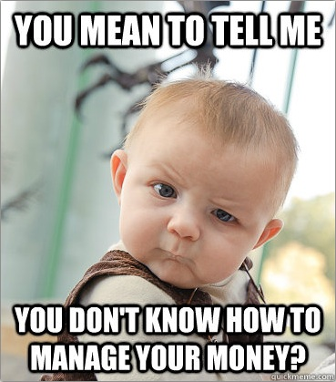
Finance Charges and APR
Finance Charge: Cost of credit expressed monthly in dollars and cents
Annual Percentage Rates: Cost of credit expressed at a yearly percentage

Slide 34
Applying for Credit
Credit Bureau: Private business that investigates a person to determine the risk involved in lending to that person
Credit Check: Investigation of a person’s income, current debts, personal life, and past history of borrowing and repaying debts.
Credit Rating: Rating of the risk involved in lending to a specific person or business
Collateral: Something of value that a borrower lets the lender claim if a loan is not repaid
Secured Loans are backed by collateral, unsecured loans are not

Slide 35
Personal Bankruptcy
Bankruptcy: The state of legally having been declared unable to pay off debts owed with available income
When bankruptcy is approved by a court, debtors must give up most of what they own
http://www.youtube.com/watch?v=hiCilTzhXrA

