Slide 1
Banking Services and Types of Money

Slide 2
Let’s look at some of the services offered by banks…
Savings Account: Pays interest, has no maturity date, and from which funds can be withdrawn at any time without penalty.
Checking Account: Deposited funds can be withdrawn at any time by writing a check.
Overdraft Checking: Checking account that allows a customer to write a check for more money than exists in his or her account.

Slide 3
Where to save your money?
Type of Account | Minimum Deposit? | Interest Rate? | Availability of Funds?
Savings | No | Low | Immediate
Money Market | $1,000-$2,500 | High | Immediate
Time Deposit | $1,000 | High | Depends on maturity; penalty for withdrawal
Certificates of Deposit: Time deposits that state the amount of the deposit, maturity, and rate of interest being paid.

Slide 4
How do these services affect your money?
Account | Amount Invested | Interest Rate | Original Investment plus interest after 12 months
Savings | $1,000 | 0.8% | $1,008.00
CD | $1,000 | 4% | $1,040.00
If you have money that you will not need for a while it is better to save it in a time deposit, like a CD, because the interest will earn you more income.

Slide 5
Electronic Banking
Electronic Funds Transfer: system of transferring money from one bank account directly to another without any paper money changing hands
Automated Teller Machine (ATM): Machine that lets consumers do their banking without the help of a teller.
Many banks no allow you to do you banking on your cell phone or computer!
Convenient, but what are some problems with this?

Slide 6
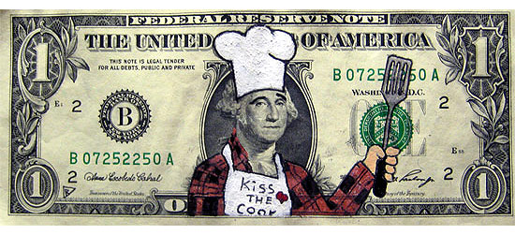
Types of Money in the U.S.
1. Currency: Coins and dollar bills, also known as Federal Reserve Notes.

Slide 7
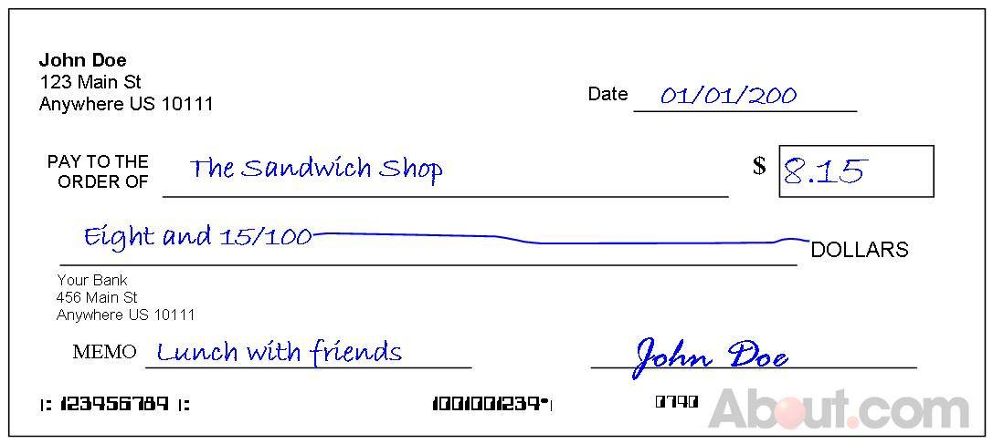
Checks
Checkable Deposits: Funds deposited in a bank that can be withdrawn at any time by presenting a check.
How to write a check?

Slide 8
Credit and Debit Cards
Credit cards are loans to you by the issuer of the card. They defer payments rather than complete transactions that ultimately involve the use of money.
Debit cards electronically withdraw money from the consumer’s checking account and transfer it directly to the store’s bank account.

Slide 9
The Money Supply
Near Moneys: Assets such as savings accounts that can be turned into money relatively easily without the loss of value.
M1: Narrowest definition of the money supply; consists of money that can be spent immediately and against which checks can be written.
M2: Includes all of M1 plus near moneys.

