Slide 1
Article of the Week Assignment
Discussion Formats

Slide 2
Socratic Seminar
Open class discussion
Assign tasks to group members
Discussion Leader
Text police
Question master
Inner/Outer circle
Everyone has a partner. Discuss each article at a time with one partner participating in discussion while other partner takes notes outside
Small groups

Slide 3
Philosophical Chairs
Group asks yes or no questions and students respond by moving from one area in the classroom to another

Slide 4
Rotating Stations
Class is divided into small groups. Each group is assigned a different station where they are given several minutes to discuss a provocative question/issue and record their ideas on a poster or whiteboard. When this time is up the groups move to new stations in the classroom where they continue their discussion, based on the ideas they encounter from the previous group. Rotations continue every few minutes until each group has been at all of the positions and has had a chance to consider all of the other groups' comments.

Slide 5
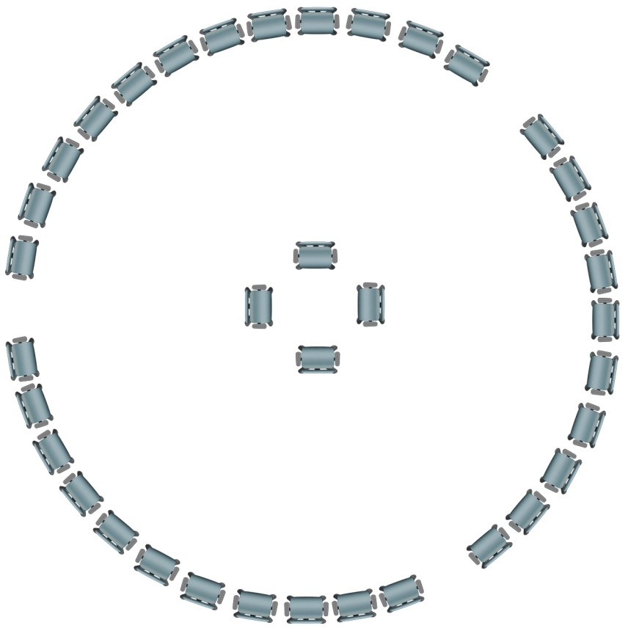
Fish Bowl
Debate activity in which students are broken up into teams. Each team must have one person in the middle of the classroom participating in debate. You may tag out/in just like a professional wrestling match!

Slide 6
Think-Pair-Share
Group creates a series of questions for everyone to answer on their own.
After responding to the questions on a sheet of paper, find a partner and share with them.
After partners have discussed, share with the classroom.

Slide 7
Possible Current Event Topics
Foreign Affairs
Cuba, ISIS, Iran, North Korea, Russia, China, Mexico, women's rights in the middle east
Election
Candidates, Polls, Issues, Primaries, ect
Social Issues
Prison system, War on Drugs, Same-sex marriage, affirmative action, abortion, use of torture, police brutality
Economic Issues
Health Care, Wall Street, Poverty, Inequality

Slide 8
Some Good Sources
Cnn.com
Politico.com
News.vice.com
Huffingtonpost.com
america.aljazeera.com

