Slide 1
The Armenian
Genocide
By: Jason N, Chip P,
& Jason P

Slide 2
What is a Genocide?
Genocide is the organized killing of a people for the express purpose of putting an end to their collective existence.
Typically well planned and organized as well as access to certain machinery and vehicles.
Considered a “State Crime” as usually only the government has to means to commit such a crime.
1944, Polish-Jewish lawyer Raphael Lemkin
Ancient Greek: Geno (race) + cide (killing)

Slide 3
Background Information
The start of World War 1 called the great war lasted from 28th of july 1914 to the 11th of November 1918. More than 70 military personnel, including 60 million europeans were mobilized in one of the largest wars in history.
There were two sides the Triple Entente which consisted of the British Empire, French Republic and Russian Empire and the Central Powers which were The German Empire, Austria Hungary and The Ottoman Empire

Slide 4
Background Information Cont.
Why did the world powers make alliances? Great Britain, France and Russia did this because they shared an absolute monarchy and were intent on defending the deep differences in their goals from the imperialistic ambitions of Germany and Austria Hungary
Armenia was the first country to make their national religion christianity. But control of the region shifted from one empire to the next which was the Ottoman Empire. So in 1915 the Turkish government set a plan to expel and massacre armenians living in the Ottoman Empire.

Slide 5
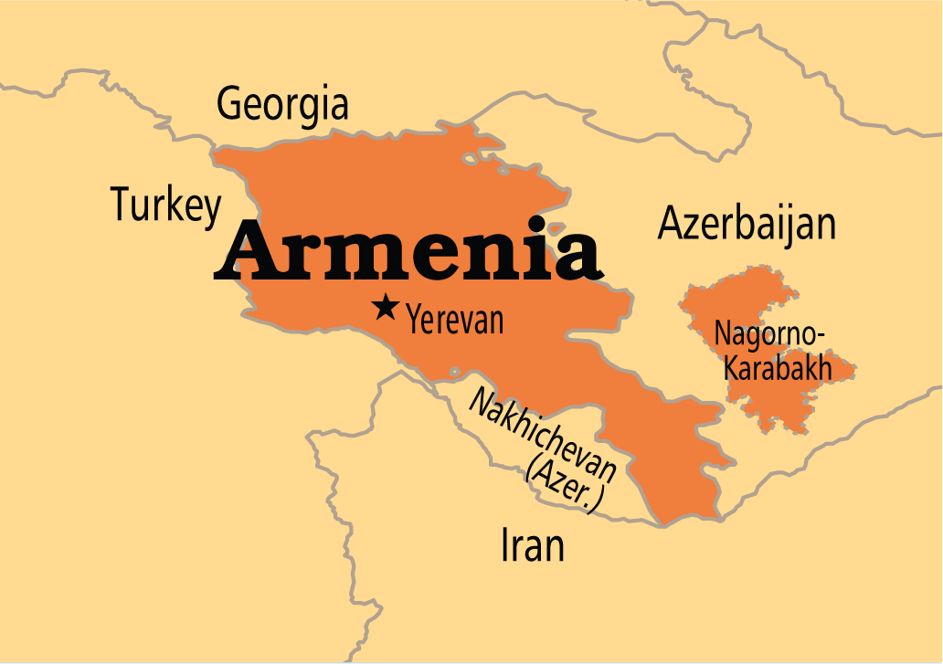
The Armenian Genocide
The Armenian Genocide was centrally planned and administered by the Turkish government against the entire Armenian population of the Ottoman Empire.
carried out during W.W.I between the years 1915 and 1918.
Estimated around 2 million Armenians killed.
Commemorated on April 24th.

Slide 6
Armenian Genocide Documentary
https://www.youtube.com/watch?v=QgUXRVnO_rM

Slide 7
Important Documentary Points
Hamidian massacres, Pre Genocide
Started because the Armenians wanted equal rights and treatment between Muslims and Christians, Sultan Abdul Hamid II didn't want Armenian nationalism to rise.
Women suffrage movement in america helped aid Armenians
April 24, 1915, known as the beginning of the genocide even though violence took place before
Death marches made Armenians march to to the syrian desert, food and water wasn’t supplied

Slide 8
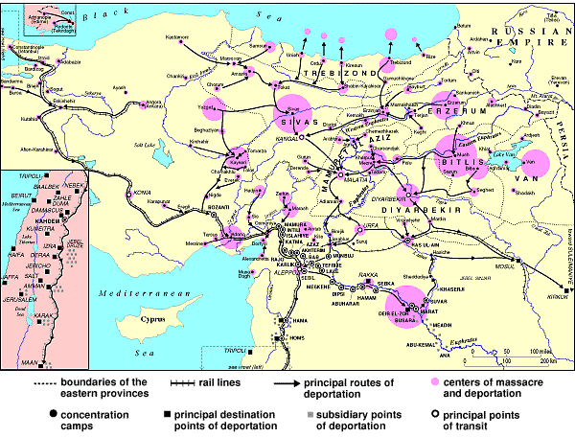

Slide 9
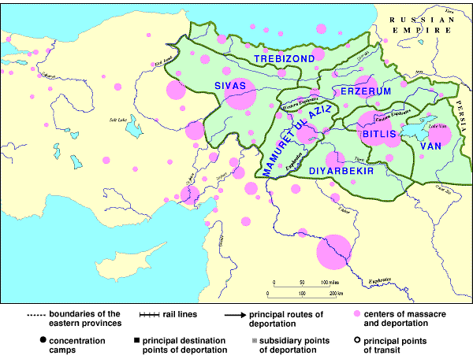

Slide 10
Unrest in Turkey
Military officers staged a Revolution and executed people for the slightest offense.
Brutal dictatorship
Armenian = Christian minority through Ottoman Empire.
Turkish government used World War I as a distraction for the Armenian Genocide.
“Officially” begins 1915.

Slide 11
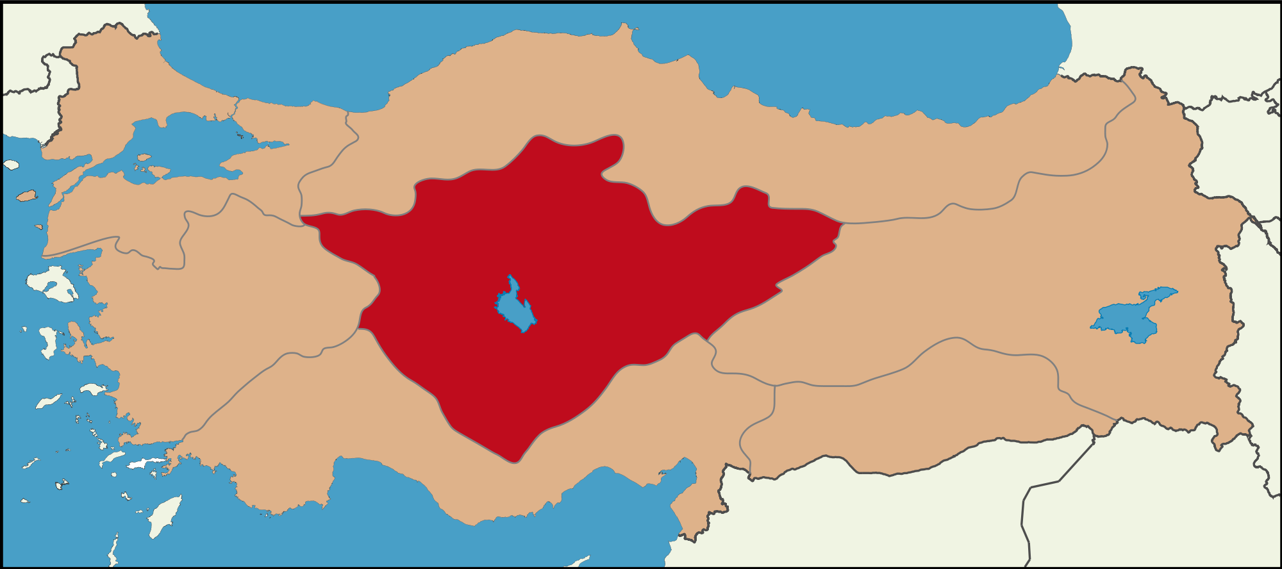
The Start in 1915
Government summoned hundreds of Armenian leaders to Istanbul
All murdered in cold-blood, slaughtered like cattle.
Armenians were forced marched into deserts in Syria.
Thousands died in the march.
Much more were killed in outright, cold-blooded massacres in Anatolia.

Slide 12
Witnesses of the Genocide
American missionaries and German Officials were first to spread the news
News made headlines in America about the Genocide occurring in Turkey during WWI.
Germans condoned the actions being taken, some reported to their superior what was happening.
Russia witnessed first hand when they took over part of Anatolia.
Many arabs saw the appalling conditions the Armenians were in when deported to Syria.

Slide 13
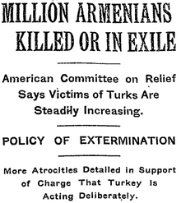
International Response
May 1915 - Britain, France, and Russia advice Young Turks that they will be held responsible for their actions.
Public Outcry in the United States for what happened to the Armenians
Relief efforts were mounted to save the starving Armenians
No action was taken against Turkish Government, despite being prosecuted.
No restitution was given to those who survived the Armenian Genocide in Turkey

Slide 14
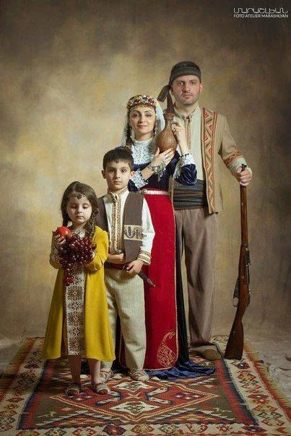
Families and Lives
Armenian women and girls from age 7 to 40 years old were sold in auctions.
More than 500 Armenian families were forced to change to islam.
Rape and beating were common. Those who were not killed at once were driven through mountains and deserts without food, drink or shelter. Hundreds of thousands of Armenians eventually were killed.

Slide 15
During the Genocide
1908 the “Young Turks” came to power and wanted to “Turkify” the empire, which was bad for the Armenians
In the city Gardens, the Armenian army force only had 1500 trained riflemen possessing only about 300 rifles 6 a.m, April 20th
Ottomans surrender in 1918 and the “Young Turks”leaders fled to Germany so they couldn't be prosecuted for the actions
Armenian nationalists made a plan to track the leaders down and assassinate them
The Government today says the reason they killed the Armenians was because they were an enemy force

Slide 16
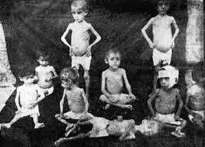
During the Genocide cont.
April 24th, 1915, also known as the start of the Genocide, the turkish government arrested hundreds of Armenian leaders and executed them.
Killing squads were organized by the Young Turks, they were usually made up of ex-convicts to kill Armenians
In 1922, when the Genocide was over, 388,00 Armenians were left out of the 2 million they lived there before
today , it is illegal to talk about what happened to the Armenians in that era in Turkey

Slide 17
John Oliver 100 year anniversary
https://www.youtube.com/watch?v=HGHBbaShIhU

Slide 18
Modern Day Knowledge
Sad that people don’t know about this genocide whatsoever, or only know of it because of the Kardashians.
The word ‘Genocide’ can’t be used when talking about Turkey to keep political relations in good shape
Before Obama’s election, he said it once. Since being in office, he has never used it again.

Slide 19
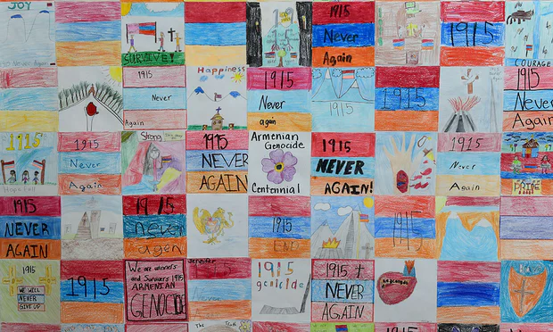

Slide 20
Armenian survivor stories
https://www.youtube.com/watch?v=VvG75gvQmU4
https://www.youtube.com/watch?v=Xq9FgRQcJXQ

Slide 21
Fun Facts
It is illegal to talk about what happened to the Armenians in Turkey.
Many Armenians who live in the US are children or grandchildren of those who fled turkey during the genocide.
It is possible that if the Turkish government at the time had the technology the Nazi’s used, the Armenians would've all died.

Slide 22
Sources
Daniels, Patricia. Hyslop, Stephen. Almanac of World History. Washington, D.C.: National Geographic, 2003. Print.
Bryce, James Bryce. The Treatment of the Armenians in the Ottoman Empire. N.P: Hodder & Stoughton, 1916.
History.com Staff. "Armenian Genocide." History.com. A&E Television Networks, 2010. Web. 11 Sept. 2016.
URL: http://www.armenian-genocide.org/genocidefaq.html
https://www.youtube.com/watch?v=QgUXRVnO_rM
https://www.youtube.com/watch?v=HGHBbaShIhU
https://www.youtube.com/watch?v=VvG75gvQmU4
https://www.youtube.com/watch?v=Xq9FgRQcJXQ
http://www.history.com/topics/armenian-genocide

