Slide 1
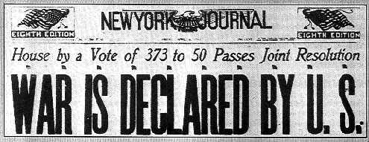
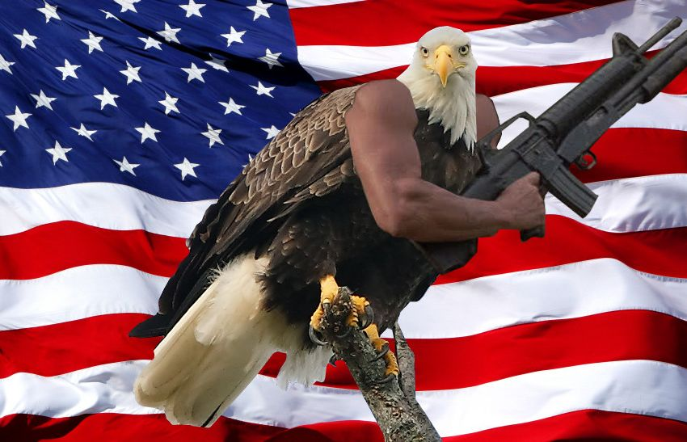
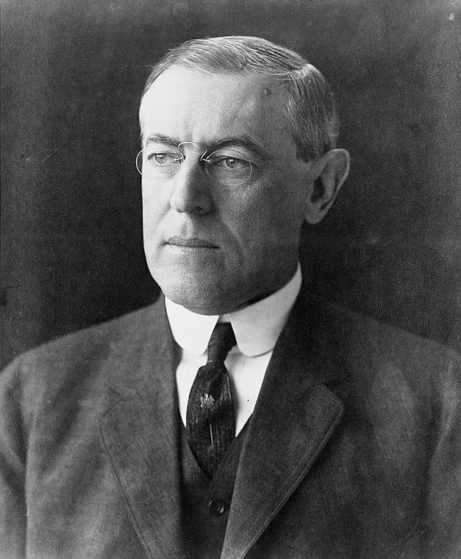
America’s Entrance Into the Great War
By: Shane Antonacci, Shige Hatanaka, and Branden Chung

Slide 2
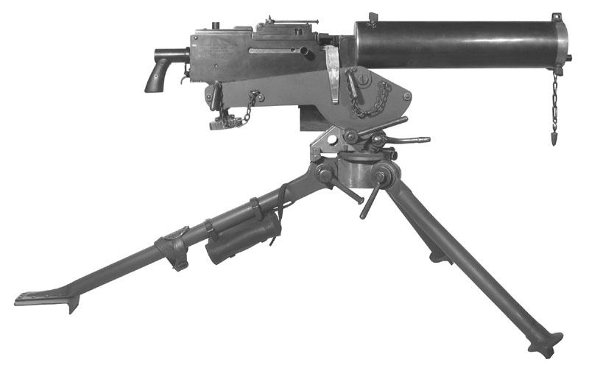
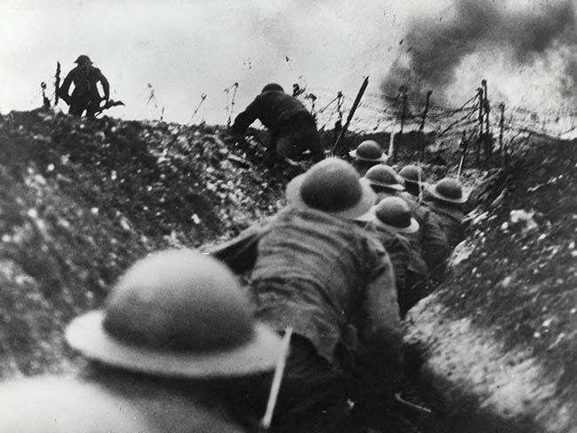
The Great War Before American Entrance
After the assassination of Archduke Franz Ferdinand by a Serbian nationalist, the entire continent of Europe was in a frenzy within days.
On July 28th of 1914, Austria-Hungary declared war on Serbia.
Serbia was allied with Russia at the time, which meant that Russia entered the war in defense of Serbia.
Germany had given Austria-Hungary the “blank check” meaning they would have their back if any country declared war on them leading to Germany declaring war on Russia and France.
This lead to Great Britain declaring war on Germany to protect their Ally France

Slide 3
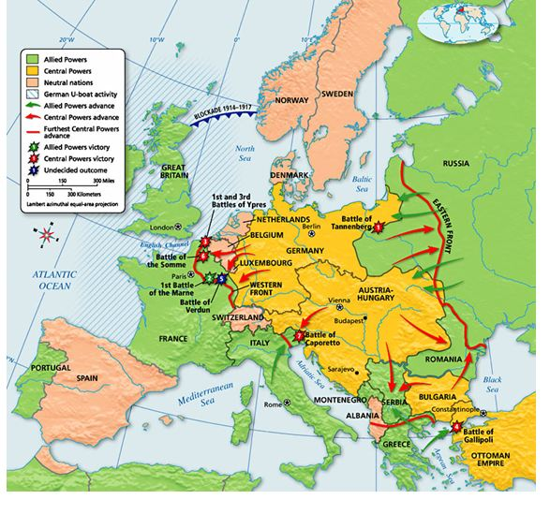
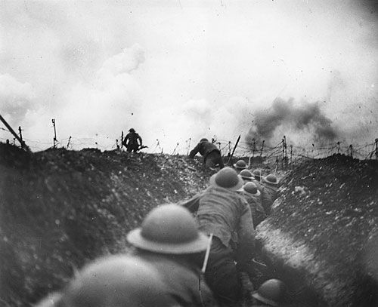
The Great War Before American Entrance Cont.
By September of 1914, most of the major powers of Europe had gotten involved in war with each other.
As the continent of Europe exchanged in warfare, the neutral United States were finding increasingly difficult to stay out of the war, with German hostilities threatening America.

Slide 4
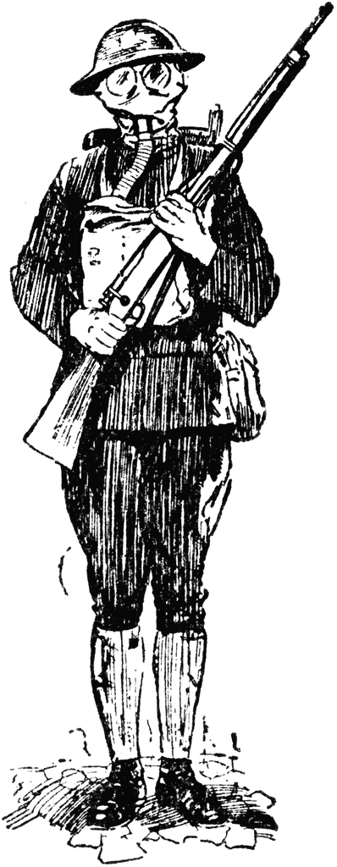
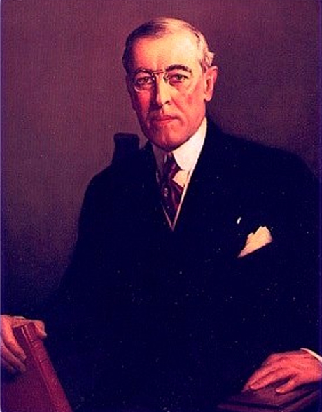
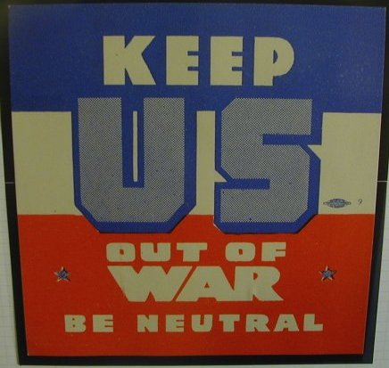
Issues of Neutrality in the United States
Although the United States had declared neutrality, this was overlooked by the pro-British concepts presented by President Woodrow Wilson at the time, which would imply that the United States were not completely impartial.
This created bad relations with Germany as a result.

Slide 5
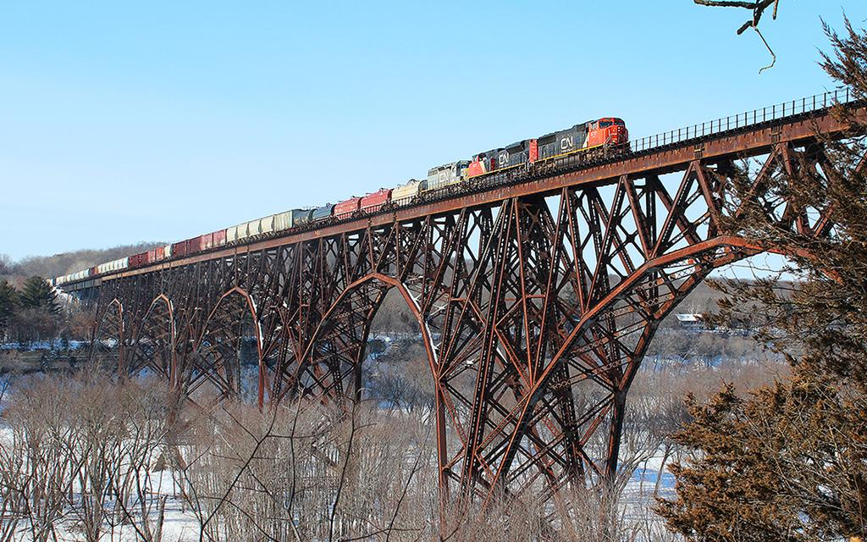
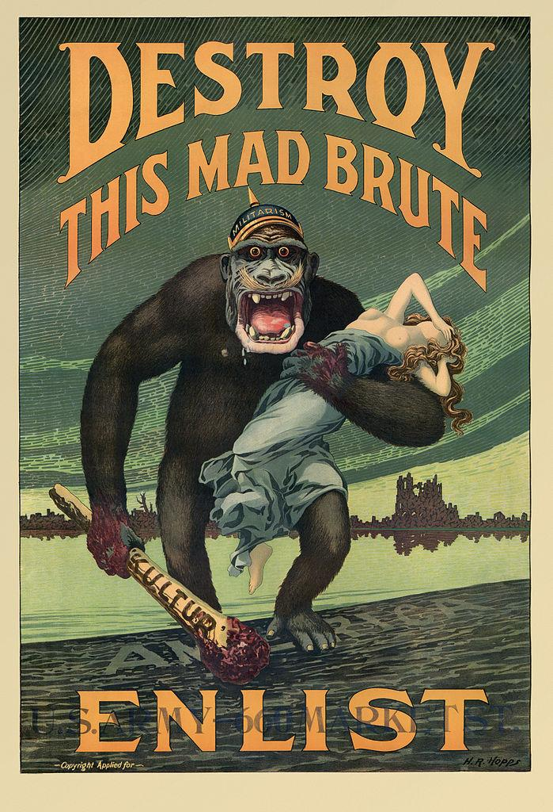
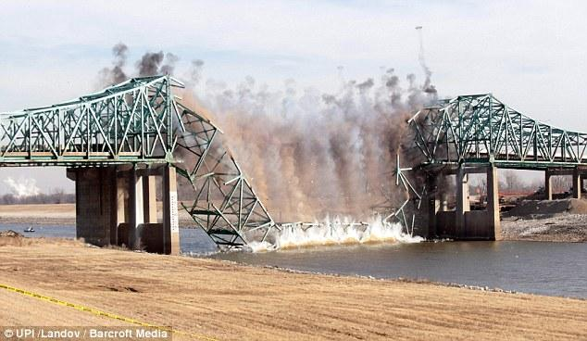
The train in Maine
A German officer was arrested in February of 1915 for exploding a bridge on the St. Croix River in Maine.
This was done as a preliminary threat to the United States to join the war by the Germans.

Slide 6
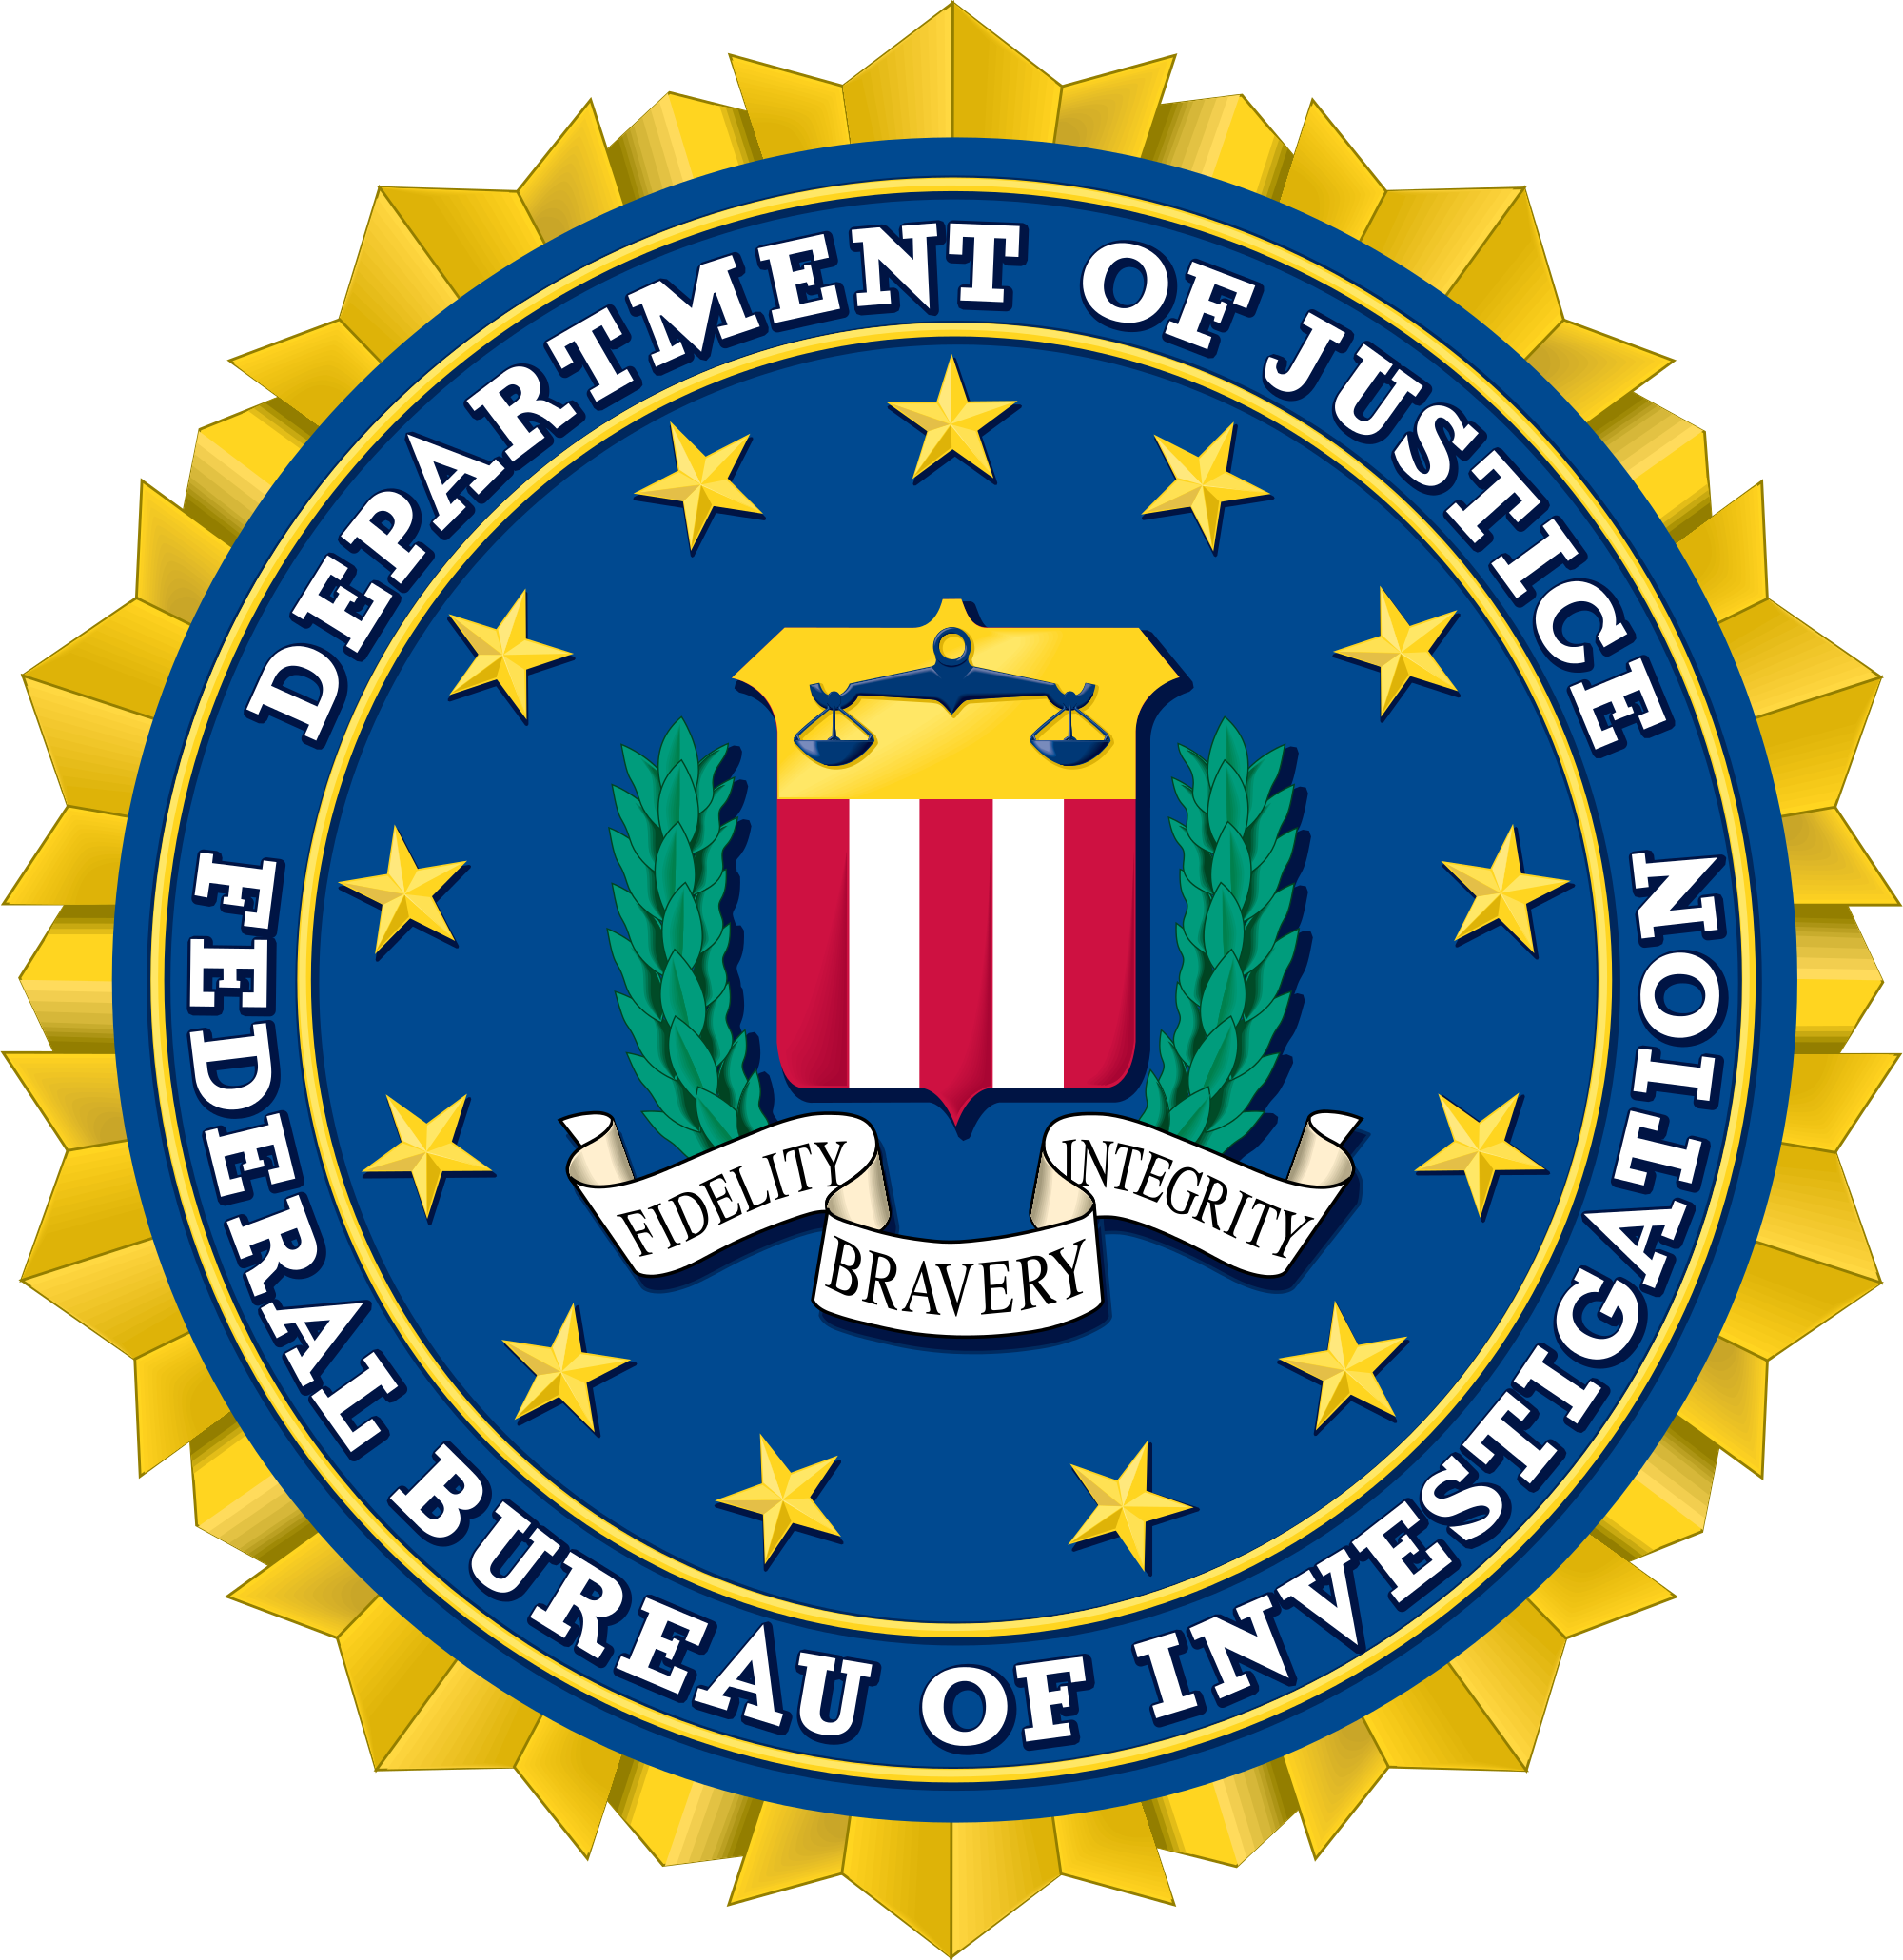
FBI During WWI
Americans were in fear of getting attack by German spies.
America was on high alert for a year after its entrance into the great war, due to an attack on a warehouse of American munitions.
The FBI was created on June 1908, Roosevelt had the Attorney General Charles Bonaparte create the FBI.
Woodrow Wilson told Americans that anyone who spoke out against the war was in effect an enemy combatant.
This lead to the FBI’s use of their first nationwide domestic surveillance programs under the Espionage Act of 1917.

Slide 7
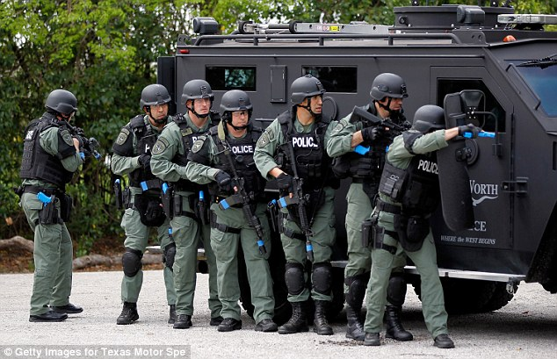
FBI During WWI Cont.
During this time period the FBI started using the power that they had to be used politically, for example when the Industrial Workers of the World tried to protest against the war, they were labeled as backers of the German cause and this lead to an FBI raid on the company.
The FBI’s abuse of power later led to thousands of innocent people being arrested without trial.

Slide 8
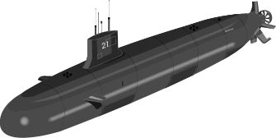
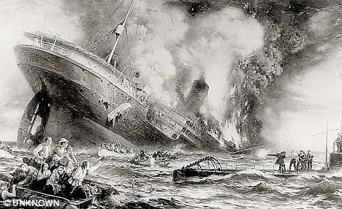
The sinking of the Lusitania by Germany
On May 7, 1915, a German submarine torpedoed the Lusitania, a British vessel that carried over 100 Americans at the time.
This was a passenger liner protected by international rules preventing any attack by submarine, therefore, this was an act of murder rather than an act of war.

Slide 9
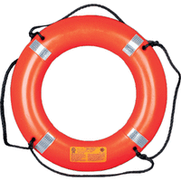
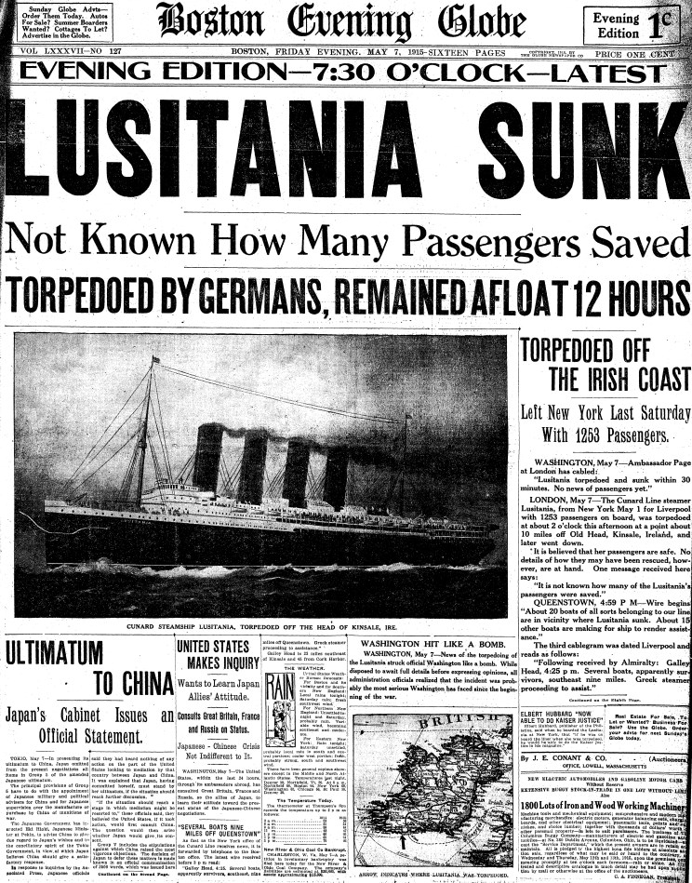
The sinking of the Lusitania cont.
At the time of this attack, there were still very few Americans calling for war with Germany, as this was not necessarily an act of war.
President Wilson demanded an apology and that reparations be accounted for by the Germans, and the United States threatens to cut off all ties with Germany.

Slide 10
The Sinking of the Lusitania video
http://www.history.com/topics/world-war-i/world-war-i-history/videos/u-boats-sink-the-lusitania-in-1915

Slide 11
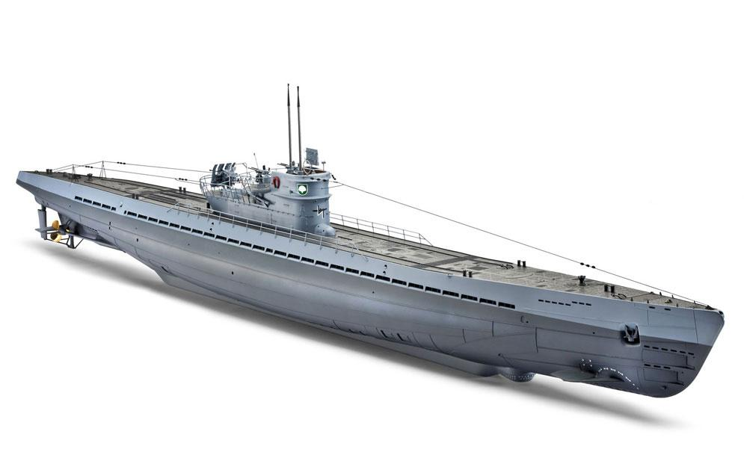
German unrestricted U-boat campaign
As submarine warfare was Germany’s key advantage in the war, they decided to begin ordering U-boats to “sink on sight” which means that they would not hold back from aggression at sea, although the United States had threatened to sever relations with them if they continued this campaign.
When Germany decided to have unrestricted submarine warfare, the United States was forced to follow through and cut off all German affairs

Slide 12
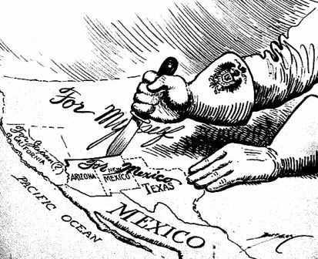
The Zimmerman Telegram
As tension was at an all time high between Germany and the United States, the Zimmerman Telegram was discovered in America.
The telegram, which was meant to be sent to Mexico by Germany, promised that Germany would return New Mexico, Arizona, and Texas to Mexican control if Mexico would join the German cause in the war.

Slide 13
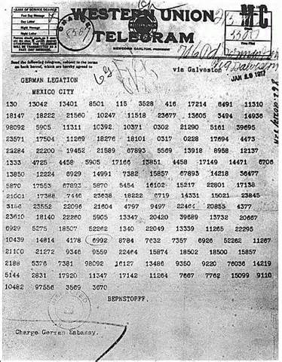
The Zimmerman Telegram cont.
When the United States was alerted of the content in the Zimmerman telegram, they were able to conclude that Germany was planning to take over all of America, giving some land to Mexico and Japan.
With this knowledge joined with the current tension between the two nations, the United States had no other choice but to join the war.

Slide 14
The Zimmerman Telegram video
https://www.youtube.com/watch?v=KKhgrCDkm0s

Slide 15
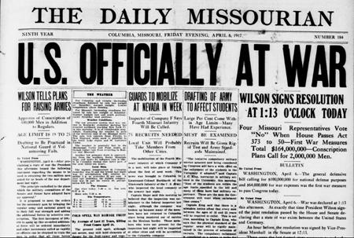
The United States goes to war
After an overwhelming majority vote by the Senate to go to war , President Wilson signs a document on April 6, 1917 which declared that United States declare war on Germany.

Slide 16
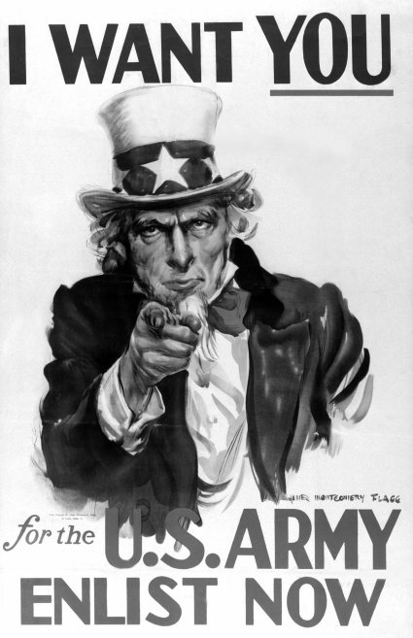
U.S. preparation for war
The United States had to move quickly into the road to war, as our military consisted of less than 150,000 soldiers and no high power equipment to use.
Recruiting and military drafting began shortly after declaring war on Germany
In the next two years, millions of men were introduced to basic training in the US Army and the United States became the leading force in the Great War.

Slide 17
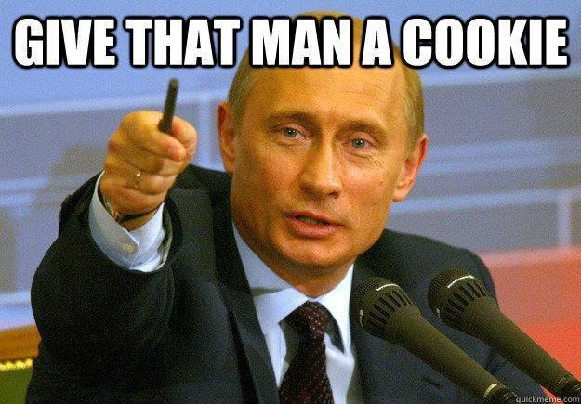
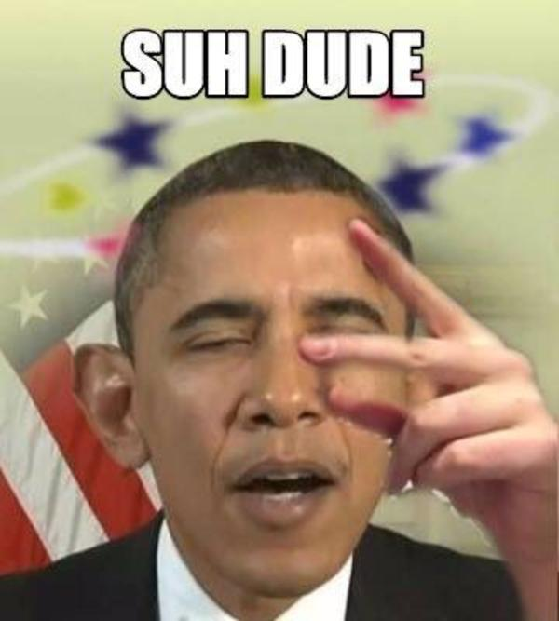
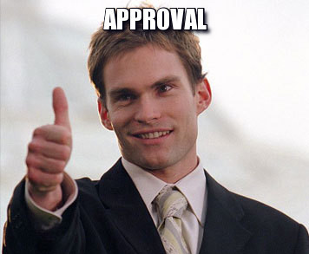
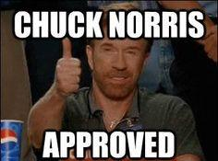
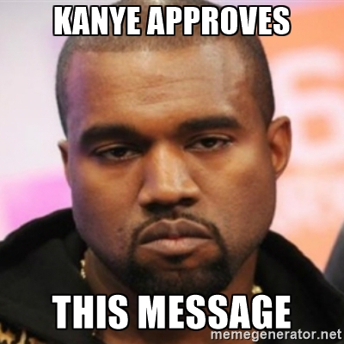
Works Cited
"Interactive WWI Timeline." National World War I Museum and Memorial. N.p., n.d. Web. 29 Aug. 2016.
Tueman, Chris. "America and World War One - History Learning Site." History Learning Site. The History Learning Site, 2015. Web. 29 Aug. 2016.
"America Enters World War I." History.com. A&E Television Networks, 2016. Web. 29 Aug. 2016.
Murphy, Donald J. America's Entry into World War I. San Diego, CA: Greenhaven, 2004. Print.
Weiner, Tim. Enemies: A History of the FBI. New York: Random House, 2012. Print.

